Slide 1
Monsoon and Globus
Utilizing Globus tools for fast, easy, & powerful data sharing
Presentation media, including this slide-stack: rcdata.nau.edu/hpcpub/globus
Notes:
UPDATE TEH ABOVE

Slide 2
Presentation topics
General introduction to Globus' capabilities and benefits
Understanding its user-facing architecture
Applicable use-cases (or alternative approaches)
Usage walk-throughs (web client and command line)
Personal end-points for workstations
Group collaboration with both edu AND unaffiliated users

Slide 3
Globus: multi-use data sharing utility
What: Globus is a great solution for transferring data to/from Monsoon, as well as to the local filesystems of other Universities and research facilities. Using its simple web interface like a virtual remote control, users may submit instructions for data-transfers, or may schedule data-syncs… and Globus takes it from there! It can even update you via email about status or exceptions.
How: Your data is transferred directly between the source and destination systems. Meanwhile, the service tunes performance parameters, maintains security, monitors progress, and validates correctness. You can check the transfer status at any time via a dashboard.
When: If a network/hardware issue is encountered, Globus will automatically resume when all components are ready. Even if an issue requires user intervention, Globus will resume after you’ve remedied the problem.
Notes:
“In their own words”: Easy to use interface … direct and fast xfers … robust & nearly-automatic error-handling user/web is REMOTE CONTROL → globus pulls strings on your behalf IN THE background

Slide 4
How your bytes become a file
Local
SOFTWARE ➡️ disk
disk ➡️ OS ➡️ disk
disk ➡️ SOFTWARE ➡️ disk
Remote
💾remote disk ➡️SOFTWARE ➡️network ➡️SOFTWARE ➡️💾local disk

Slide 5
How your bytes become a file (II)
Local
WORD PROCESSOR ➡️ disk
WEB BROWSER ➡️ disk
GLOBUS PERSONAL ➡️ disk
Remote
💾remote HPC disk (eg @ ASU) ➡️GLOBUS SW (running on Sol) ➡️network ➡️GLOBUS SW (on Monsoon) ➡️💾local HPC disk (/home, /scratch, /projects)

Slide 6
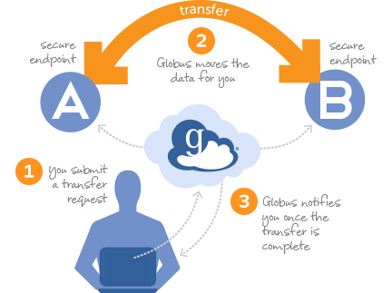
Architecture of a Globus transfer
remote HPC disk (e.g. @ ASU) ➡️GLOBUS SW (running on cluster, ‘A’) ➡️network ➡️GLOBUS SW (on Monsoon, ‘B’) ➡️local HPC disk (/home, /scratch, /projects)

Slide 7
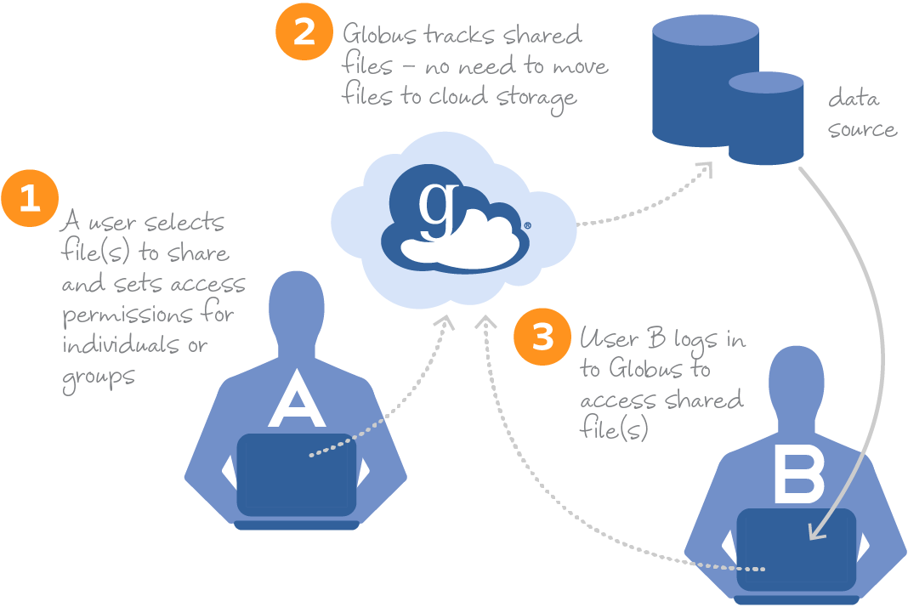
Globus transfers

Slide 8
What is a Globus ‘collection’?
A collection is a named set of files which are hierarchically organized in folders, and associated with a specific storage gateway.
Mapped collection: Access requires a user to have a local account. Their Globus identity is mapped to their local account and its local filesystem.
Guest collection: Access is based on permissions explicitly granted by an authenticated collection owner.
Collection access is authenticated:
Users: Globus Auth-issued OAuth2 access tokens, and audit-consents
Files: with data access policies defined in the collection itself (ACLs)
Notes:
say something about gridFTP

Slide 9
What is a Globus ‘collection’?
Notes:
say something about gridFTP

Slide 10
Globus ‘collections’
A Globus “collection” is simply a pre-defined set of files accessible via Globus’ filesharing software.
For example, Monsoon hosts the NAU HPC Filesystems collection through Globus’ server-software (which runs on the dtn1 login-node).
Individual users may also install/run Globus Connect Personal on their own desktop/laptop to enable transfers between PC ↔ any other endpoint.

Slide 11
Globus use-cases
Globus is well suited for transferring data sets to and from an HPC resource like Monsoon, without the need for a command line or extensive technical knowledge.
This also comes in especially handy when a user wants to make a quick file transfer, and may not have access to a terminal: only a web browser is needed in most cases.
Globus is a fantastic solution for transferring data between/among different collaborators, especially when the size of the data or number of files gets relatively large.
Monsoon ↔ personal PCs*
Monsoon ↔ other HPCs/Edus**
My Monsoon ↔ your Monsoon
PC_{A} ↔ PC_{B}*
Remote collaborator(s) ↔ Monsoon
NAU-affiliated, or not
Different slurm or enterprise group
Time consuming & complex xfers
Advanced
CLI tools (via conda) and APIs
Notes:
these are CAPABILITIES that people should be aware globus offers Xfer tons of data from workstation to workstation; aka lab to lab Probably right now only places running globus software “up to full potential”
→ collaborator has to have globus

Slide 12
Globus' capabilities and benefits
Secure collaboration!
Highly customizable, granular permissions
Share as read-only or full-access
Require logins, or allow anonymous access
Direct transfers between Monsoon ↔ other institutions’ filesystems
Networked-filesystem to networked-filesystem!
Simple copies, or (schedulable!) sync tasks
Also between Monsoon ↔ personal PCs, G-Drive, OneDrive…
Web-based interface – no user-software required
CLI tools also available, as alternative to web
Notes:
Core functionality doesn’t require anything but a browser
Scripters, be aware! – yadda
Collection upload/download, or sync a local folder as a personal collection

Slide 13
Globus ‘collections’
A Globus “collection” is simply a pre-defined set of files accessible via Globus’ filesharing software.
For example, Monsoon hosts the NAU HPC Filesystems collection through Globus’ server-software (which runs on the dtn1 login-node).
Individual users may also install/run Globus Connect Personal on their own desktop/laptop to enable transfers between PC-collection ↔ any other collection.
💾
💾
💾
/home, /scratch, /projects
NAU HPC Filesystems
DTN1 (running Globus software)
Notes:
gif = worth a thousand words (general interface) COLLECTIONS of files = in the SEARCH … we have couple MAPPED FS’s as COLLECTIONS
INDIVIDUALS can make their OWN GUEST COLLECTIONS ((based on filesystems))

Slide 14
Globus ‘collections’
A “guest collection” is created by YOU!
NAU HPC Filesystems
YOU control sharing-access to guest collections!
DTN1 (running Globus software)
NAU HPC Endpoint
NAU HPC Filesystems
Notes:
gif = worth a thousand words (general interface) COLLECTIONS of files = in the SEARCH … we have couple MAPPED FS’s as COLLECTIONS
INDIVIDUALS can make their OWN GUEST COLLECTIONS ((based on filesystems))

Slide 15
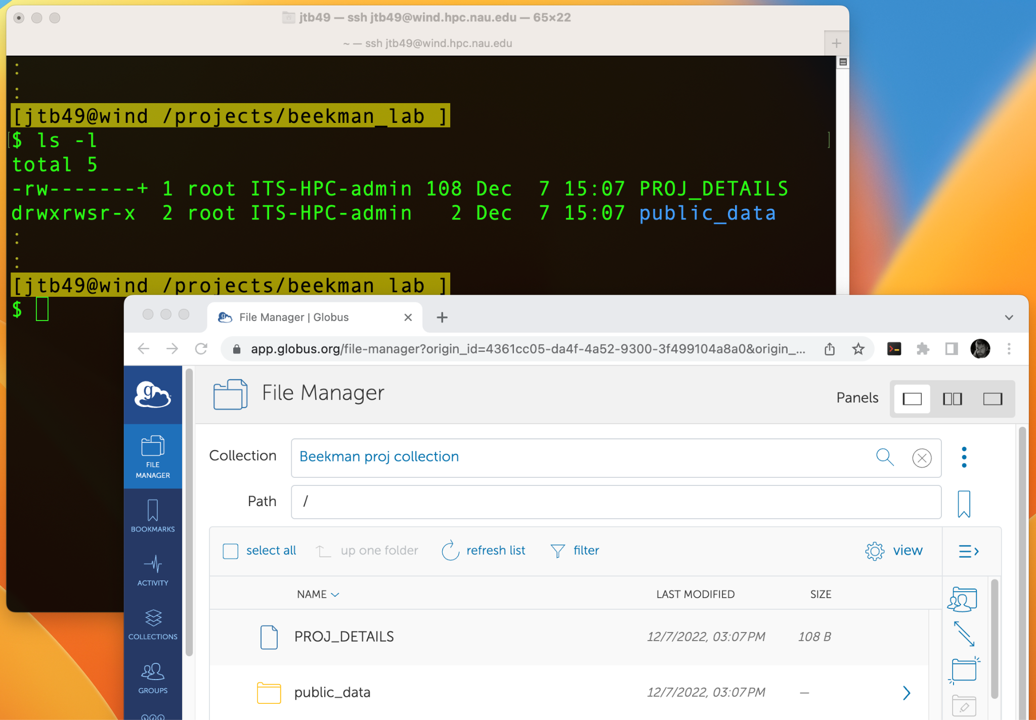
Guest collection via mapped collection

Slide 16
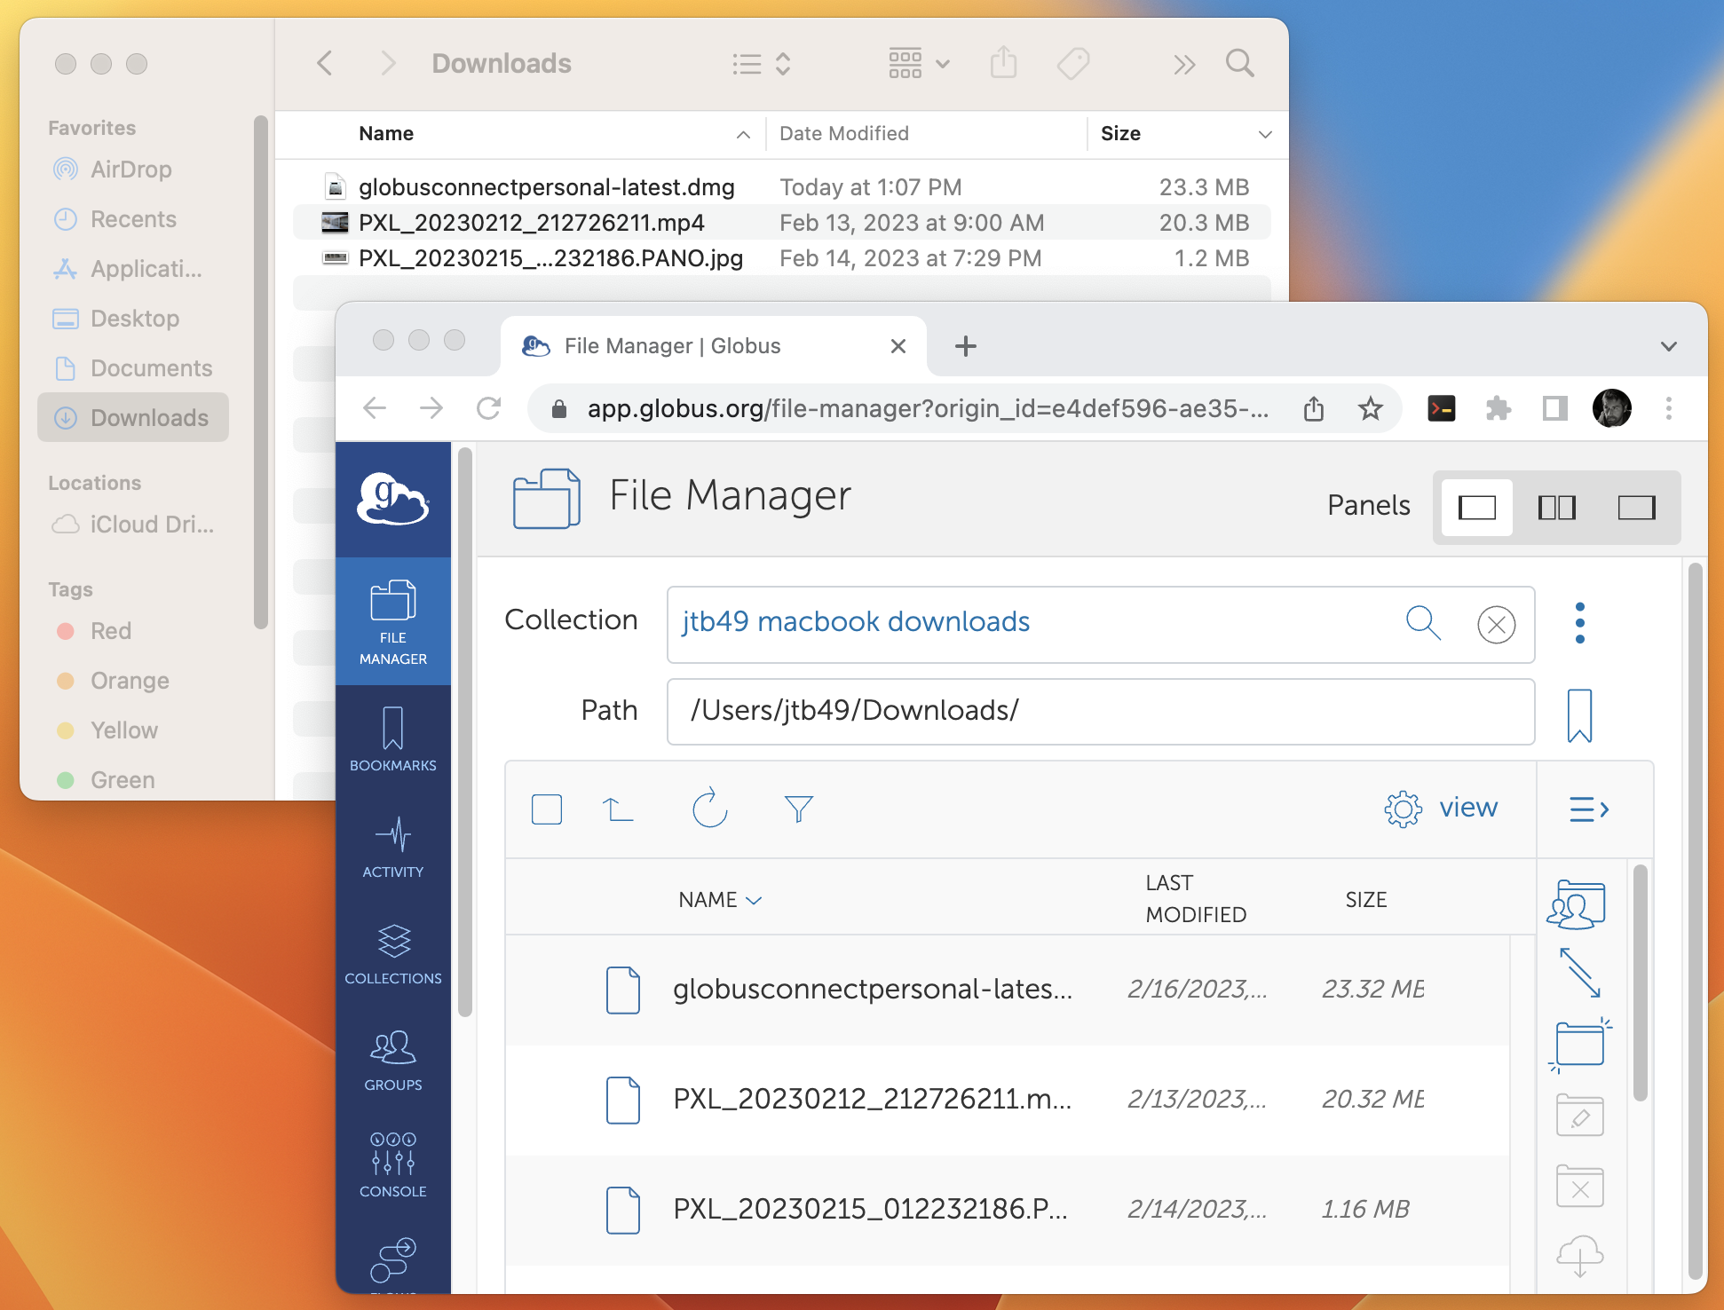
Guest collection via Globus Personal

Slide 17
Demo ‘A’: Quick Globus interface tour

Slide 18
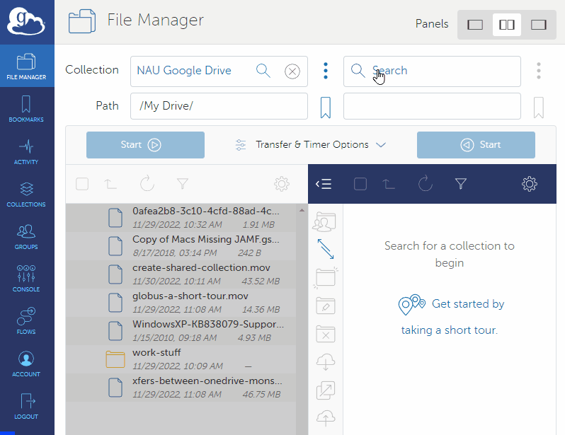
Interface: Example transfer
NAU HPC Filesystems
NAU Google Drive
NAU OneDrive
DTN1 (running Globus software)
NAU HPC Endpoint
Notes:
gif = worth a thousand words (general interface) COLLECTIONS of files = in the SEARCH … we have couple MAPPED FS’s as COLLECTIONS
INDIVIDUALS can make their OWN GUEST COLLECTIONS ((based on filesystems))

Slide 19
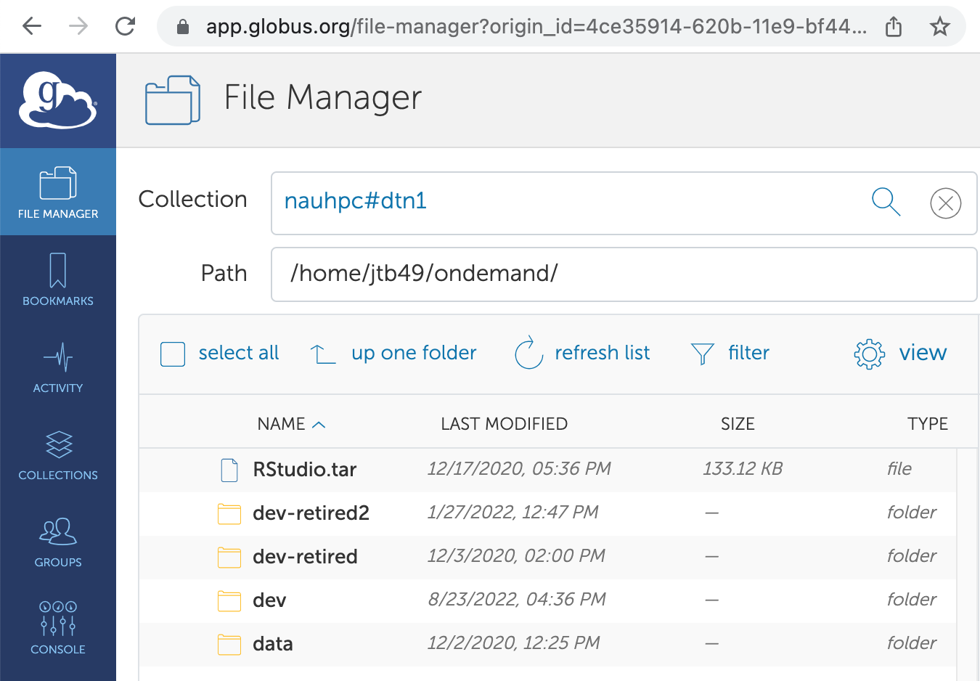
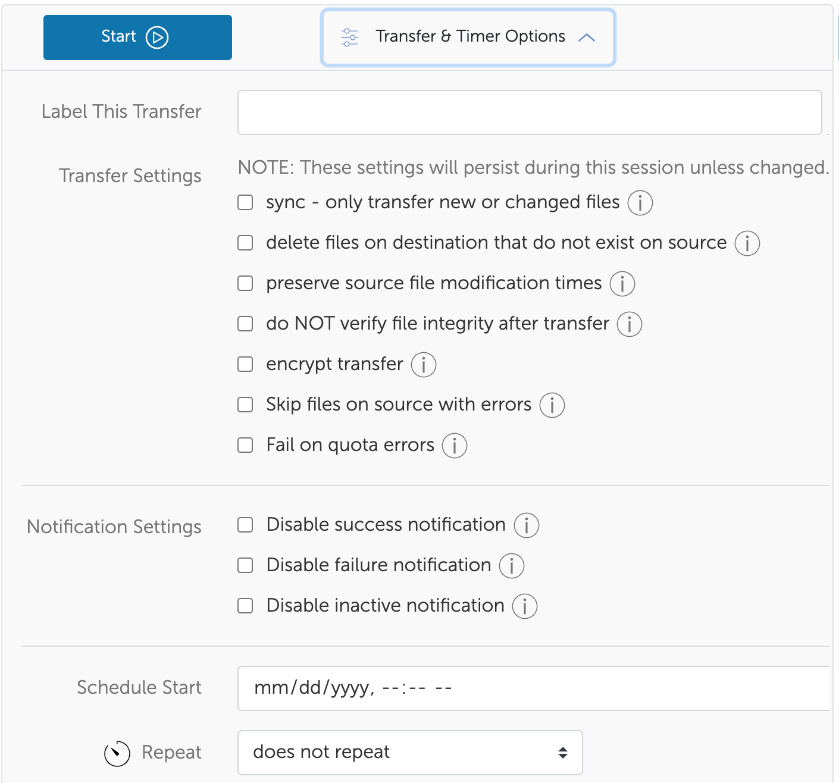
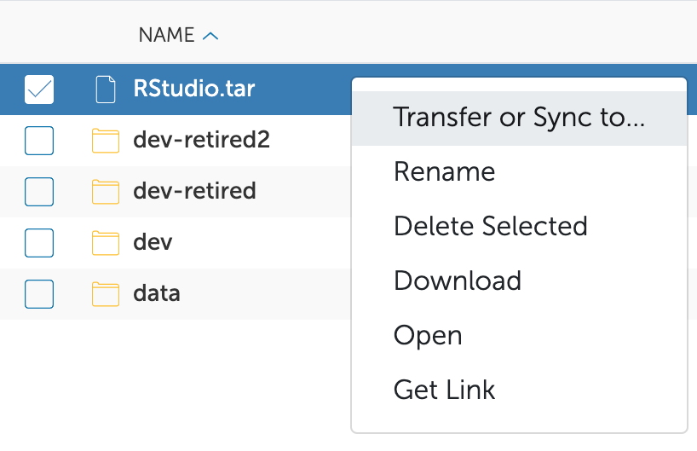
PLAIN- LANGUAGE OPTIONS!
Notes:
A picture is worth a thousand words!
File-browser familiar to mac/windows users :: useful right-click menus :: clear, plain language options :: friendly ‘info’ toggles (5 more slides)

Slide 20
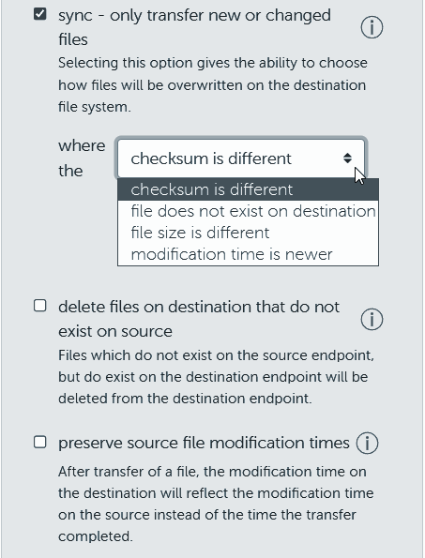
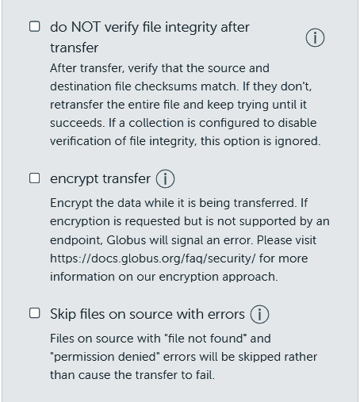
Transfer options (1/2)
Notes:
Full info for each option (click the (i) to view)
Options very familiar to rsync users :: full control over what defines “different” files

Slide 21
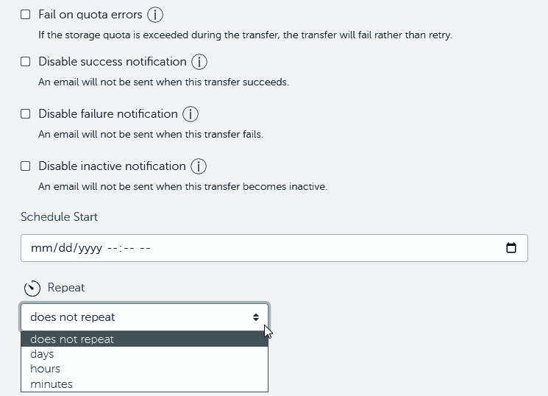
Transfer options (2/2)
Notes:
Sync options FOR DIRECTORIES pair suuuuper-well with scheduling/repeating!
Notifications optional :: status can be checked via “activity” on web console :: scheduling + sync = full solution!!

Slide 22
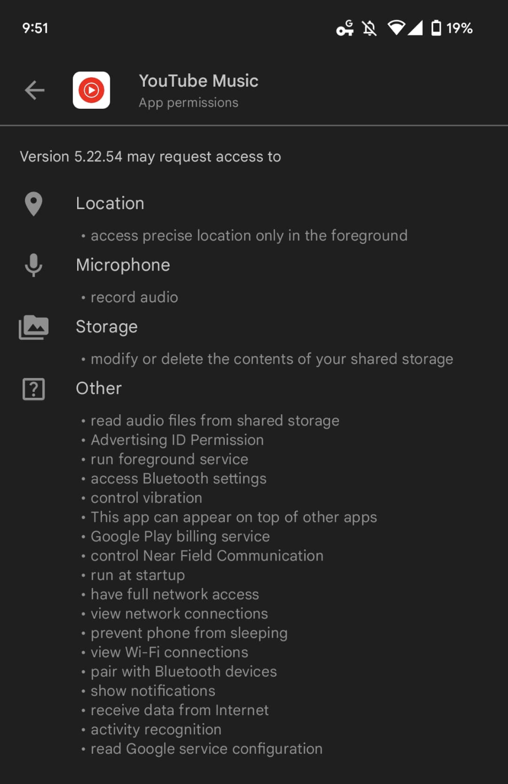
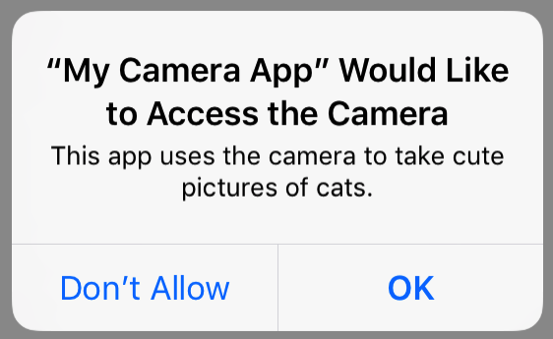
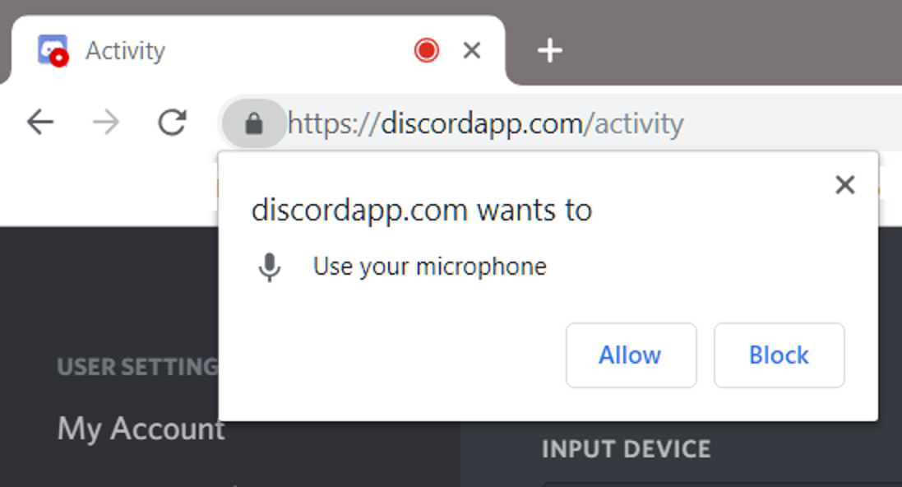
App capability ‘Consents’
Notes:
think of a consent as a very specific proxy permission – the globus **website** is allowed to XYZ. The globus **CLI** is allowed to XYZ. Etc.

Slide 23
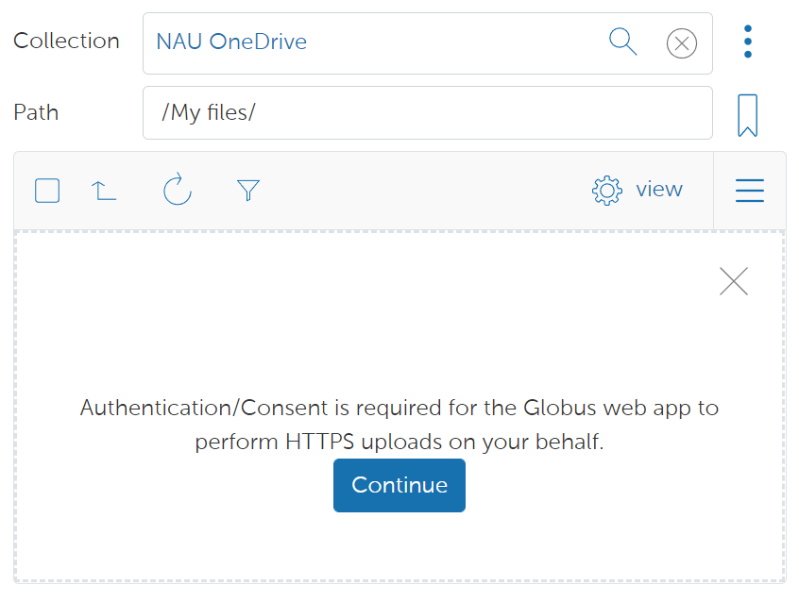
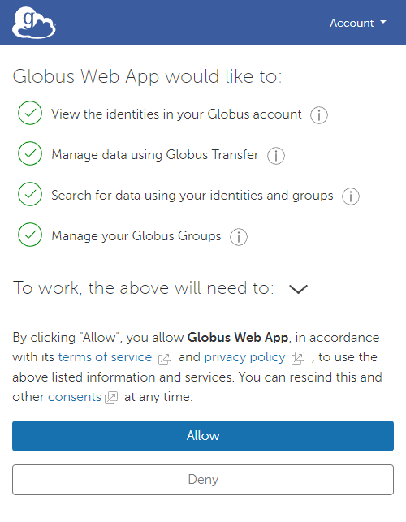
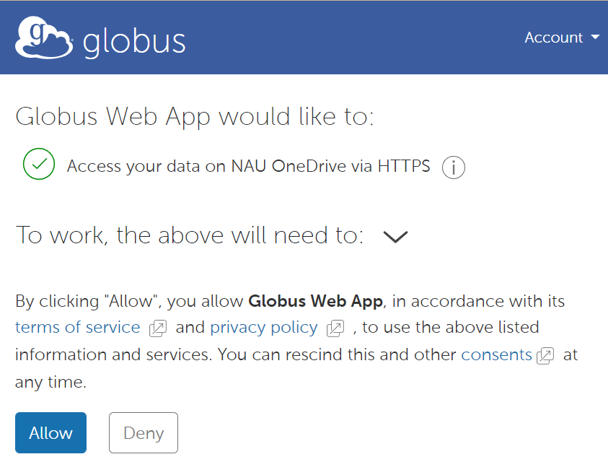
About audit ‘Consents’
The Globus service has many indiv. capabilities …each one is individually authorized via these consent pop-ups
Notes:
GLOBUS has many capabilities (e.g. talking to MS/google/https) and they all have explicit consents ((just a heads up, that you'll see these initially, nothing to really worry about))

Slide 24
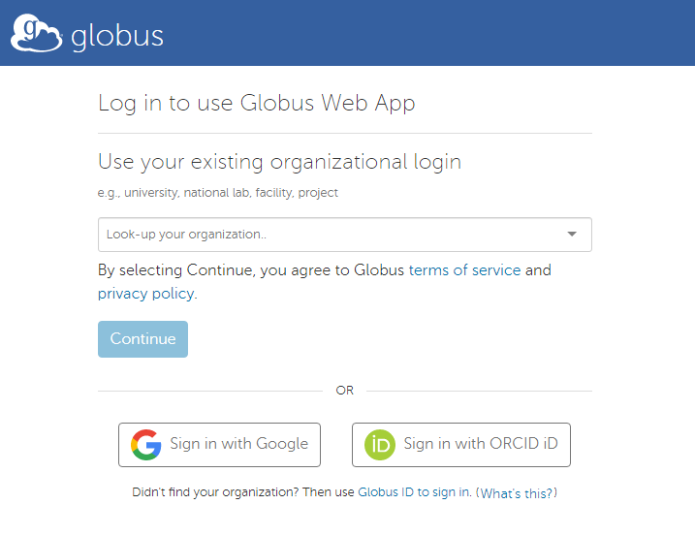
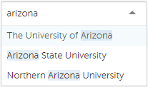
Globus sign-in options

Slide 25
Exercise #1: login & browse your files
Visit app.globus.org in a browser
Select NAU under Use your existing org login, then Continue
Type “nau” in the Collection field to filter for Monsoon-based
Click on the NAU HPC Filesystems title …and explore!
Read and authorize all “consents” you are presented with
NOTE: Non-HPC users can
Browse OneDrive & G-Drive,
but not NAU HPC Filesystems
Cool stuff:
You can manually change the Path field
You can “bookmark” a folder within a collection
What else caught your attention?
Notes:
NOTE: non-nau users just SEARCH DEMO ← can still work with OneDrive and Google
‘ONE PANE’ == downloading or uploading to the storage available on your desktop

Slide 26
Demo ‘B’: Transfer between collections, via web
Notes:
You can also copy directories like this
Interject: new google policy means you might wanna move a LOT of data (no need to call it out specifically)

Slide 27
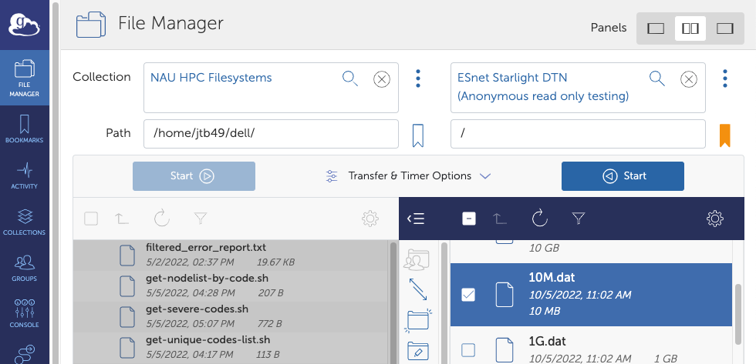
Exercise #2: copy a small file to Monsoon
Set two-panel view
In the new panel:
Find either your G-/OneDrive or this ESnet collection →
Select a file
Click
Check status via sidebar > ACTIVITY
Bonus: upload a file from your desktop
Notes:
If you already have some files in your GoogleDrive or OneDrive, feel free to copy those instead of ESnet’s files :: left vs right doesn’t matter :: use the correct ‘start’
DOUBLE CHECK ANON CAN SEE ESNET

Slide 28
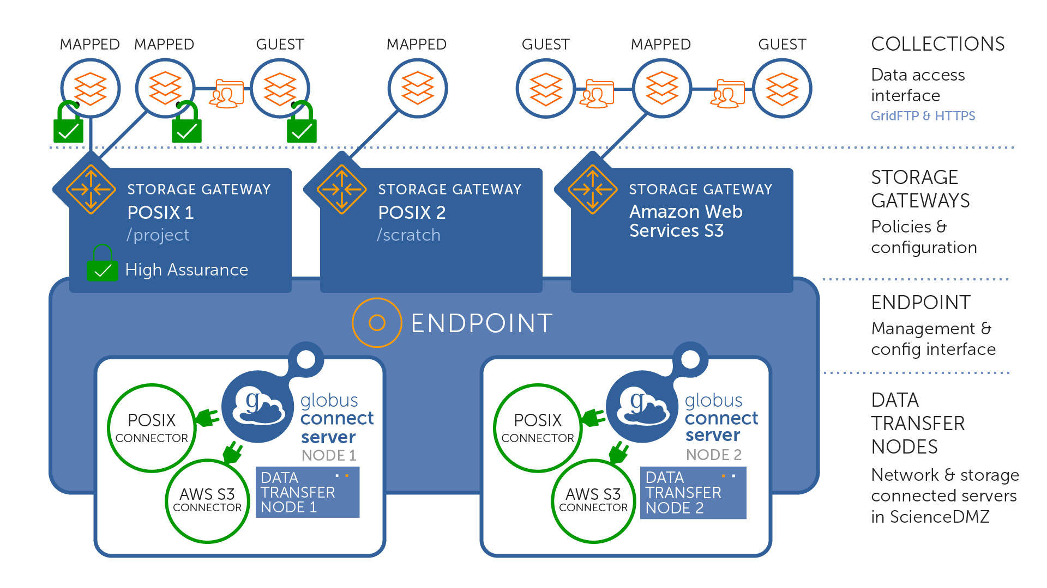
Architecture & Interface
NAU HPC Filesystems
NAU Google Drive
NAU OneDrive
NAU HPC Endpoint
DTN1 (running Globus software)
https://docs.globus.org/globus-connect-server/v5/#globus_connect_version_5_terminology
Notes:
NOTE!!! :: can only create a collection (to share) from a MAPPED collection! you can create one in your HOME, in your SCRATCH, even in your PROJECTS

Slide 29
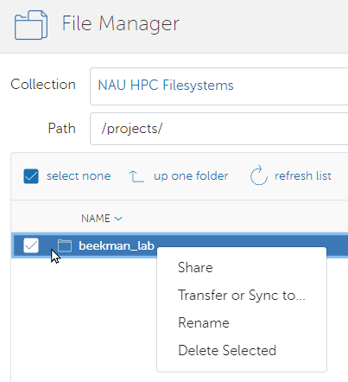
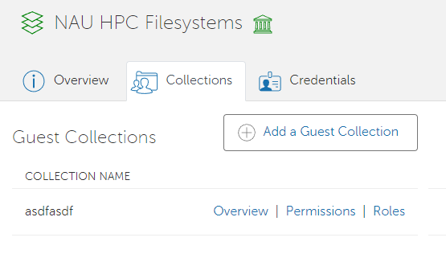
Collab/Sharing via Guest Collections
Notes:
NOTE!!! SHARE ⇒ COLLECTIONS list, not ACL list

Slide 30
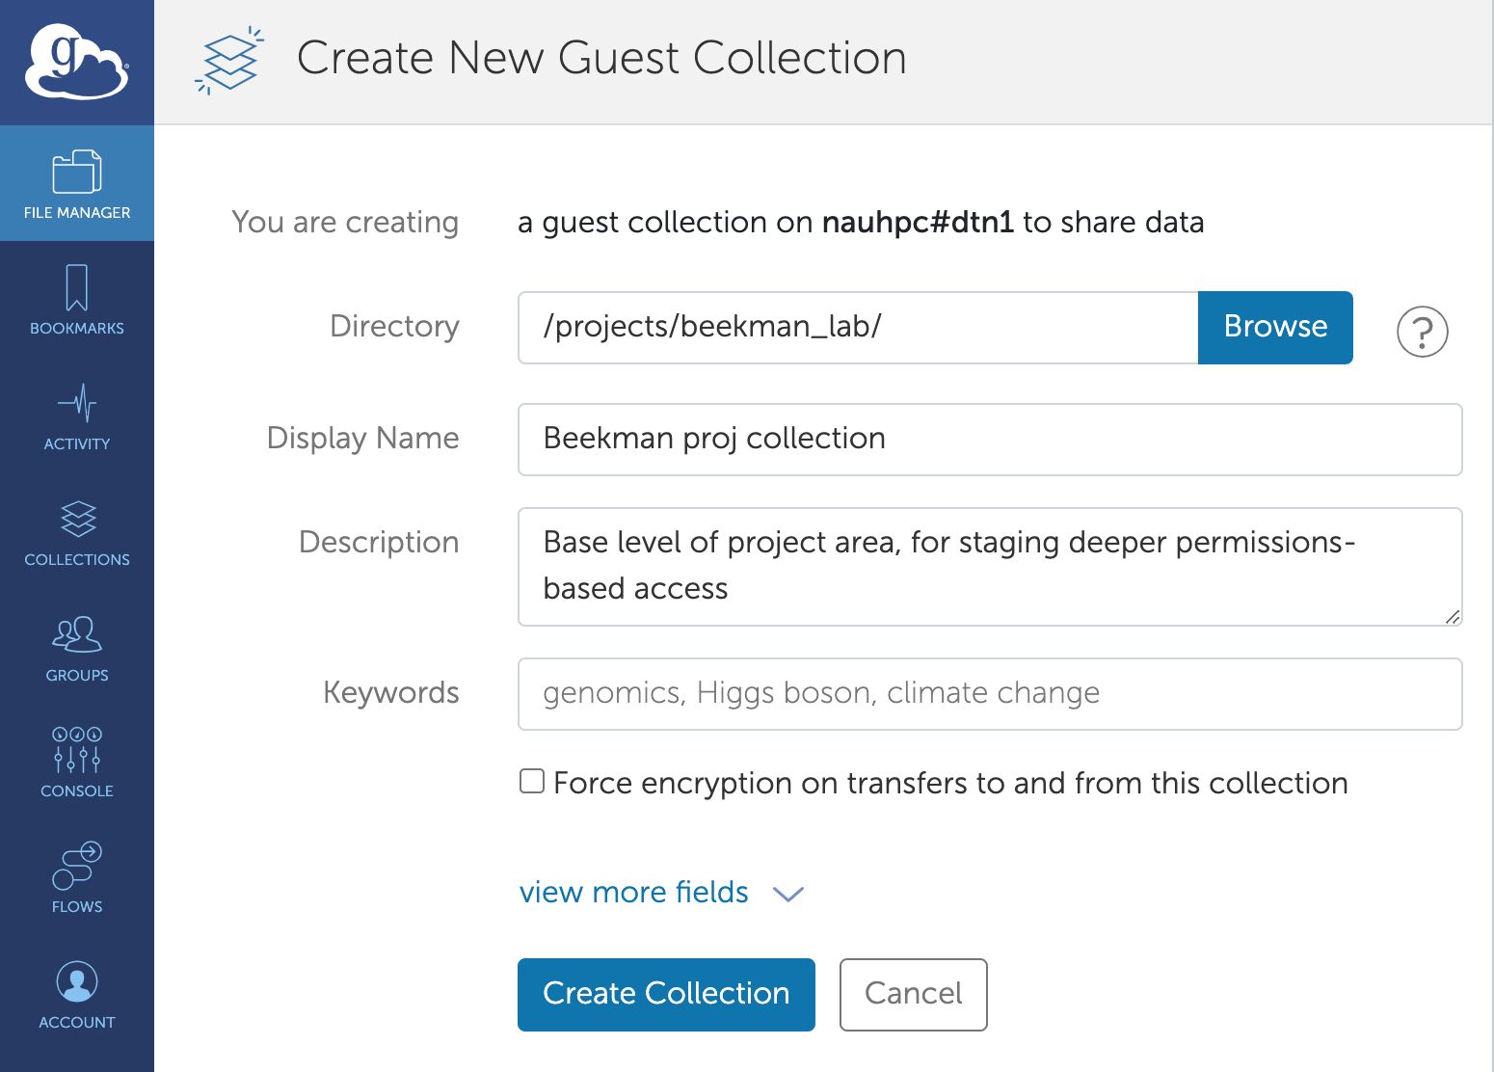
Adding a Guest Collection
Think of a collection like its own pre-defined filesystem
“/” in the file-browser equates to the chosen directory →
On top of your Guest Collection, you will define Access Control Lists for files & directories
Share with
Specific Globus users
All Globus-auth users
Anonymous/web
Notes:
“/” in the GLOBUS file-browser

Slide 31
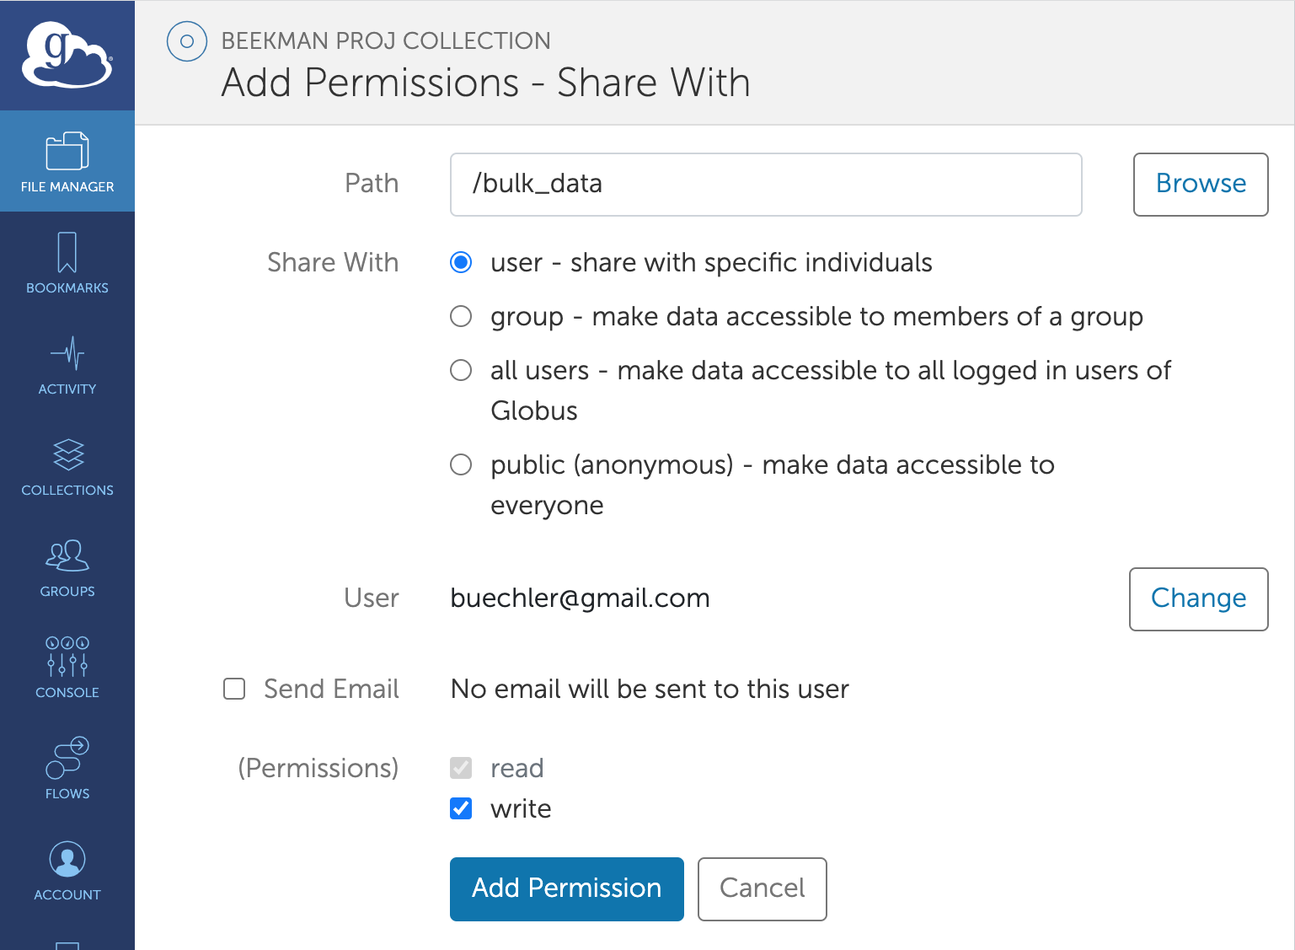
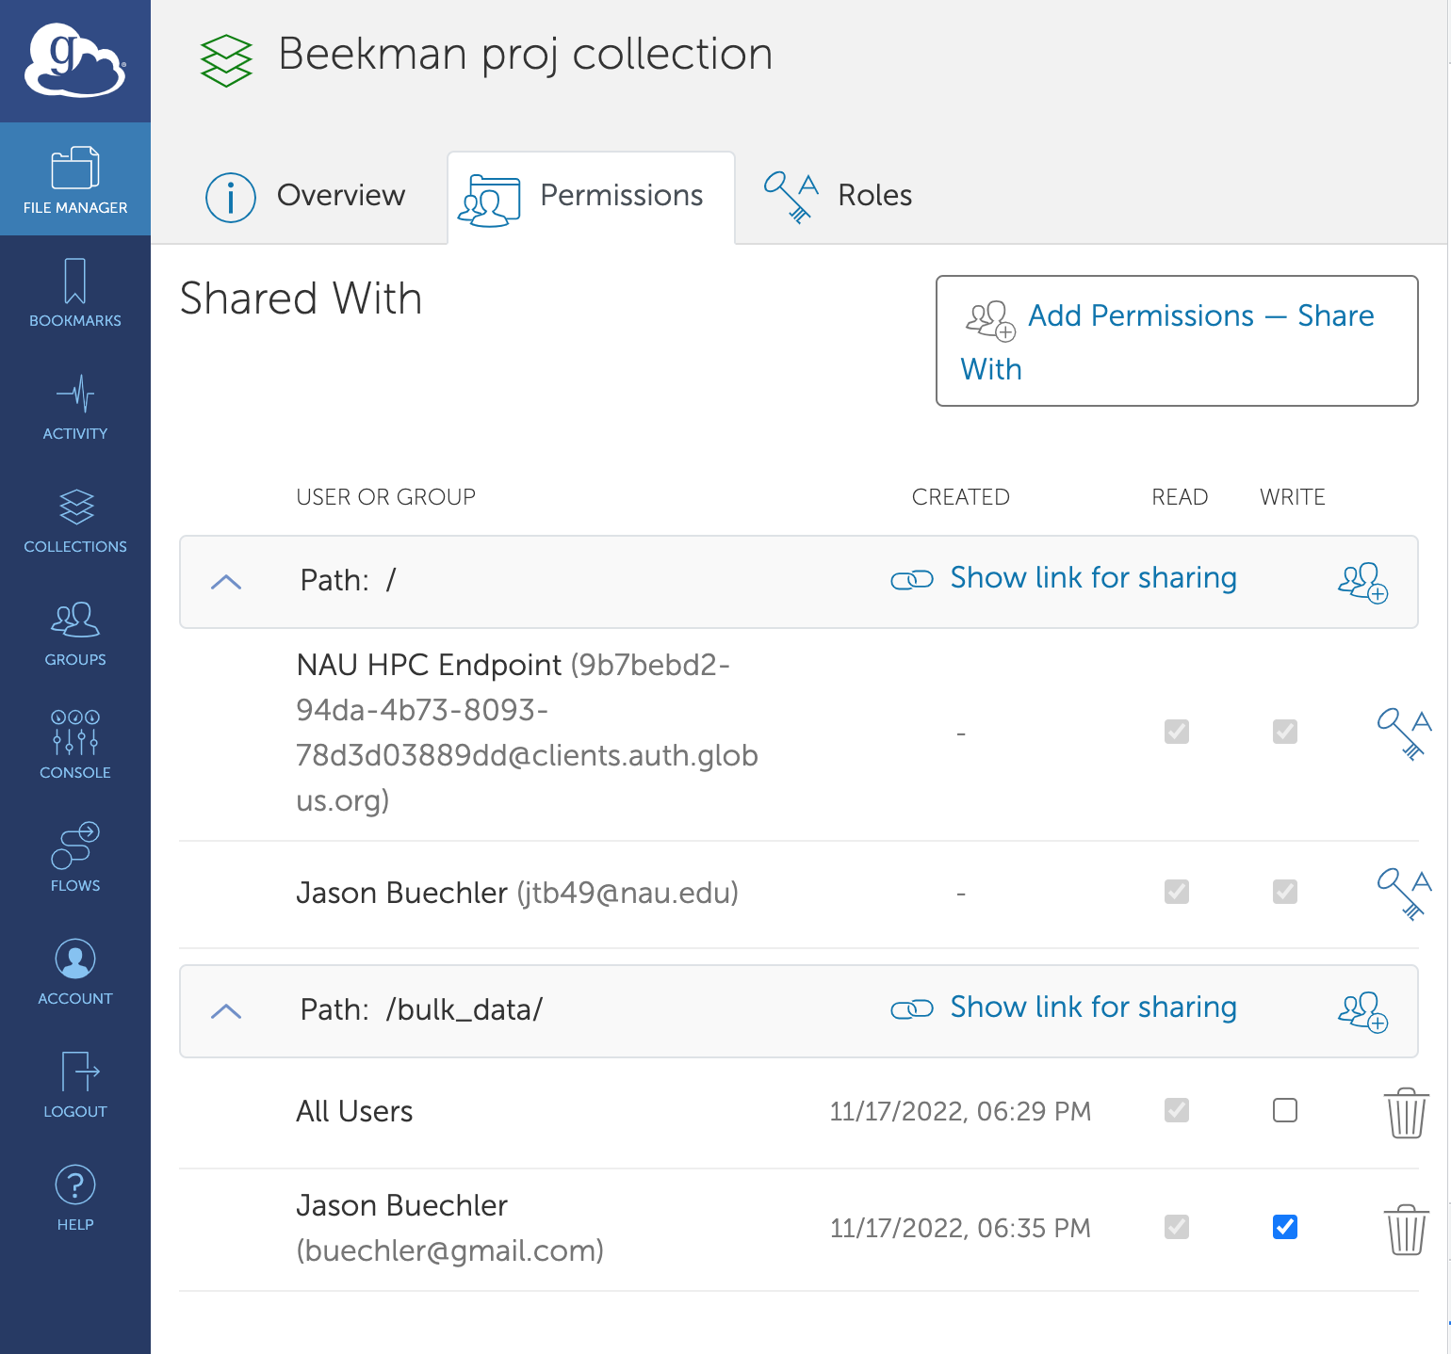
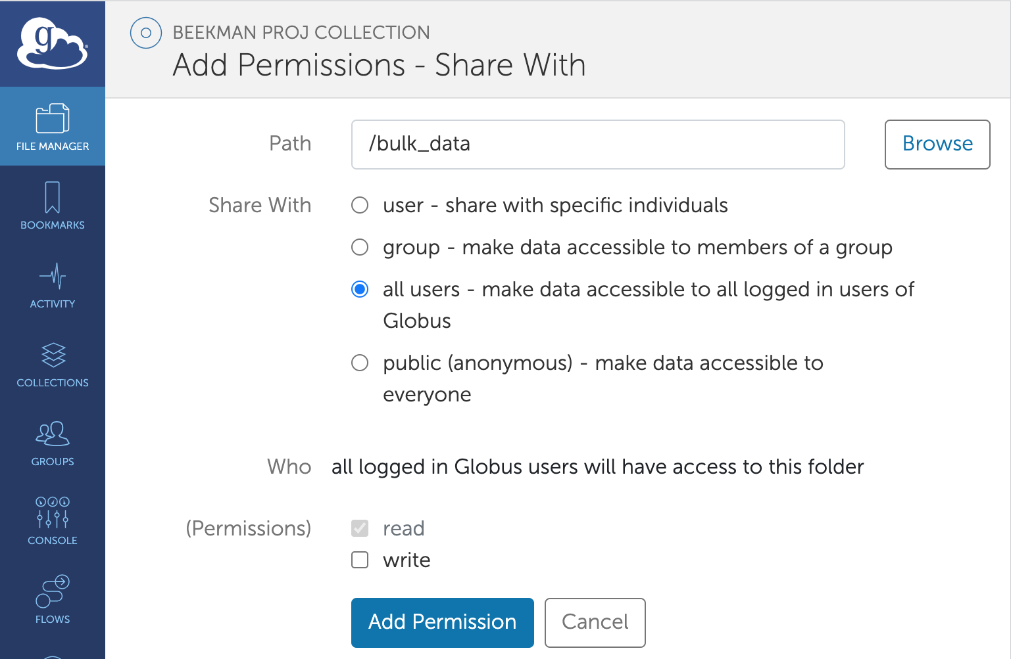
Friendliest UI in the game!
Notes:
this is the process (and summary) of adding ACLs to a personal collection

Slide 32
Demo ‘C’: setup a shared area

Slide 33
Exercise #3: create/share a Guest Collection
Create a new directory in your home (e.g. ~/jb_collection)
“Share” it, via side-toolbar or right-click
Click “Add a guest collection” and fill-out required fields
Click “Create collection”
Note you (and NAU’s “endpoint”) have default access
Click “Add Permissions – Share With”
Give access to another NAU user
Give read-only access to a non-nau email address (click Add even if not found)
Notes:
explain: (Gmail easiest to quickly test via Google-login)

Slide 34
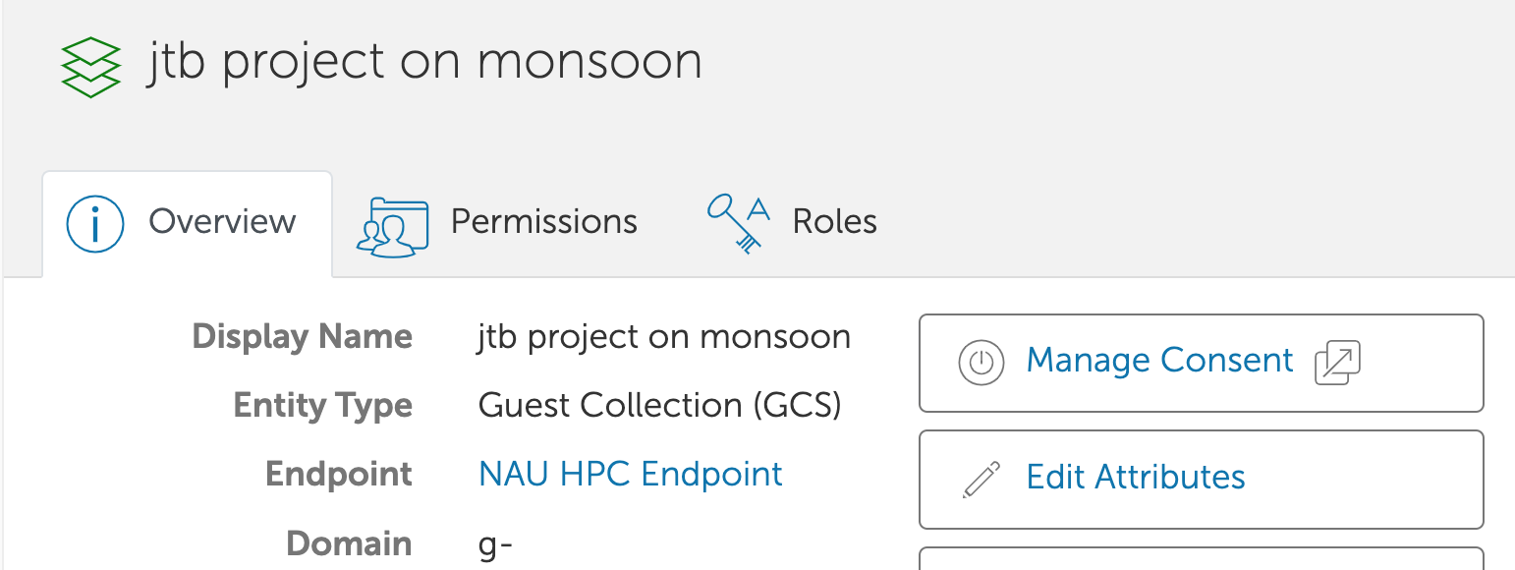
When you forget what path this collection uses

Slide 35
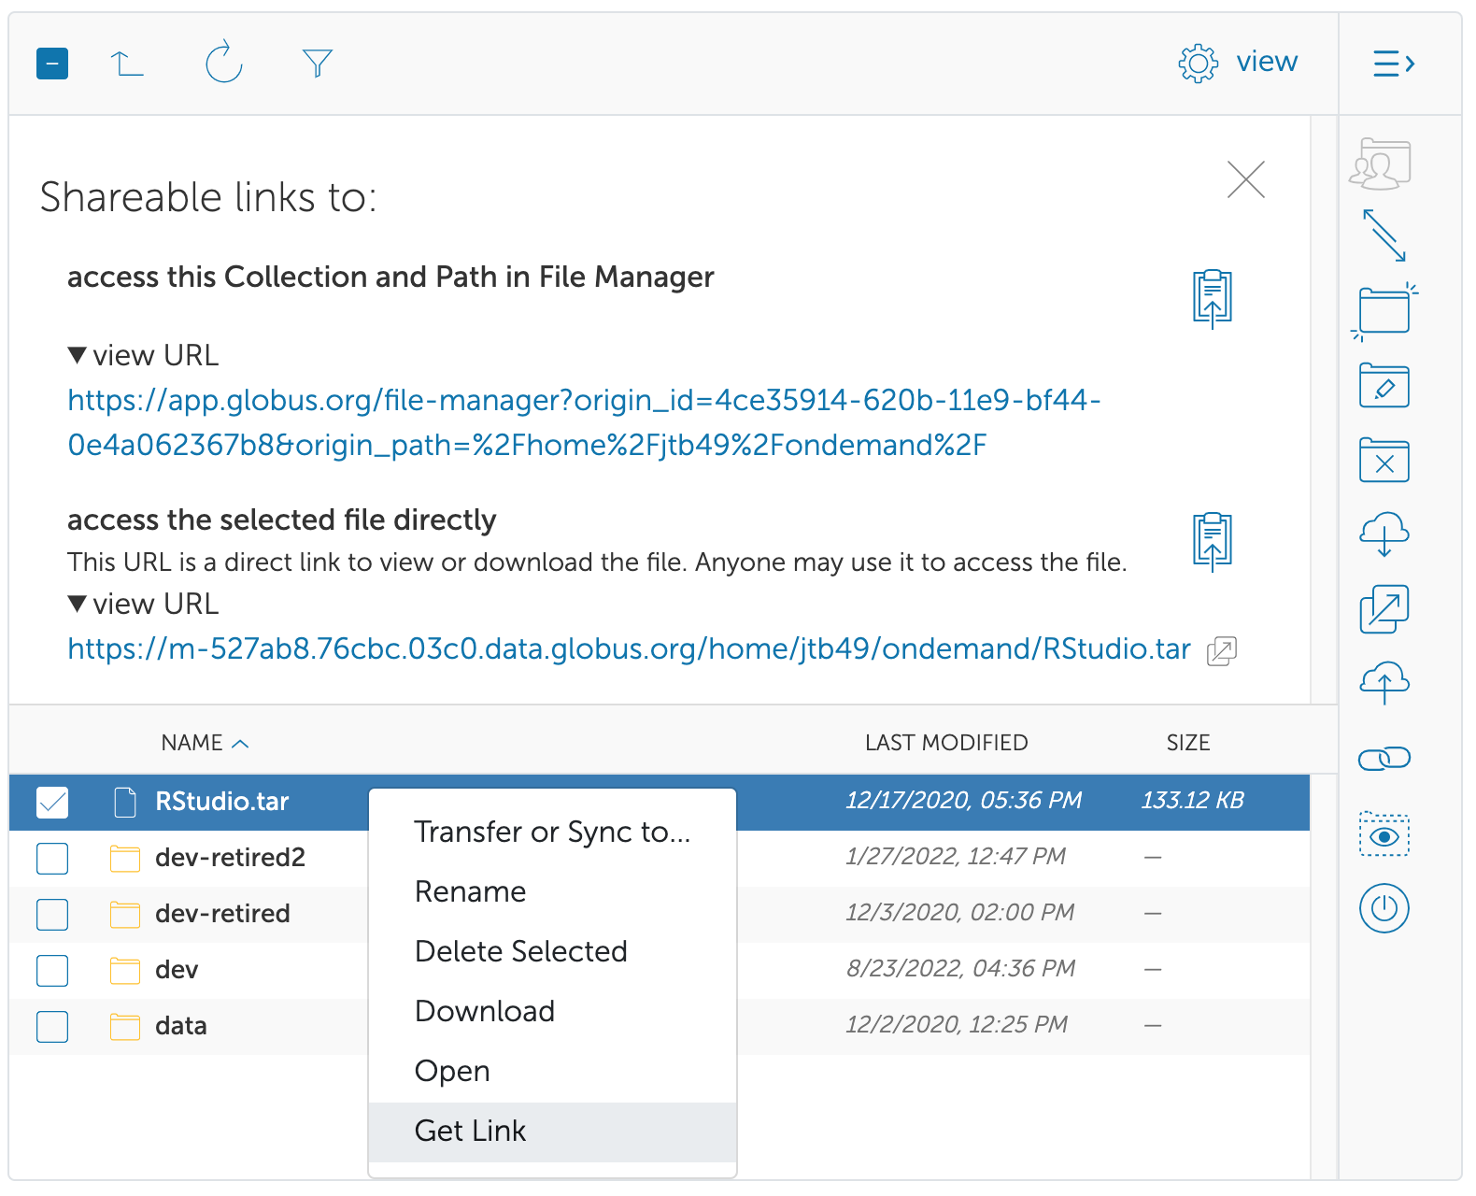
Sharing data (via link)
Two kinds of globus links
1st: “view” link (Goes to a specific folder)
2nd: “open file” (Not available for dirs)
Share individual files
Specific Globus users
All Globus-auth users
Anonymous/web
Notes:
“Anonymous” is the only option that allows downloads when user not logged in! (Otherwise globus has to be aware of SOME account they have creds for. You can’t BROWSE w/o login.)

Slide 36
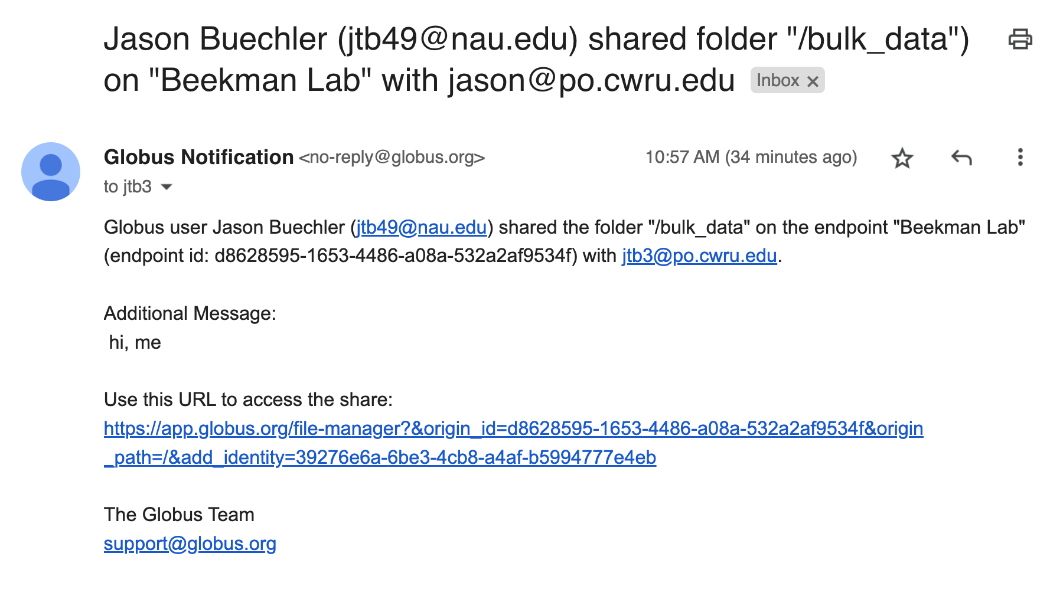
Sharing with non-NAU, new-to-Globus users
Notes:
BY EMAIL ADDRESS

Slide 37
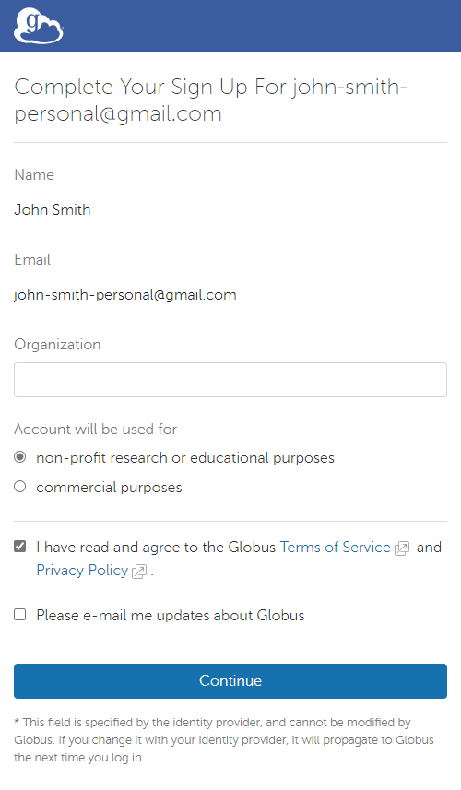
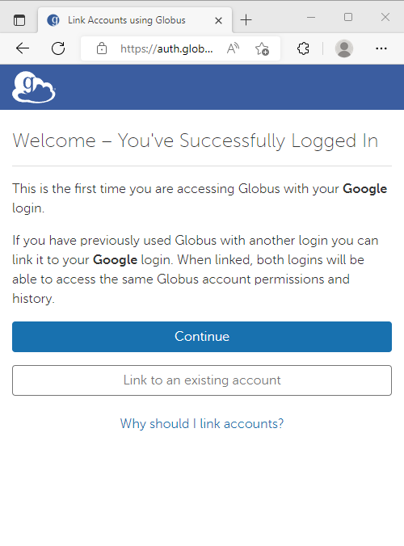
Non-NAU login with Globus
Notes:
if you want to collaborate with non-NAU people, it’s still possible, but they’ll probably want to sign up for globusid account (( add url for globusid.org here ))

Slide 38
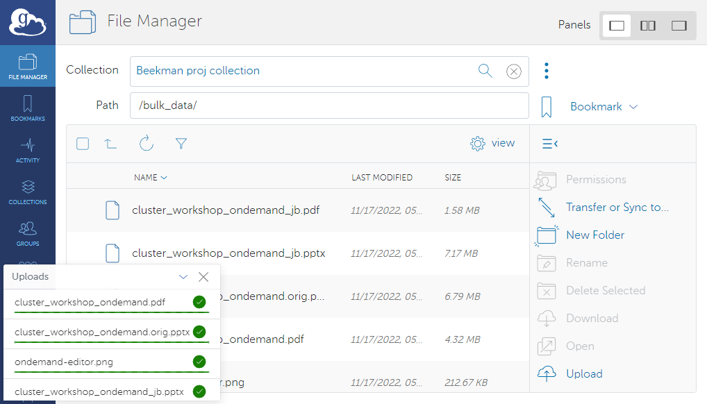
POV: A collaborator uploads to Monsoon via (just) web browser
Notes:
my personal collection looks just the SAME as ANY OTHER
still super easy to use

Slide 39
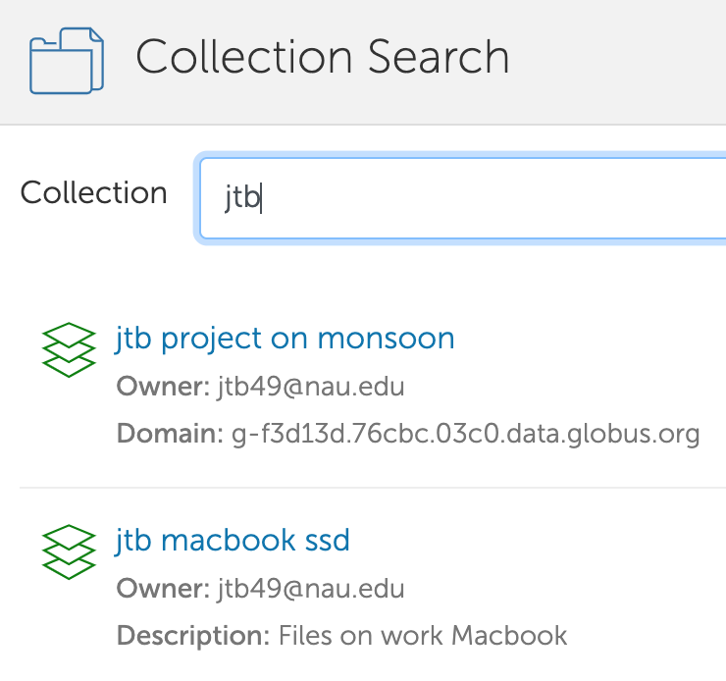
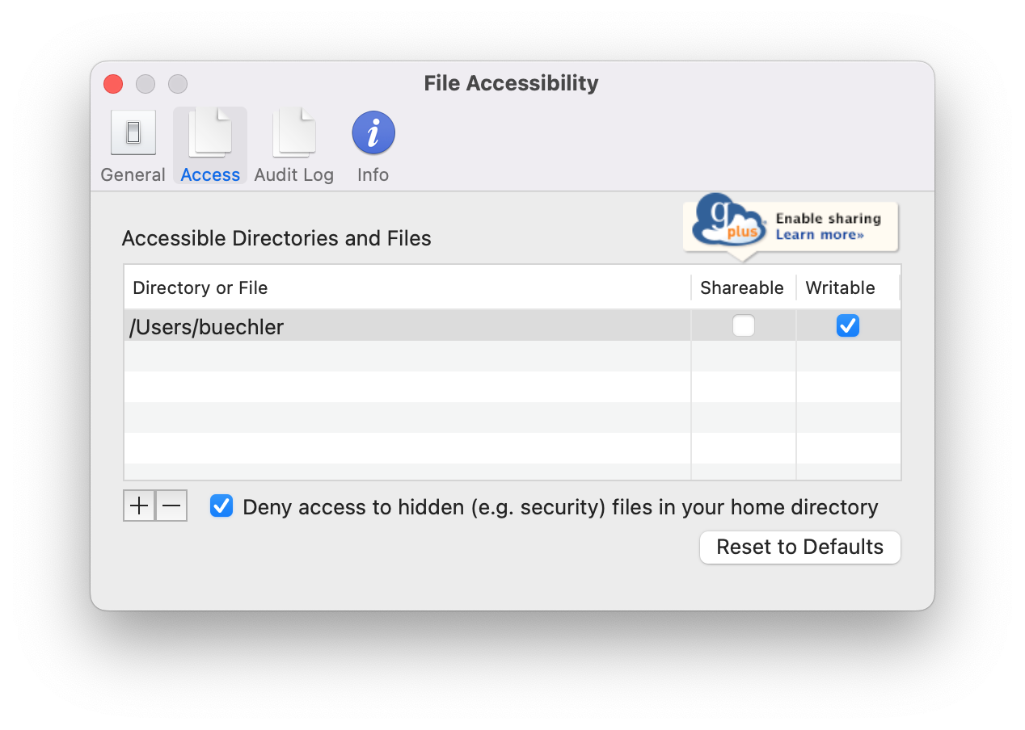
Download from: www.globus.org/globus-connect-personal
Notes:
that URL has much better “how to” (and per-platform) instructions than i could offer
NOTE!!!! JTB49@NAU.EDU && JASON.BUECHLER@NAU.EDU

Slide 40
Globus CLI
$ module load anaconda3 && conda activate globus
(globus): $ globus endpoint search nau | grep NAU | tr -s ' '
9b7bebd2-94da-4b73-8093-78d3d03889dd | cbc@nau.edu | NAU HPC Endpoint
aa21c1e8-ba46-4e73-879b-50c9f946a887 | cbc@nau.edu | NAU Google Drive
4f4bbfcb-005f-40d7-97ee-9cba31b40bfc | cbc@nau.edu | NAU HPC Filesystems
b81db7c2-e355-420d-b5ce-6e903ad24594 | cbc@nau.edu | NAU OneDrive
NOTE 1: in Globus CLI, use `endpoint search` to find both collections AND endpoints NOTE 2: Globus web usually hides “actual” endpoints
Notes:
Endpoints and collections are frequently used in eachother’s places…

Slide 41
$ globus ls b81db7c2-e355-420d-b5ce-6e903ad24594
The collection you are trying to access data on requires you to grant consent
for the Globus CLI to access it.
message: Missing required data_access consent
Please run
globus session consent 'urn:globus:auth…………-6e903ad24594/data_access]'
to login with the required scopes
$ globus session consent 'urn:globus:auth…………-6e903ad24594/data_access]'
Please authenticate with Globus here:
------------------------------------
https://auth.globus.org/v2/oauth2/authorize?cli…………ne&prompt=login
------------------------------------
Enter the resulting Authorization Code here: uPAbsSuBw1QhXjivEOPLo143OBBHeS
You have successfully updated your CLI session.
$ globus ls b81db7c2-e355-420d-b5ce-6e903ad24594
Contacts/
Desktop/
Documents/
Downloads/
Microsoft Teams Chat Files/

Slide 42
A Globus CLI transfer
$ globus transfer -r --encrypt b81db7c2-e355-420d-b5ce-6e903ad24594:"Microsoft
Teams Chat Files" 4f4bbfcb-005f-40d7-97ee-9cba31b40bfc:/home/jtb49/demo/
The collection you are trying to access data on requires you to grant consent
for the Globus CLI to access it.
message: Missing required data_access consent
Please run
globus session consent 'urn:globus:auth…………-6e903ad24594/data_access]'
to login with the required scopes
$ globus session consent 'urn:globus:auth…………-6e903ad24594/data_access]'
Please authenticate with Globus here:
------------------------------------
https://auth.globus.org/v2/oauth2/authorize?cli…………ne&prompt=login
------------------------------------
Enter the resulting Authorization Code here: YSiSa2UXnWOeuFzMxt0l8TPha9z7s9
You have successfully updated your CLI session.
$ globus transfer -r --encrypt b81db7c2-e355-420d-b5ce-6e903ad24594:"Microsoft
Teams Chat Files" 4f4bbfcb-005f-40d7-97ee-9cba31b40bfc:/home/jtb49/demo/
Message: The transfer has been accepted and a task has been created and queued
for execution
Task ID: 6c971d9a-703a-11ed-8423-8d2923bcb3ec

Slide 43
$ globus task show 6c971d9a-703a-11ed-8423-8d2923bcb3ec | grep -v Subtasks
Label: None
Task ID: 6c971d9a-703a-11ed-8423-8d2923bcb3ec
Is Paused: False
Type: TRANSFER
Directories: 1
Files: 131
Status: SUCCEEDED
Request Time: 2022-11-29T23:06:20+00:00
Faults: 0
Completion Time: 2022-11-29T23:06:58+00:00
Source Endpoint: NAU OneDrive
Source Endpoint ID: b81db7c2-e355-420d-b5ce-6e903ad24594
Destination Endpoint: NAU HPC Filesystems
Destination Endpoint ID: 4f4bbfcb-005f-40d7-97ee-9cba31b40bfc
Bytes Transferred: 296728329
Bytes Per Second: 7613995
$ globus task event-list 6c971d9a-703a-11ed-8423-8d2923bcb3ec
Time | Code | Is Error | Details
------------------------- | --------- | -------- | ------------------------
2022-11-29T23:06:58+00:00 | SUCCEEDED | False | {"files_succeeded":131}…
2022-11-29T23:06:58+00:00 | PROGRESS | False | {"bytes_transferred":29…
2022-11-29T23:06:23+00:00 | STARTED | False | {"concurrency":2,"paral…

Slide 44
Thank You

