Slide 1
Intro to Monsoon and Slurm
2024-10-28 presentation with Jason Buechler
These slides:
https://rcdata.nau.edu/hpcpub/workshops/odintro.pdf
Notes:
Jason Buechler
Masters in Mech Engineering (fluidthermodynamics & renewable energy-/grid-engineering)
Been with Monsoon for 6 years
Linux/supercomputing since 2000
REMOVING MENTION OF ODINTRO.MP4
-- Supplemental video:
https://rcdata.nau.edu/hpcpub/workshops/odintro.mp4
$ date
Tue Jul 2 13:36:00 MST 2024
$ stat /projects/hpcpub/trash/odintro.mp4
File: /projects/hpcpub/trash/odintro.mp4
Size: 250141537 Blocks: 484779 IO Block: 1048576 regular file
Device: 31h/49d Inode: 175 Links: 1
Access: (0664/-rw-rw-r--) Uid: (26774/ cbc) Gid: (11055/ITS-HPC-staff)
Access: 2021-06-24 16:13:03.874027744 -0700
Modify: 2021-06-24 16:13:04.540493102 -0700
Change: 2024-03-29 15:39:14.943823123 -0700
Birth: -

Slide 2
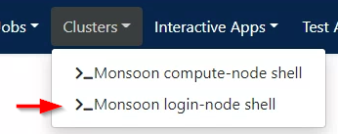
Get logged in!
From a computer:
Connect to the NAU VPN if off-campus!
Info: https://in.nau.edu/its/remote-services
Open any web browser
Login to http://ondemand.hpc.nau.edu
Standard ‘abc123’ Louie ID & password
Click on Clusters tab
Select Monsoon login-node shell
These slides:
https://rcdata.nau.edu/hpcpub/workshops/odintro.pdf
Notes:
No mobile yet

Slide 3
HIT RECORD! ☺

Slide 4
Introductions
Introduce yourself
Name
Department / Group
What project(s) do you plan to use monsoon for?
Linux or Unix experience
Previous cluster experience?
Jason Buechler
Masters in Mech Engineering (fluidthermodynamics & renewable energy/grid engineering)
Been with Monsoon for 86 years?
Linux/supercomputing since 2000
Notes:
Bk836 : Bharat Khandelwal
Dn622 : Divya Narula
Mf2447 : Modupeola Fagbenro
Sk3879 : Satya Phanindra Kumar Kalaga
Cleared 7/2/2024 -jb

Slide 5
Agenda
(High-Performance) Cluster education
What is a cluster, exactly?
Job-queues, scheduling, and resource management
Monsoon Cluster orientation
How do I use this cluster?
Group resource limits
Exercises
Question and answer
Notes:
A bit about HPCs in general
Physically – hw
Practically – daily use
About our HPC specifically

Slide 6
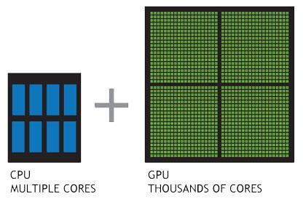
Cluster (of) Resources
Node itself
Memory
CPU’s
GPU’s
Networking
Licenses
MEMORY (i.e. DIMMs)
Notes:
STUFF IN HOME PCS
cpu = cores (in HPC)
Net: speed, limited access

Slide 7
Inside a (single) compute-node
Socket 0
Socket 1
Bill’s job
Mary’s job
Socket 2
Socket 3
Ted’s job
Notes:
Single cn = lots of resources
Finite resources ← jobs get exclusive use
Login-node = same

Slide 8
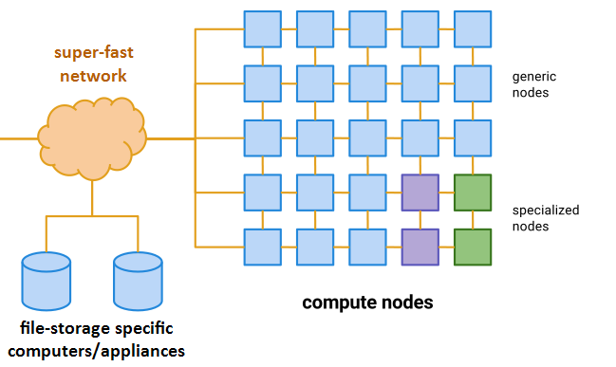
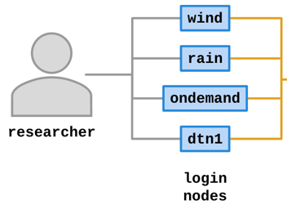
Cluster = Login-nodes + Compute-nodes + etc
Notes:
Green gpu node/resources
Purple licenses/whatev
Storage = machines

Slide 9
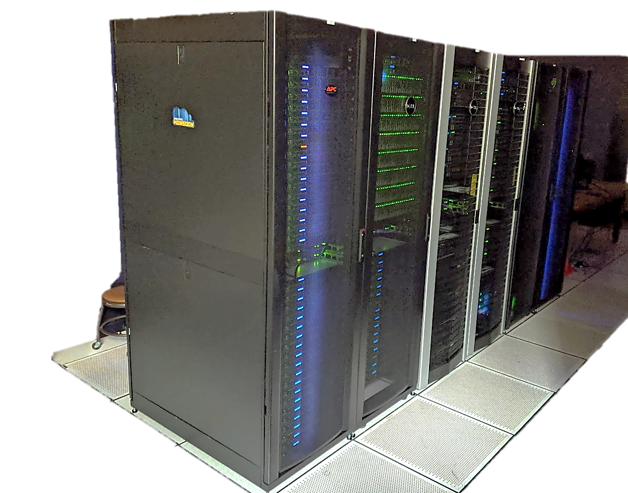
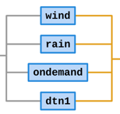
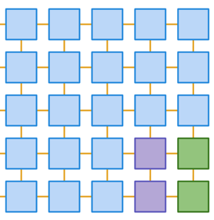
Monsoon (≈4000 cores)
Notes:
Note for later: 4000 vs 8.7 M cores

Slide 10
Largest Cluster!
8.7M cores

Slide 11
Small Cluster!
Dual core?

Slide 12
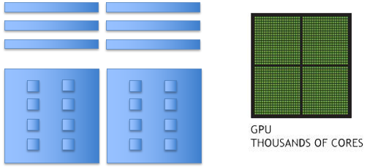
Monsoon Today ( summarized from https://in.nau.edu/arc/details )
The Monsoon cluster is a resource available to the NAU research enterprise
107 compute-nodes (cn1 ∼ cn108)
26TB memory - 128GB/node min, 2TB max
27 GPUs, NVIDIA Tesla K80, P100, V100, A100
4048 cores (Intel + AMD)
Red Hat Enterprise Linux 8.9
High speed interconnect: FDR, and HDR Infiniband
Storage
1PB scratch high-speed storage (Lustre)
615TB long-term storage (ZFS)

Slide 13
What is a queue?
Normally thought of as a line, FIFO (Line at Starbucks)
Queues on a cluster can be as basic as a FIFO, or far more advanced with dynamic priorities taking into consideration many factors
Notes:
Small purple job?
Single green job? (vs 4x blue)
Fast job?
Covid job?

Slide 14
What is scheduling?
“A plan or procedure with a goal of completing some objective within some time frame”
Scheduling for a cluster at the basic level is much the same. Assigning work to computers to complete objectives within some time availability
Not exactly that easy though. Many factors come into play scheduling work on a cluster.
A scheduler needs to know what resources are available on the cluster in order to make accurate scheduling decisions
Notes:
XX
Scheduling priority = balancing incoming jobs vs fairness
Priority re-evaluated every second

Slide 15
Scheduling
A scheduler needs to know what resources are available on the cluster in order to make accurate scheduling decisions
Assignment of work on a cluster is carried out most efficiently with the scheduler and resource manager working together
Resource availability changes by the minute
Notes:
Considerations for fairness?
“watching” all jobs (completion)
Resource hogs (people balance)
- Available resources (jobs balance)

Slide 16
Resource Manager
Assignment of work on a cluster is carried out most efficiently with the scheduler and resource manager working together
Monitoring resource availability and health
Accounting of resources
Allocation of resources
Execution of resources
Notes:
Accounting <- priority
Constant monitoring

Slide 17
Our Scheduling Goals
Optimize quantity of work
Optimize usage of resources
Service all users and projects justly
Make scheduling decisions transparent
Notes:
Minimize time not-used
As transparent as a doctoral dissertation can be

Slide 18
Cluster Resources
Node
Memory
CPU’s
GPU’s
Licenses
MEMORY (e.g. DIMMs)

Slide 19
Many scheduling methods
FIFO
Simply first in first out
Backfill
Runs smaller jobs with lower resource requirements while larger jobs wait for higher resource requirements to be available
Fairshare
Prioritizes jobs based on a users recent resource consumption
Notes:
Backfill = minimize unused hw-time

Slide 20
Monsoon scheduling
Combination of scheduling methods
Currently configured to utilize backfill along with a multifactor priority system to prioritize jobs
Notes:
Slurm = resource mgr and scheduler

Slide 21
Slurm … yummm
Slurm (Simple Linux Utility for Resource Management)
Excellent resource manager and scheduler
Precise control over resource requests
Developed at LLNL, continued by SchedMD
Used everywhere from small clusters to the largest clusters:
Frontier (#1), 8.7M cores, 1,102 PF, 21 kW - USA
Fugaku (#2), 7.6M cores, 537 PF, 30 kW - Japan
Notes:
Open-source like most linux
Account-PI’s can manage SOME job parts

Slide 22
Factors attributing to priority
Fairshare (predominant factor)
Priority points determined on users’ recent resource usage
Decay half life over 12 hours
QOS (Quality of Service)
Some QOS have higher priority than others, for instance: debug
Age – how long has the job sat pending
Job size - the number of nodes/cpus a job is requesting
Notes:
complicated

Slide 23
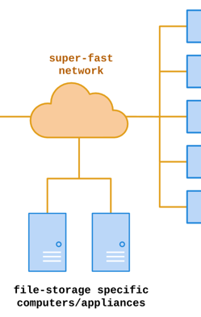
Storage
/home – 10 GB quota
Keep your scripts and executables here
Snapshotted twice a day: /home/.snapshot
Please do not write job output (logs, results) here!!
Run the command “quota” now
/scratch – 15 TB quota (also 2M files quota)
1PB total space, 30 day retention
Very fast storage, capable of 20GB/sec
Checkpoints, logs
Keep all temp/intermediate data here
Should be your default location to perform input/output
Notes:
“usually” “usually”
“first save it to scratch. if it’s important enough to have to remember to move to home after job-run… it should be”

Slide 24
Storage
/projects – 615TB
Long-term storage project shares
5TB is assigned to faculty member for group to share
$24/TB/year above 5TB
Snapshots available
Backups available - $.10/GB/month
/common
Cluster support share
Contrib: place to put software/libs/confs/db’s for others use
Notes:
Large GIS databases
Genome databases

Slide 25
Data Workflow
Keep scripts and executables in /home (or on Ondemand)
Write logs/temp/intermediate data to /scratch/<uid>
Copy data to /projects/<group_project>, for group storage and reference in other projects
Cleanup /scratch files
** Remember, /scratch is a scratch filesystem, used for high-speed temporary, and intermediate data
Notes:
NOT BACKED UP. All you gotta know.

Slide 26
Remote storage access
Via Ondemand in a web browser
Drag and drop files
https://in.nau.edu/arc/overview/file-management/
scp command/protocol
scp <files> <nauid>@dtn1.hpc.nau.edu:/scratch/<nauid>/
GUI examples: WinSCP on windows, Fetch for mac
samba /smb / cifs / “windows file sharing” / “shared drive”
Windows: \\shares.hpc.nau.edu\cirrus
Mac: smb://shares.hpc.nau.edu/cirrus
Globus
https://nau.edu/high-performance-computing/globus/

Slide 27
Data transfer node
We have a dedicated (login-node) system for transferring data
This host’s name is dtn1.hpc.nau.edu
Use dtn1 for moving large datasets around on monsoon, and to/from the internet

Slide 28
Groups
NAU has a resource called Enterprise groups. Enterprise Groups are utilized to manage who has access to specific folders and files on the cluster
They are available to you on the cluster if you’d like to manage access to your data
https://my-old.nau.edu
“Open directory services”
“Enterprise groups”
Take a look at our FAQ :: https://nau.edu/high-performance-computing/faqs/
If they are not working for you, contact ITS Solution Center
What groups are you in? Run the command “groups”, or ”id”

Slide 29
Modules
Software environment management handled by the modules package management system. This is available through the Command Line Interface (cli)
module avail …what modules are available
module list …modules currently loaded
module load <module name> …load a package module

Slide 30
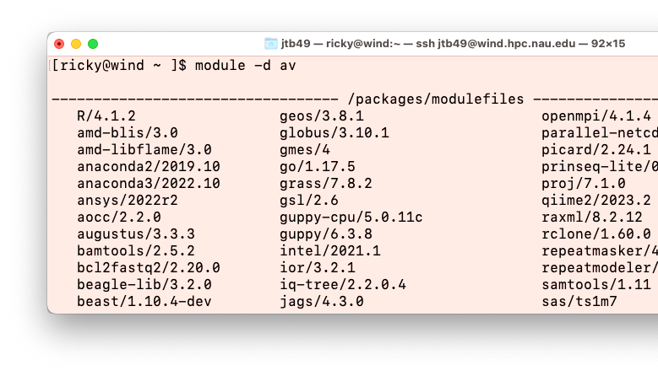
Software
Matlab
Mathematica
R
SAS
Qiime2
Anaconda Python
Lots of bioinformatics programs
Request additional software to be installed!

Slide 31
Requesting Software
You can install quite a bit of R, and python software yourself!
For R
module load R
R
install.package(c(package))
For python
module load anaconda3/<ver>
conda create -n myenv
conda activate myenv
conda install package
You are also welcome to compile your own programs
If you’d like our help installing a piece of software, please have your research sponsor request it here:
https://in.nau.edu/high-performance-computing/request-software/

Slide 32
MPI
Quick PSA for advanced users
Message Passing Interface for parallel computing
Open MPI set as default MPI
Example MPI job script:
/common/contrib/examples/job_scripts/mpijob.sh

Slide 33
Job Scripts and sbatch
Except for limited testing and debugging, all jobs on the cluster should be run via a shell script which is typically denoted by the extension .sh on the filename
sbatch shell scripts are composed of three sections:
Slurm job parameters (#SBATCH)
module loading
srun job steps/statements for the actual work

Slide 34
Interacting with Slurm
What resources are needed?
2 cpus, 12GB memory, for 2 hours?
What steps are required?
Run prog1, then prog2 … etc
Are the steps dependent on one another?
Can your work, or project be broken into pieces?
Smaller pieces can make the workload more agile.
How long should your job run for? (i.e.: educated guess)
Is your software multithreaded, uses OpenMP or MPI?

Slide 35
Example Job script
#!/bin/bash
#SBATCH --job-name=test
#SBATCH --output=/scratch/NAUID/output.txt # the stdout from your job goes here
#SBATCH --time=20:00 # shorter time = sooner start
#SBATCH --chdir=/scratch/NAUID # default location slurm searches
# replace this module with software-
# modules required by your jobscript
module load anaconda3/2021.11 # loads a specific anaconda-python
# example job commands: each srun command is
# a job step, so this job will have 2 steps
srun sleep 300
srun python -V

Slide 36
Example Job script (in Ondemand’s editor)

Slide 37
Job Parameters
You want | Switches needed
More than one cpu for the job | --cpus-per-task=2, or -c 2
To specify an ordering of your jobs | --dependency=afterok:job_id, or -d job_id
Split up the output, and errors | --output=result.txt --error=error.txt
To run your job at a particular time/day | --begin=16:00 --begin=now+1hour --begin=2010-01-20T12:34:00
Add MPI tasks/ranks to your job | --ntasks=2, or -n 2
To control job failure options | --norequeue –requeue
To receive status email | --mail-type=ALL

Slide 38
Contraints and Resources
You want | Switches needed
To choose a specific node feature (e.g. avx2) | --constraint=avx2
To use a generic resources (e.g. a gpu) | --gres=gpu:tesla:1, -G1
To reserve a whole node for yourself | --exclusive
To chose a partition | --partition

Slide 39
Interacting with Monsoon
Three Methods (must be on NAU Internet or NAUVPN):
Connect to OpenOndemand web interface at: https://ondemand.hpc.nau.edu
Via SSH protocol in a command-line shell
Type “ssh <nau-id>@<login-node>”
…within Powershell (Windows), or Terminal (Mac,*nix)
login nodes:
monsoon.hpc.nau.edu (for research)
wind.hpc.nau.edu
ondemand.hpc.nau.edu
rain.hpc.nau.edu (for class work)
SMB connection (files only -- no linux tools/commands)
\\shares.hpc.nau.edu\cirrus ...win/mac... shares.hpc.nau.edu/cirrus
see guide here: https://in.nau.edu/arc/overview/file-management/

Slide 40
Login node vs Compute node
When you log into “monsoon” interactively or via Ondemand you are “placed” on a login node.
The login node is a shared system used solely for:
Developing scripts
Transferring small data
Submitting work to the scheduler
Analyzing results
Debug work less than 30 minutes in length
The compute nodes are what make the cluster powerful!

Slide 41
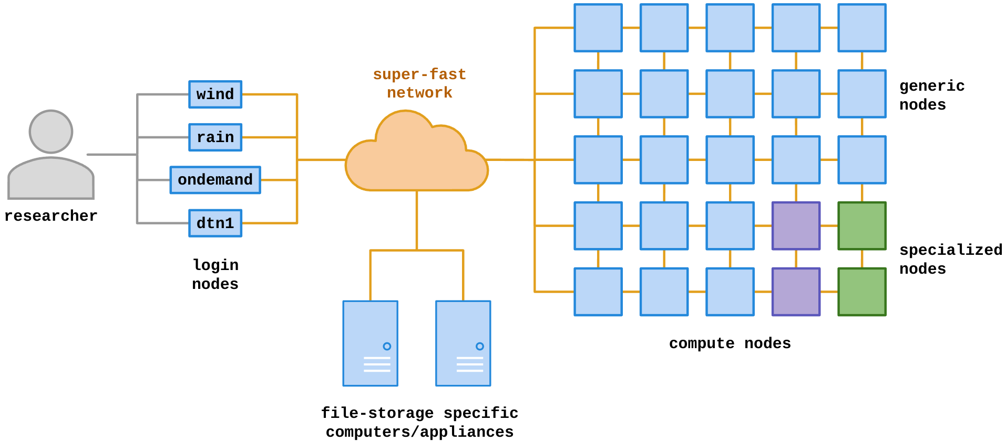
Cluster = Login-nodes + Compute-nodes + etc
Notes:
Green gpu node/resources
Purple licenses/whatev
Storage = machines

Slide 42
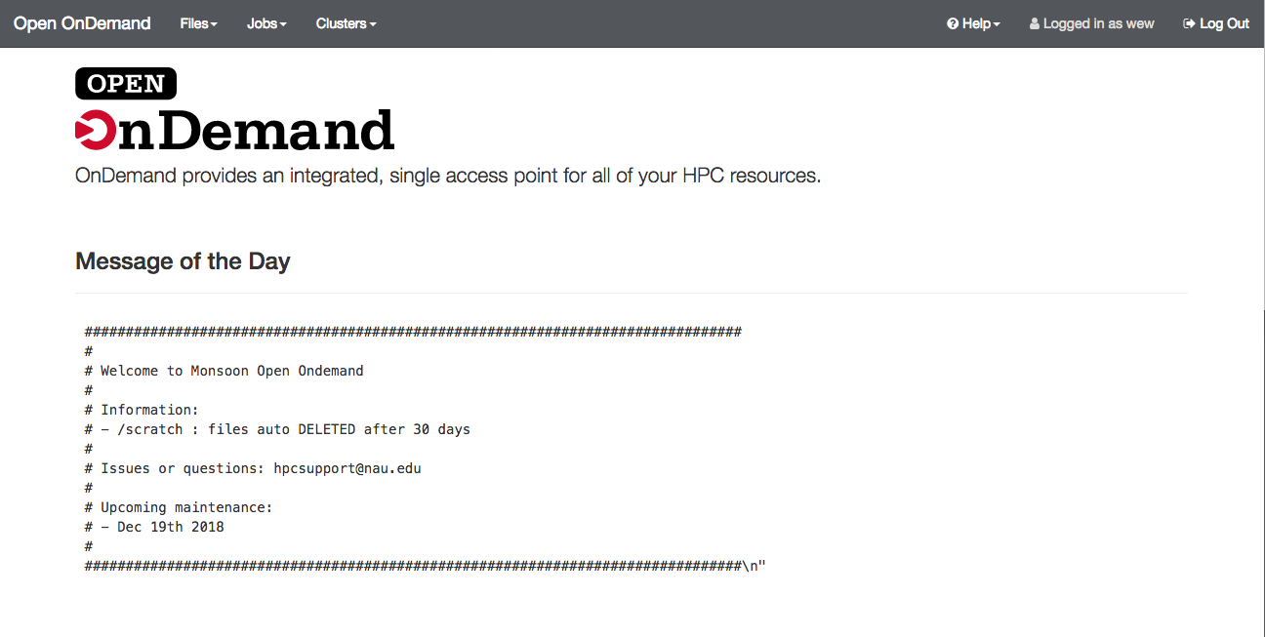
Ondemand
Open Ondemand (OOD) is an interactive Graphical User Interface (gui) to the Cluster. You access it from your web browser at https://ondemand.hpc.nau.edu

Slide 43
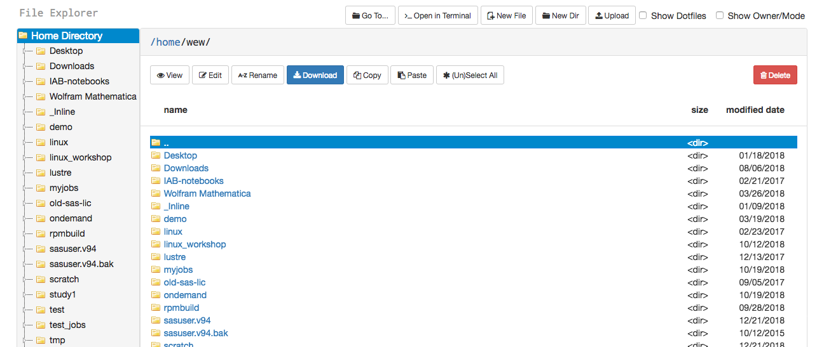
Ondemand File Explorer
The file explorer is used to explore, and transfer the files in your home, scratch, or other areas on the cluster.

Slide 44
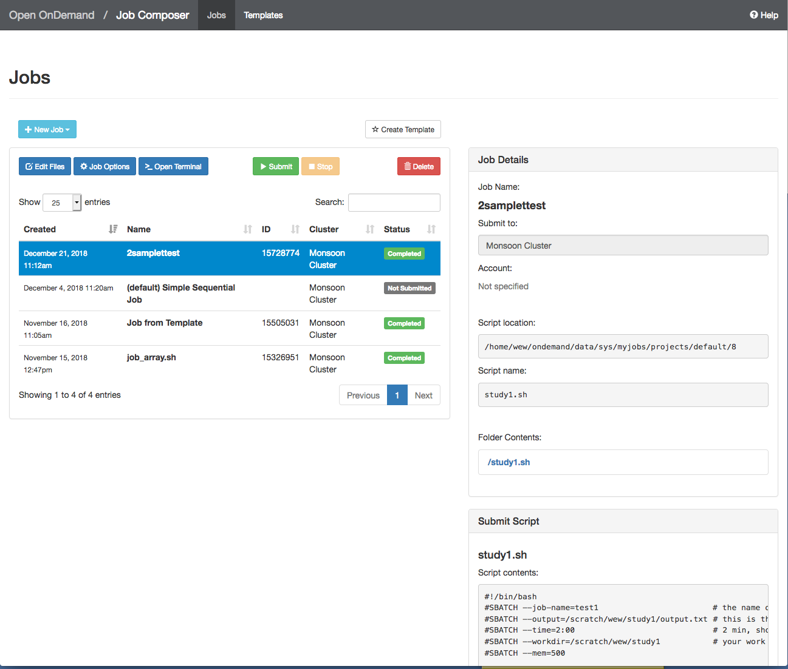
Ondemand Job Composer
The Job Composer can be used to create and run jobs.

Slide 45
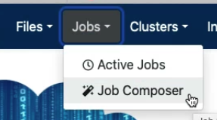
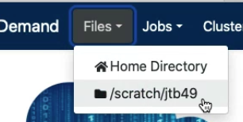
Exercise 1
Create a simple job in the job composer from the template that you will then submit to the scheduler to run on the compute nodes.
From Ondemand, click the Jobs > Job Composer menu
Click on New Job and select From Default Template
Click on Open Editor (bottom of right-column of page)
Change all “NAUID” to be your nau user-ID, e.g.: abc123!
Name your job: “exercise1”
Name & direct your output to /scratch/<NAUID>/exercise1.out
Make your jobscript load the module named “workshop”
Make your jobscript run the “date” command
i.e.: “srun date”
Additionally, run the “exercise1” command, as well
Save (in this tab), and then submit your job via the job composer (previous tab)
Use the File Explorer to examine your output (Files > /scratch/NAUID)
Make a note of the secret code in exercise1.out
Exercise 1 (CLI)

Slide 46
Exercise 2
Create a new job using New Job > From Specified Path
Source path: /common/contrib/examples/job_scripts
Name: “longjob” (this is your name for your job)
Script name: “longjob.sh” (this is our existing filename)
For Cluster and Account: leave empty
Save, select “longjob” from the Jobs list, and click Open Editor button as before
Change all “NAUID” to be your nau ID
Make your jobscript load the module named “workshop”
Make your jobscript run the “exercise2” command
e.g. “srun exercise2”
Make your job sleep for 5 minutes (sleep 300)
Sleep is a command that creates a lazy process that … sleeps and does nothing
Save, and then Submit
Monitor your job by selecting Jobs and Active Jobs from your Dashboard.
Examine the output in long.txt
Make a note of the secret code from long.txt
Exercise 2 (CLI)

Slide 47
Command-line access
Once you have the basics down using Ondemand, then the power of the cluster is exposed through the command-line interface (CLI)
We will be utilizing a CLI built-in to Ondemand
Follow along after opening a CLI (from “Clusters” menu)
Feel free to tryout the commands that we will be discussing
Tip: The Monsoon CLI may also be accessed outside of ondemand via an “ssh client” such as Putty on Windows or Terminal on the Mac.

Slide 48
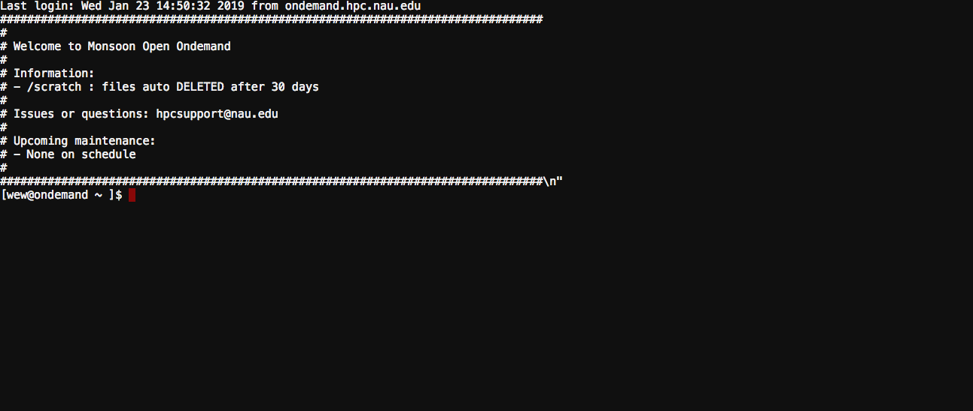
The Ondemand CLI
You may access the CLI from the dashboard and selecting Clusters > Monsoon login node shell
Note: When logging in, ssh does NOT give interactive feedback while you enter your password, but it will evaluate your password attempt upon hitting enter!

Slide 49
Cluster info
sinfo
view information about SLURM nodes and partitions.
sinfo -N –l
sinfo –R
List reasons for downed nodes and partitions

Slide 50
Interactive / Debug Work
Run your compiles and testing on the cluster nodes by:
srun gcc hello.c –o a.out
srun --qos=debug -c12 make -j12
srun Rscript analysis.r
srun python analysis.py
Try this now:
srun hostname
hostname

Slide 51
Long Interactive work
salloc
Obtain a SLURM job allocation that you can work with for an extended amount of time interactively.
This is useful for testing/debugging for an extended amount of time.
[user1@wind ~ ]$ salloc -c 8 --time=2-00:00:00
salloc: Granted job allocation 33442
[user1@wind ~ ]$ srun python analysis.py
[user1@wind ~ ]$ exit
salloc: Relinquishing job allocation 33442
[user1@wind ~ ]$ salloc -N 2
salloc: Granted job allocation 33443
[user1@wind ~ ]$ srun hostname
cn3
cn2
[user1@wind ~ ]$ exit
salloc: Relinquishing job allocation 33443
Notes:
DEFAULTS for srun without salloc first

Slide 52
Submitting non-interactive jobs
The sbatch command is used to submit batch jobs to the slurm workload manager. Jobs submitted with sbatch are placed in a queue where they wait for resources to become available.
[user1@wind ~ ]$ sbatch jobscript.sh
Submitted batch job 85223
slurm returns a job id for your job that you can use to monitor or modify constraints

Slide 53
Monitoring your job
jobstats: your main tool
jobstats -r
jobstats -j <jobid>
sprio: view the factors that comprise a job’s scheduling priority
sprio –l
-- list priority of users jobs in pending state
sprio -o “%j %u … “
sprio -w

Slide 54
Monitoring your job
squeue
view information about jobs located in the SLURM scheduling queue.
squeue --start
squeue -u login
squeue -o “%j %u … “
squeue -p partitionname
squeue -S sortfield
squeue -t <state> (PD or R)

Slide 55
Monitoring your job
sstat
Display various statistics and information of a running job
sstat -j jobid
sstat -o AveCPU,AveRSS
Only works with jobs where analysis is executed with “srun”

Slide 56
Controlling your job
scancel
Used to signal jobs or job steps that are under the control of Slurm.
scancel jobid
scancel -n jobname
scancel -u mylogin
scancel -t pending (only yours)

Slide 57
Controlling your job
scontrol
Used to view and modify Slurm configuration and state
Can change job constraints while it’s in the pending state, but once the job starts, it can no longer be modified
scontrol show job 85224
scontrol update jobid=6880341 timelimit=4:00:00

Slide 58
Job Accounting
sacct
displays accounting data for of your jobs and job steps in the SLURM job accounting log or SLURM database
sacct -j jobid -o jobid,elapsed,maxrss
sacct -N nodelist
sacct -u mylogin
Try our sacct wrapper “jobstats”
jobstats -r
jobstats -j <jobid>

Slide 59
Job Accounting
sshare
Tool for listing the shares of associations to a cluster.
sshare -l : view and compare your groups cpu minutes usage
sshare -a : view all users fairshare
sshare –A –a <account> : view all members in your account (group)
group_efficiency <account>

Slide 60
Account hierarchy
Your user account belongs to a parent faculty account (group)
Your user account shares resources that are provided for your group
Example:
account1
user1
user2
View the account structure you belong to with: “sshare -a –A <account>”
Example:
sshare -a -A account1

Slide 61
Limits on the account (group)
Limits are in place to prevent intentional or unintentional misuse of resources to ensure quick and fair turn around times on jobs for everyone.
Groups are limited to a total number of cpu minutes in use at one time: 5M, and gpu minutes: 64K
This resource limit mechanism is referred to as: “TRESRunMins”.
This limiting mechanism has nothing to do with priority!

Slide 62
TRESRunMins Limit
What the heck is that!?
A number which limits the total number of remaining resource minutes which your running jobs can occupy.
Enables flexible resource limiting
Staggers jobs
Increases cluster utilization
Leads to more accurate resource requests
Sumofjobs(resource * timelimit remaining)

Slide 63
Examples
14400 = 10 jobs, 1 cpu, 1 day in length
144000 = 10 jobs, 10 cpu, 1 day in length
720000 = 10 jobs, 10 cpu, 5 days in length
720000 = 1000 jobs, 1 cpu, ½ day in length
1105920 = 1 job, 1024 cpus, 18 hrs in length
Questions?
Check your groups resource min usage:
sshare -l

Slide 64
TRES run minutes (demo)
Say, groupA’s total cpu minute limit is: 5000
Example, groupA submits three jobs
Job1:
1 core
1 day timelimit (1440 minutes)
1 GB memory
Job2:
2 core
1 days (1440 minutes)
16 GB memory
2880 minutes total !
Job 3:
1 core
1 day (1440 minutes)
1GB memory

Slide 65
TRES run minutes
Assuming there are available monsoon resources
How many jobs start?
How many cpu minutes are in use?
When is job 3 ELIGIBLE to start?

Slide 66
TRES run minutes
Assuming there are available monsoon resources
How many jobs start?
2
How many cpu minutes are in use?
1440+2880 = 4320
When is job 3 ELIGIBLE to start?
After ~6 hours (6*60 = 360), and 2 jobs (360*2) = 720 minutes
We have only 5000-4320 = 680 minutes available initially
After ~ 1/4 day goes by (360 minutes) * 2 (two jobs) = 720 minutes
680 + 720 = 1400
After another 40 minutes we’ll have 1440 at which point job starts

Slide 67
Helpful Linux Commands
List Files | ls options -l – to show more information
Change Directory | cd <directory path> cd by itself will return you to your home directory
Show/print current working directory | pwd
Copy Files | cp <source> <destination> use a period for the destination to copy a file to your current directory
Move or rename a file | mv <source> <destination>
Delete a file | rm <filename>
Create a directory | mkdir <directory name>
View contents of a file | more <filename> less <filename> cat <filename>
Edit a file | nano <filename>
Exit your terminal session (log off) | exit

Slide 68
Exercise 3 via CLI
Get to know monsoon and Slurm, on your own. Start by opening a shell to Monsoon.
1. How many nodes make up monsoon?
Hint: use “sinfo”
How many nodes are in the gpu partition?
3. How many jobs are currently in the running state ?
Hint: use “squeue -t R”
4. How many jobs are currently in the pending state? Why?
Hint: use “squeue –t PD”

Slide 69
Exercise 4 via CLI
Ok, memory looks good, but notice that the usercpu is the same as the elapsed time
Usercpu = num utilized cpus * elapsed time
This is because the application we were running only used 1 of the 4 cpus that we requested
Edit the lazy job script, comment out first srun command, and uncomment the second srun command.
Resubmit
Rerun jobstats -r, notice now usercpu is a multiple times the elapsed time, in this case (4). Because we were allocated 4 cpus, and used 4 cpus.
Now address the egregious time estimate!
Make a note of the secret code from lazy.txt!
Copy job script and edit:
/common/contrib/examples/job_scripts/lazyjob.sh
Edit the job, change NAUID to be your id
Save the job
Submit the job (sbatch lazyjob.sh), it will take 65 sec to complete
Use sstat and squeue to monitor the job
sstat -j <jobid>, and squeue –u <userid>
Review the resources that the job used
jobstats -r
We are looking for “MaxRSS”, MaxRSS is the max amount of memory used
Edit the job scripts memory request, reduce the memory being requested in MB and resubmit, edit “--mem=“ , e.g. --mem=600
Review the resources that the optimized job utilized once again
jobstats -r

Slide 70
Archived Job scripts
Every job script that is submitted to slurm on monsoon is archived for three reasons:
Convenience – if you forget what script was used for what job, you can find out!
Support assistance – we can find the job script that was used in your job to help troubleshoot with you.
Security / stability – in case of any security or stability issues, we can connect issues and outages to associated jobs

Slide 71
Retrieval of a job script
Archived job scripts, and their environment are stored here:
/common/jobscript_archive/<user>/<year>/<month>
<job id>.sh – job script
<job id>.env – job scripts environment
Only the individual researcher and our support group can access their job scripts
Example:
User abc123, accessing job id 2600 from March, 2021
cat /common/jobscript_archive/abc123/2021/03/2600*.sh
cp /common/jobscript_archive/abc123/2021/03/2600*.sh ~/
Use “showscript” to make it easy!!!!
Notes:
showscript 10713758
10713758-long.sh
jobstats -S 1/1/24

Slide 72
Showscript Demo
Notes:
showscript 10713758
10713758-long.sh
jobstats -S 1/1/24

Slide 73
Checking your quotas
From time to time you may need to examine how much space you are using in the various monsoon storage areas

Slide 74
Changing Your Default Account
All researchers have a default slurm account to track usage
See it now by: “sacctmgr show user name=<NAUID>”
Some researchers belong to multiple slurm accounts
Example to override the default:
#SBATCH --account=inf503-fall24
#SBATCH --account=prof_lastname

Slide 75
Confirming Your Account
This is a required step for your account to be fully enabled!
After completing the exercises: one, two, and four, you will have three, 32 character alpha-numeric codes
With the codes in hand, confirm your monsoon account with the commands:
module load workshop
confirm_user
More information here:
https://in.nau.edu/arc/obtaining-an-account/

Slide 76
Optimizing Your Cluster Use
To get the most out of the cluster for yourself and your team, it is important to optimize the settings for your jobs.
Optimization includes memory requested, time for the job to run, number of cpus

Slide 77
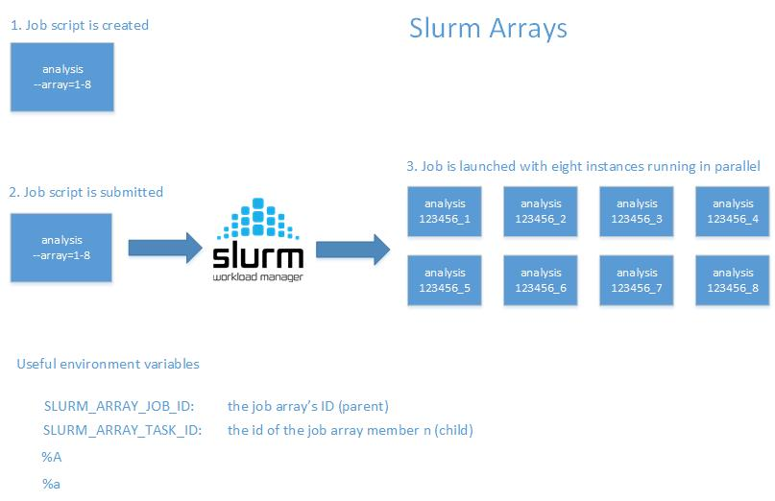
Slurm Arrays!
Notes:
https://rcdata.nau.edu/hpcpub/test/

Slide 78
Slurm Arrays Exercise
From your scratch directory: “/scratch/nauid”
tar xvf /common/contrib/examples/bigdata_example.tar
cd bigdata
edit the file “job_array.sh” so that it works with your nau id replacing all NAUID with yours
Submit the script “sbatch job_array.sh”
Run “squeue”, notice there are 5 jobs running, how did that happen!

Slide 79
Keep these tips in mind
Know the software you are running, is it multi-threaded?
Request resources accurately
Supply an accurate time limit for your job
Don’t be lazy, it will affect you and your group negatively

Slide 80
Common Questions
Should I use OnDemand or the command line?
Power users will tend to use command line
However, the terminal in ondemand is worth using all the time

Slide 81
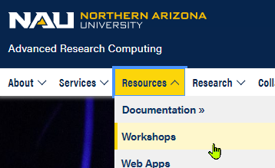
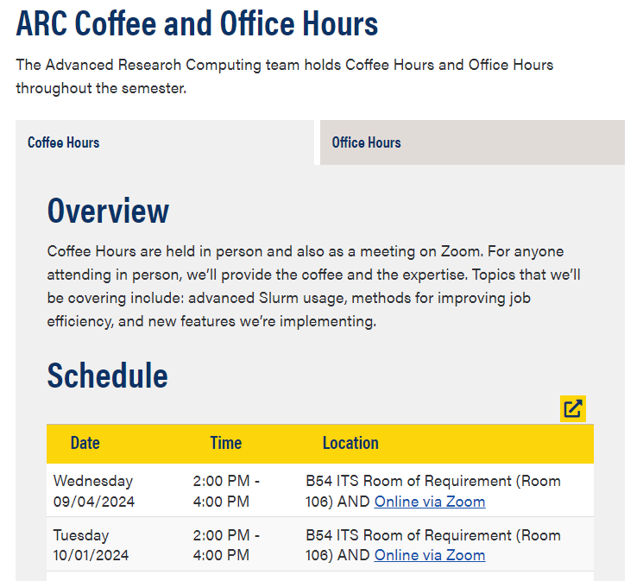
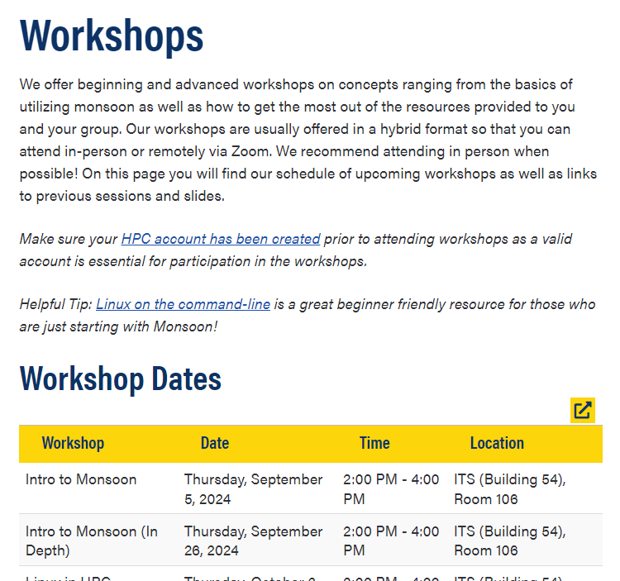
Workshops, Office-, and Coffee-hours!

Slide 82
Question and Answer
More info here:
http://in.nau.edu/arc
ask-arc@nau.edu
Job efficiency
http://metrics.hpc.nau.edu
FREE – Linux command line book:
http://linuxcommand.org/tlcl.php
Info here: https://in.nau.edu/arc/external-resources/linux-resources/
And on the nauhpc listserv
nauhpc@lists.nau.edu

Slide 83
MPI Example
Refer to the MPI example here:
/common/contrib/examples/job_scripts/mpijob.sh
Edit it, for your work areas, then experiment:
Change number of tasks, nodes … etc
Also can run the example like this:
srun --qos=debug –n4 /common/contrib/examples/mpi/hellompi

Slide 84
Exercise 1 (CLI)
cp /common/contrib/examples/job_scripts/exercise1.sh ~/
nano exercise1.sh (or another editor)
Replace all occurrences of “NAUID” to be your nau user-ID, e.g.: abc123!
Name your job (--job-name): “exercise1”
Set --output to be /scratch/<NAUID>/exercise1.out
Example: --output=/scratch/abc123/exercise1.out
Make your jobscript load the module named “workshop”
Example: module load workshop
Make your jobscript run the “date” command
Example: “srun date”
Additionally, run the “exercise1” command, as well
Example: “srun example1”
Save the file
For nano: cntrl x, and “yes”
Submit the batch script to slurm
sbatch exercise1.sh
Make a note of the secret code in exercise1.out
Next Slide: Exercise 2 (CLI)

Slide 85
Exercise 2 (CLI)
cp /common/contrib/examples/job_scripts/exercise2.sh ~/
nano exercise2.sh
Replace all occurrences of NAUID with your nau ID, e.g. abc123
Name your job output “exercise2.out”
Example: --output=/scratch/abc123/exercise2.out
Make your jobscript load the module named “workshop”
Example: ”module load workshop”
Make your jobscript run the “exercise2” command
Example: “srun exercise2”
Make your job sleep for 5 minutes (sleep 300)
Example: “srun sleep 300”
Sleep is a command that creates a lazy process that … sleeps and does nothing
Save the file
For nano: cntrl x, and “yes”
Submit the batch script to Slurm
Example: “sbatch exercise2.sh”
Monitor your job utilizing “squeue -u <NAUID>”
Examine the output in excercise2.out
Make a note of the secret code from exercise2.out
Next Slide: Command-line Access

