Slide 1

Intro to Monsoon and Slurm
2026-09-25 presentation with Jason Buechler
These slides:
https://rcdata.nau.edu/hpcpub/workshops/odintro.pdf

Slide 2
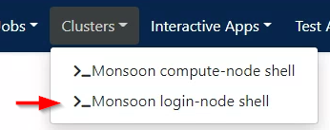
Get logged in!
From a computer:
  Connect to the NAU VPN if off-campus!
    Info: https://in.nau.edu/its/remote-services
  Open any web browser
  Login to http://ondemand.hpc.nau.edu
    Standard ‘abc123’ Louie ID & password
  Optional: try out the command-line
    Clusters > Monsoon login-node shell
These slides:
https://rcdata.nau.edu/hpcpub/workshops/odintro.pdf
Notes:
Optional for first half, until exercises
No mobile yet

Slide 3
              HIT RECORD! 🎥

Slide 4
Introductions
Introduce yourself
  Name
  Department / Group
  What project(s) do you plan to use monsoon for?
  Linux or Unix experience
  Previous HPC experience?
Don’t worry: few researchers have prior linux/HPC experience!
I am Jason Buechler
Aero, Mech Engineering
fluid-thermodynamics, renewable
energy, & grid-engineering
With Monsoon since 2019
Linux/supercomputing since 2000
Notes:
trail running, racquetball, kitchen science

Slide 5
Agenda
(High-Performance-Computing) Cluster education
  What is a cluster, exactly?
  Job-queues, scheduling, and resource management
Monsoon Cluster orientation
  How do I use this cluster?
  Resource limits
  Exercises
  Question and answer
Notes:
A bit about HPCs in general
Physically – hw
Practically – daily use
About our HPC specifically

Slide 6
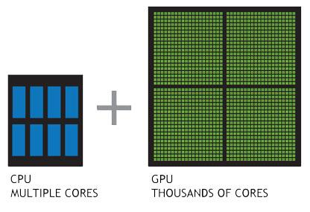
Cluster (of) resources
Node itself
  Memory
  CPU’s
  GPU’s
Networking
Licenses
MEMORY (i.e. DIMMs)
Notes:
STUFF IN HOME PCS
cpu = cores (in HPC)
Net: speed, limited access

Slide 7
Inside a (single) compute-node
Socket 0
Socket 1
Bill’s job
4x cpu
1x mem
Mary’s job
16x cpu
4x mem
Socket 2
Socket 3
Ted’s job
1x cpu
2x mem
Notes:
Single cn = lots of resources
Finite resources ← jobs get exclusive use
Login-node = same

Slide 8
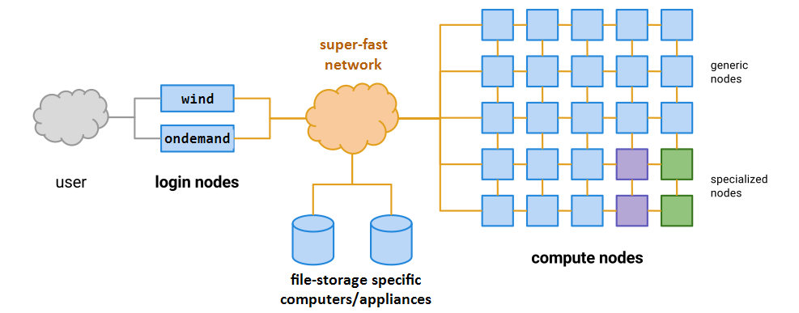
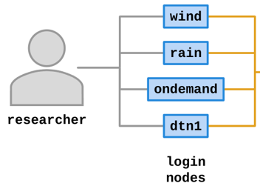
Cluster =
Login-nodes + Compute-nodes + More
Notes:
Green gpu node/resources
Purple licenses/whatev
Storage = machines

Slide 9
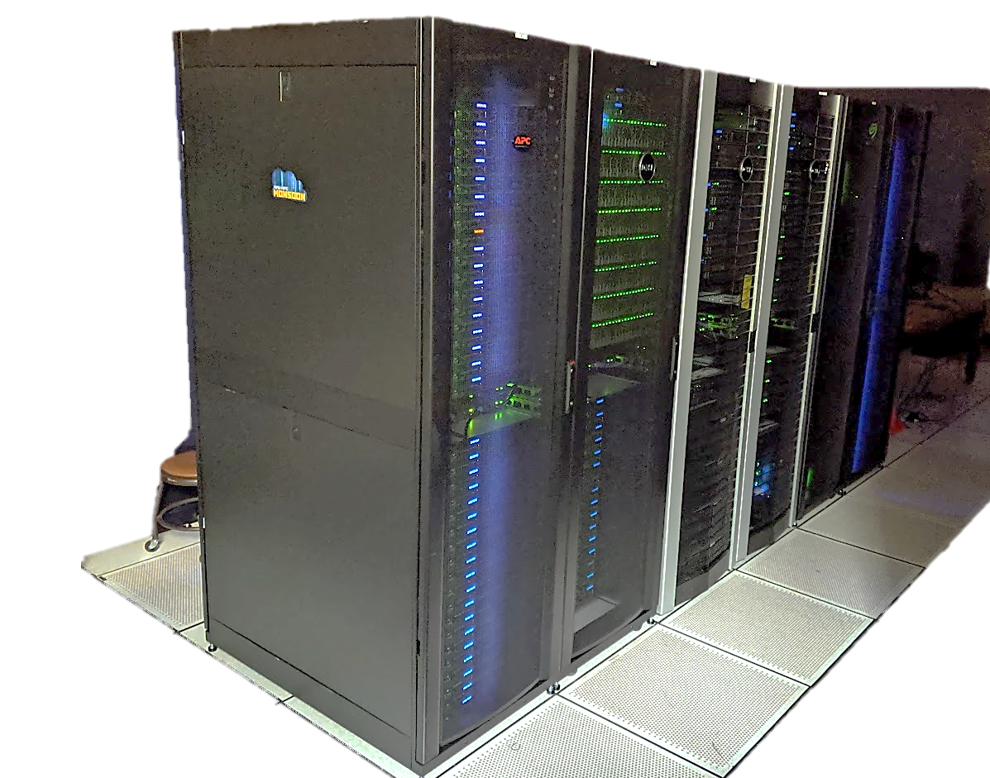
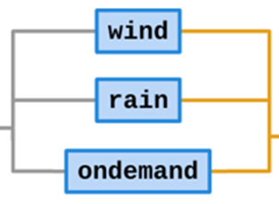
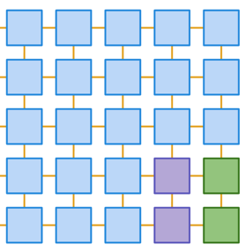

Monsoon
Monsoon: ≈4252 CPU cores
Notes:
Note for later: 4000 vs 8.7 M cores

Slide 10

(now 2nd-) Largest Cluster!
El Capitan: 11.3M cores

Slide 11

Largest Cluster!
LineShine:
13.8M cores
Notes:
2.2 exaflops vs 1.8 for ElCap

Slide 12

Small Cluster!
2 cores? 2 jobs!
Notes:
“cluster of resources” jobs could be scheduled!

Slide 13
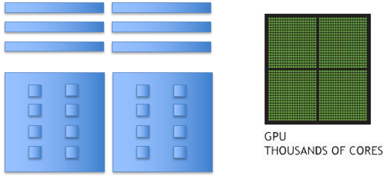


Monsoon Today
(from https://in.nau.edu/arc/details)
The Monsoon cluster is a resource available to the NAU research enterprise
109 compute-nodes (cn1 ∼ cn109)
  27TB memory - 128GB/node min, 2TB max
  28 GPUs (P100, V100, A100, H200, RTX6000)
  4252 cores (Intel + AMD)
Red Hat Enterprise Linux 10.2
High speed interconnect: FDR, and HDR Infiniband
Storage
  1PB scratch high-speed storage (Lustre)
  1.6PB home,proj storage (proprietary object-store)

Slide 14
What is a queue?
Normally thought of as a line, FIFO (Line at Starbucks)
Queues on a cluster can be as basic as a FIFO, or more advanced with dynamic priorities taking into consideration many factors
A scheduler needs to know what resources are available on the cluster in order to make accurate scheduling decisions
Notes:
A queue arranged by a *scheduler*
Single green job? (vs 4x blue) … Small-resource purple job?

Slide 15
Resource Manager
Resource availability changes by the second!
Assignment of work on a cluster is carried out most efficiently with the scheduler and resource manager working together
Monitoring resource availability and health
  Accounting of resources
  Allocation of resources
  Execution of resources
Notes:
Resource manager = Constant monitoring
Constant communication with scheduler = optimization

Slide 16

Slurm … yummm
Slurm (Simple Linux Utility for Resource Management)
Excellent resource manager and scheduler
Precise control over resource requests
Developed at LLNL, continued by SchedMD
Used everywhere from small clusters to the largest clusters:
  LineShine (#1), 13.8M cores, 2.2 PF/s, 42.2 MW - China
  El Capitan (#2), 11.3M cores, 1.8 PF/s, 29.7 MW - USA
Notes:
Open-source like most linux
Code AND DOCS online
Account-PI’s can manage SOME job parts

Slide 17

Our Scheduling Goals
Optimize quantity of work
Optimize usage of resources
Service all users and projects justly
Make scheduling decisions transparent
Notes:
Minimize unused hw-time
Transparent doesn’t mean simple tho

Slide 18
Monsoon scheduling
Monsoon utilizes a combination of scheduling methods to optimize cluster productivity and resource usage:
FIFO
  Simply first in first out
Backfill
  Runs smaller jobs with lower resource requirements while larger jobs wait for higher resource requirements to be available
Fairshare
  Prioritizes jobs based on multiple factors such as users’ recent resource consumption
Additional factors
  Including job-specific and user-specific
Notes:
Backfill = minimize unused hw-time
Addl factors: next slide

Slide 19
Factors attributing to priority
Fairshare (predominant factor)
  Priority points determined on users’ recent resource usage
  Decay half life over 12 hours
Age – how long has the job sat pending
Job size - the number of nodes/cpus a job is requesting
QOS (Quality of Service)
  Some QOS have higher priority than others, for instance: debug
Notes:
Complicated
QOS: Super short-time debug job? … High-pri covid job?

Slide 20
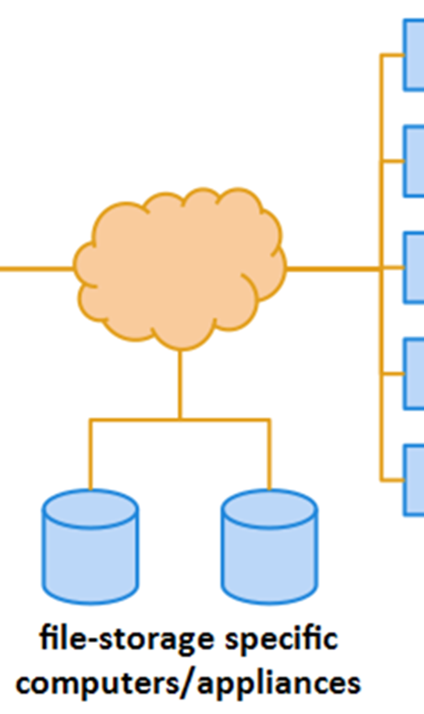
Storage
/home – 20 GB quota
  Keep your scripts and executables here
  Backed up to tape
  Snapshotted twice a day: /home/.snapshot
  Please do not write job output (logs, results) here!!
  Run the command “getquotas” now
/scratch – 15000 GB quota (also 2M files quota)
  1PB total space, 30 day retention
  Very fast storage, capable of 20GB/sec
  Checkpoints, logs
  Keep all temp/intermediate data here
  Should be your default location to perform input/output
Notes:
“usually” “usually”
“first save it to scratch. if it’s important enough to have to remember to move to home after job-run… it should be”

Slide 21
Storage
/projects – 1.6 PB
  Long-term storage project shares
  5TB is assigned to faculty member for group to share
  $48/TB/year above 5TB
  Snapshots available
  Option to make datasets available to the web
/common
  Cluster support share
NOTE: the only storage area on monsoon backed-up*
is your /home area (due to size limitations)
Notes:
/common: Large GIS & Genome databases
A project is usually easier / more control

Slide 22
Data Workflow
Keep scripts and executables in /home
Write logs/temp/intermediate data to /scratch/<uid>
Copy data to /projects/<group_project>, for group storage and reference in other projects
Cleanup /scratch files
** Remember, /scratch is a scratch filesystem, used for high-speed temporary and intermediate data
Notes:
NOT BACKED UP. All you gotta know.

Slide 23
Remote storage access
Quick transfers via web
<10 GB, <100 files
Ondemand’s file-browser, or Globus*
Very large/numerous files
Globus: https://in.nau.edu/arc/globus
General purpose
scp: 100’s of GBs, 1000’s of files
smb: 10’s of GBs, 100’s of files
SCP/SMB: https://in.nau.edu/arc/file-management
scp protocol / shell-command
GUI apps: WinSCP on windows, Fetch for mac
scp <files> <nauid>@<dtn>:/scratch/<nauid>/
smb / samba / “shared drive”
Windows: \\shares.hpc.nau.edu\cirrus
Mac: smb://shares.hpc.nau.edu/cirrus

Slide 24
Data transfer nodes
We have dedicated, specialized login-nodes for transferring data
These hosts’ names are
dtn1.hpc.nau.edu & dtn2.hpc.nau.edu
Use dtn1/dtn2 for moving large datasets around on monsoon, and to/from the internet
Notes:
Login here to download large files from internet
Or point file-xfer tools here

Slide 25
Enterprise Groups
NAU has a resource called Enterprise groups. Enterprise Groups are utilized to manage who has access to specific folders and files on the cluster
They are available to your group on the cluster if you’d like to manage access to your data
What groups are you in? Run the command “groups”, or ”id”
More info in our FAQs https://in.nau.edu/arc/faqs
  “Creating and Managing an Enterprise Group”

Slide 26
(Software) Modules
Software environment management handled by the modules package management system. This is available through the Command Line Interface (cli)
module avail …what modules are available
module load <module name> …load a package module
module list …modules currently loaded

Slide 27
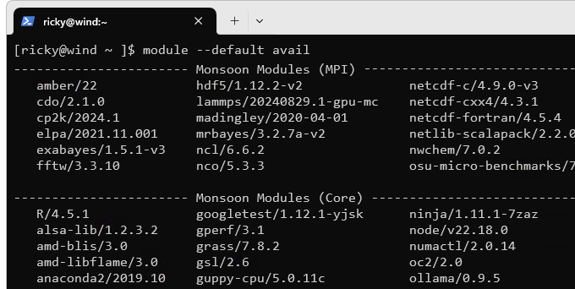
Modules on Monsoon
What’s already available?
module –d avail
Anaconda Python
R
Matlab
Qiime2
Many bioinformatics programs
Notes:
This is our MASTER list of software
Single-dash D == double-dash DEFAULT

Slide 28
Requesting Software
You can install quite a bit of R, and anaconda/python software yourself!
For R
  module load R
  R
  install.package(c(package))
For python/anaconda/miniforge3
  module load anaconda3
  conda create -n myenv
  conda activate myenv
  conda install package
You are also welcome to compile your own programs
If you’d like our help installing a piece of software, please have your research sponsor request it
More info:
https://in.nau.edu/arc/installing-software-packages
Notes:
*more info*

Slide 29
MPI
Quick PSA for advanced users
Message Passing Interface for parallel computing
Open MPI set as default MPI
Example MPI job script:
  /common/contrib/examples/job_scripts/mpijob.sh

Slide 30
Interacting with Slurm
What resources are needed?
  2 cpus, 12GB memory, for 2 hours?
  You can (must!) start with an educated guess
What software environment is needed?
What steps are required? (must prog1 run before prog2?)
Can your work, or project be broken into pieces?
  Smaller pieces can make the workload more agile
  Is each step dependent on the last?
  Is your software multithreaded, uses OpenMP or MPI?
Notes:
#4 is for your benefit, leveraging the scheduler

Slide 31
Job Scripts and sbatch
Except for limited testing and debugging, all jobs on the cluster should be run via a shell script which is typically denoted by the extension .sh on the filename
sbatch shell scripts are composed of three sections:
  Slurm job parameters (“#SBATCH …”)
  Software environment/module loading (“module load …”)
  srun job-steps/cmd-statements for actual work (“srun <command>”)
Notes:
I’ll be highlighting these 3 sections repeatedly as we discuss job-scripts

Slide 32
Example Job script
#!/bin/bash
#SBATCH --job-name=test
#SBATCH --time=20:00 # shorter jobs usually start sooner
#SBATCH --chdir=/scratch/NAUID # default location of files
#SBATCH --output=/scratch/NAUID/output.txt # the job’s output/errors go here
# replace this module with software-
# modules required by your jobscript
module load anaconda3/2025.06 # loads a specific anaconda-python
# example job commands: each srun command is
# a job step, so this job will have 2 steps
srun sleep 300
srun python -V
Notes:
Shell scripts’ first line always the same
Same 3 sections
COMMENTS begin with “#” buuut #SBATCH lines are SPECIAL

Slide 33
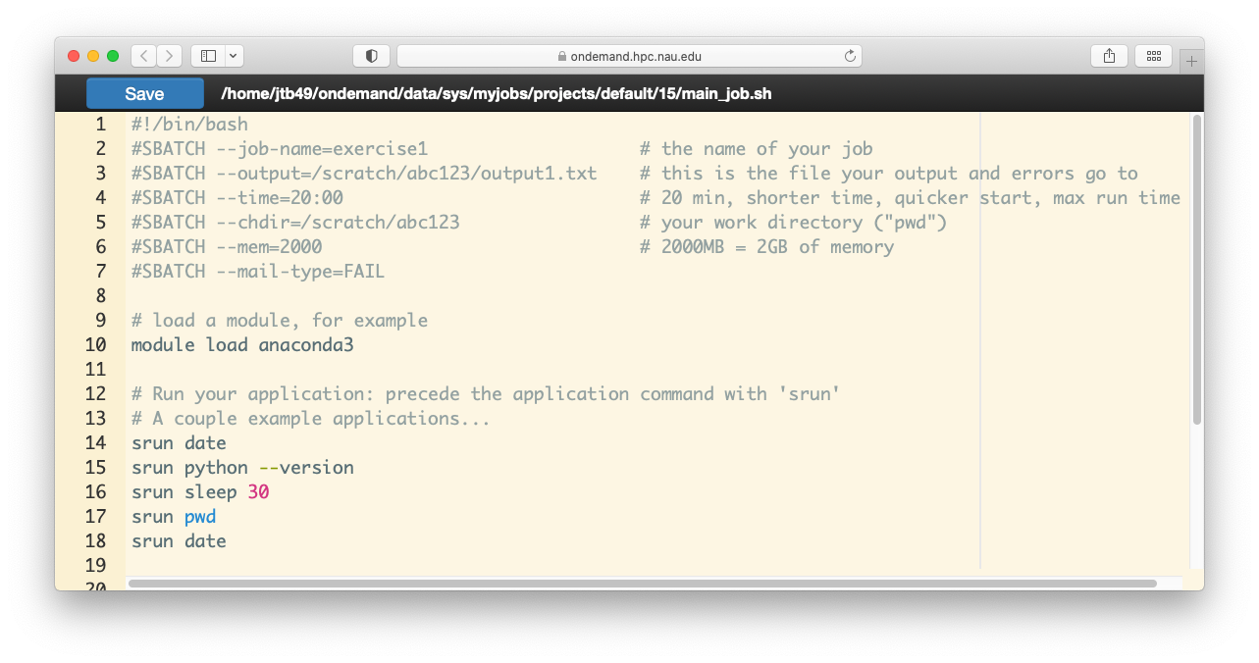
Example Job script (in Ondemand)
Job parameters (for slurm)
Software environment setup
Job commands
Notes:
Same 3 sections
THIS IS WHAT WE’LL SEE IN EX1
You can DELETE EXTRA LINES

Slide 34
Job Parameters
You want | Switches needed
More than one cpu for the job | --cpus-per-task=2 (or: -c 2)
To specify an ordering of your jobs | --dependency=afterok:job_id (or: -d job_id)
Split up the output, and errors | --output=result.txt --error=error.txt
To run your job at a particular time/day | --begin=16:00 --begin=2026-02-14T12:34:00
Add MPI tasks/ranks to your job | --ntasks=2, or -n 2
To control job failure options | --norequeue --requeue
To receive status email | --mail-type=ALL
More info:
https://slurm.schedmd.com/sbatch.html
Notes:
*more info*

Slide 35
Contraints and Resources
You want | Switches needed
To choose a specific node feature (e.g. avx2) | --constraint=avx2
To use a generic resources (e.g. a gpu) | --gpus=a100 , -G 1
To reserve a whole node for yourself | --exclusive
To chose a partition | --partition
More info:
https://slurm.schedmd.com/sbatch.html
https://in.nau.edu/arc/gpus/
Notes:
See arc webpage for gpus

Slide 36
Cluster Review
Notes:
Login nodes shared with dozens at a time
Compute nodes can be exclusive

Slide 37
Login node vs Compute node
When you log into “monsoon” interactively or via Ondemand you are “placed” on a (shared!) login node.
The login node is a shared system used solely for:
  Developing scripts
  Transferring small data
  Submitting work to the scheduler
  Analyzing results
  Debug work* less than 30 minutes in length
The compute nodes are what make the cluster powerful!
Notes:
In 11 slides: Long debug/interactive work

Slide 38
Interacting with Monsoon
Three Methods (must be on NAU network or NAUVPN):
Connect to OpenOndemand web interface at: https://ondemand.hpc.nau.edu
Via SSH protocol in a command-line shellll
  Enter “ssh <nau-id>@<login-node>”
  …within Powershell (Windows), or Terminal (Mac, Win, Linux)
  …using Monsoon’s login nodes:
    monsoon.hpc.nau.edu (for research)
    wind.hpc.nau.edu
    ondemand.hpc.nau.edu
    rain.hpc.nau.edu (for class work)
Remote storage access* (files only -- no command interface)
Notes:
Remote storage access was 15 slides ago

Slide 39
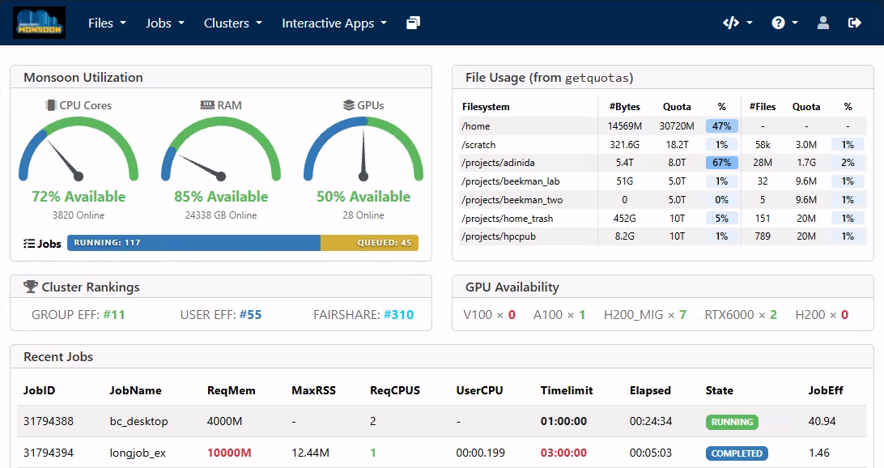
Ondemand
Open Ondemand (OOD) is an interactive Graphical User Interface (gui) to the Cluster. You access it from your web browser at https://ondemand.hpc.nau.edu

Slide 40
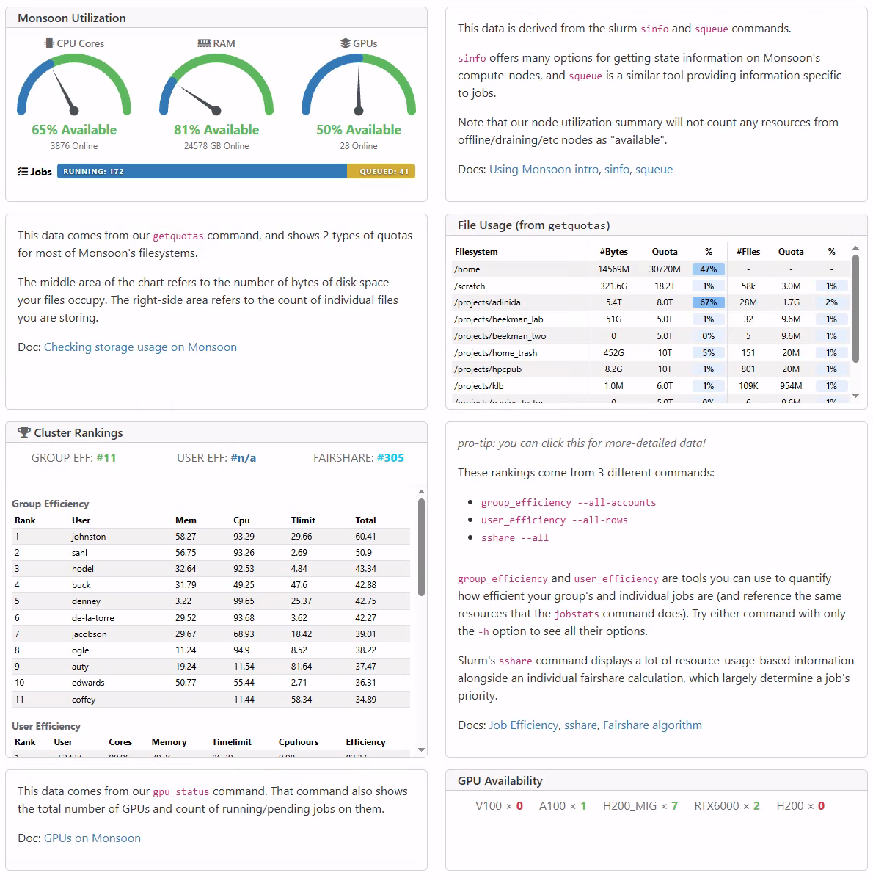
Ondemand’s Dashboard
Metrics on Monsoon and your account
  Available cluster resources & job activity
  Personal filesystem usage & quotas
  Recent job activity (jobstats)
  Job efficiency & fairshare rankings
Most info straight from CLI commands
The extra-info version is linked at the very bottom of the main dashboard!

Slide 41
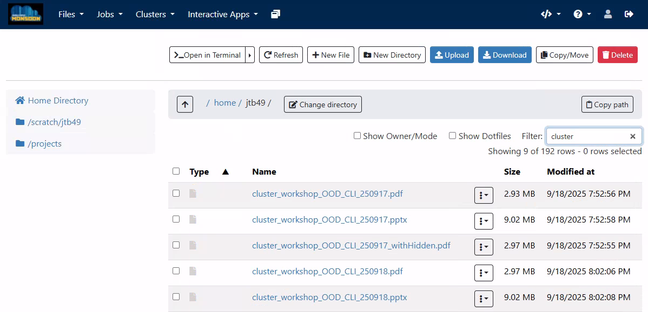
Ondemand’s File Explorer
The file explorer is used to explore, and transfer the files in your home, scratch, or other areas on the cluster.
Notes:
Nb: scratch

Slide 42
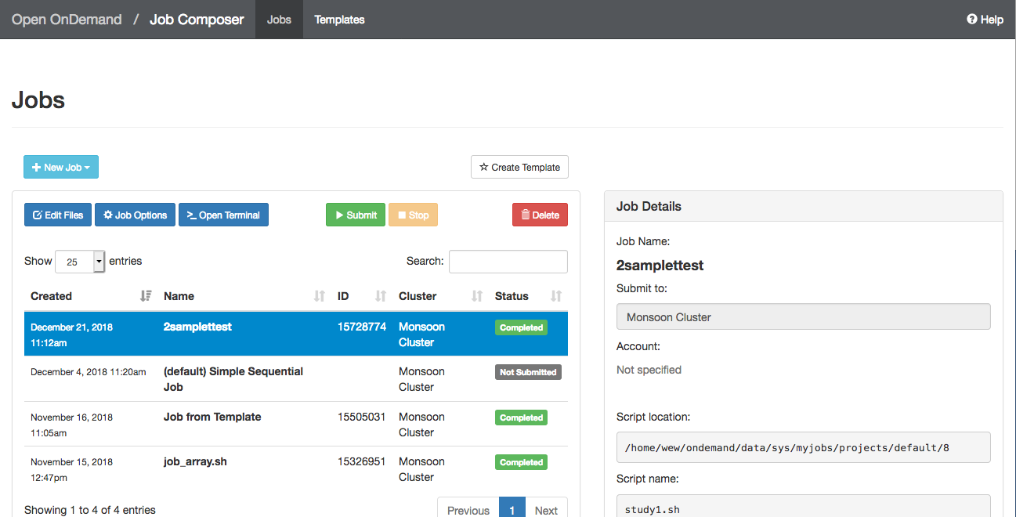
Ondemand Job Composer
The Job Composer can be used to create and run jobs.
Notes:
Composer is just creating text files and
running the “sbatch” command on your behalf!

Slide 43
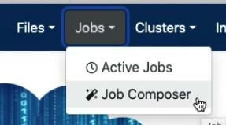
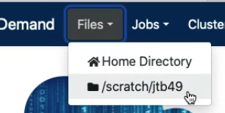
Exercise 1
Create a simple job and run it on the compute nodes
From Ondemand, click the Jobs > Job Composer menu
Click on New Job and select From Default Template
From the bottom of the right-column, click the blue Open Editor button
Change all “NAUID” to be your nau user-ID, e.g.: abc123!
Set your job-name to: “simple”
Set your output location to /scratch/<NAUID>/exercise1.txt
Make your jobscript load the module named “workshop”
Make sure it runs the “date” command (i.e. “srun date”)
Finally, have it run the “exercise1” command, as well
Save (in this tab), and then submit your job via the composer (previous tab)
Use the File Explorer to examine your output (Files > /scratch/NAUID)
Make a note of the secret code written to exercise1.txt
Exercise 1 (CLI)
Notes:
Advanced users can use alternative CLI slide

Slide 44
Exercise 2
Create a new job using New Job > From Template
Select the ‘Long Job’ template, optionally rename it, and click Create New Job
From the Jobs list, select the new draft job, and click Open Editor as before
Change all “NAUID” to be your nau user-ID, again
Make your jobscript load the module named “workshop”
Make your jobscript run the “exercise2” command
  i.e. “srun exercise2”
Make your job sleep for 5 minutes
  i.e. “srun sleep 300” (Sleep is a command that does nothing for N seconds)
Save your jobscript, and submit this job
Monitor your job by selecting Jobs > Active Jobs from your Dashboard
When it has completed, examine the output in long.txt
Make a note of the secret code from long.txt
Exercise 2 (CLI)

Slide 45
Command-line access
Once you have the basics down using Ondemand, then the power of the cluster is exposed through the command-line interface (CLI)
We will be utilizing a CLI built-in to Ondemand
Feel free to tryout the commands we discuss
Reminder: The Monsoon CLI is most commonly accessed via an “ssh client” (ex: Putty on Windows, or via the ssh command in your OS’s PowerShell or Terminal app)
Now open a login-node shell (from the “Clusters” menu) and follow along!
Notes:
A compute node shell does run on a compute node
2hr, 1cpu, 500mb

Slide 46
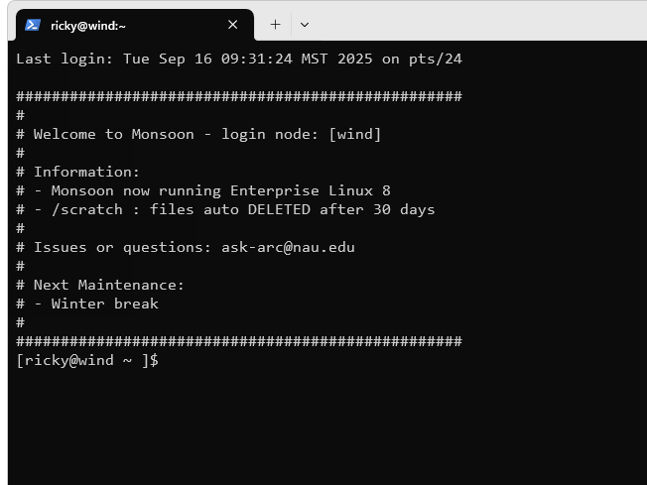
The Ondemand CLI
You may access the Ondemand’s CLI from the dashboard by selecting
Clusters > Monsoon login-node shell
Note: Linux does NOT give interactive feedback when you enter passwords!* But it will evaluate your password attempt upon hitting enter!
Notes:
* = some flavors offer asterisks. Individual programs can do what they want.

Slide 47
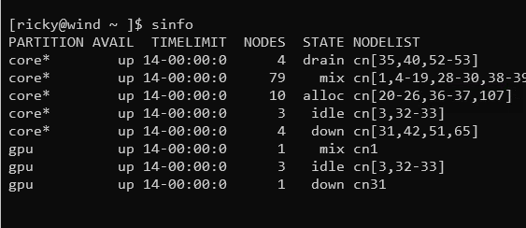
Cluster info
sinfo
  view state information about SLURM nodes and partitions.
sinfo -N -l
  view state and specs on all individual nodes
sinfo -R
  List reasons for downed nodes and partitions
More info:
https://slurm.schedmd.com/sinfo.html
Notes:
*more info*

Slide 48
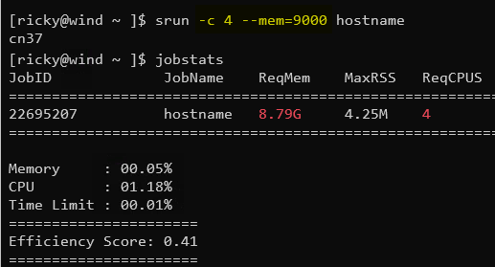
Interactive / Debug Work
Run your compiles and testing on the cluster nodes by:
  srun gcc hello.c –o a.out
  srun --qos=debug -c12 make -j12
  srun Rscript analysis.r
  srun python analysis.py
  Try this now:
    srun hostname
    hostname
More info:
https://slurm.schedmd.com/srun.html
Notes:
ALSO CONSIDER COMPUTE-NODE SHELL
*more info*

Slide 49
Long Interactive work
salloc
  Obtain a SLURM job allocation that you can work interactively with for an extended amount of time
  This is useful for testing/debugging for an extended amount of time
  For when you need more than a single srun but aren’t ready for sbatch
[ricky@wind ~ ]$ salloc -c 8 --time=2-00:00:00
salloc: Granted job allocation 33442
[ricky@wind ~ ]$ srun python analysis.py
[ricky@wind ~ ]$ exit
salloc: Relinquishing job allocation 33442
[ricky@wind ~ ]$ salloc -N 2
salloc: Granted job allocation 33443
[ricky@wind ~ ]$ srun hostname
cn3
cn2
[ricky@wind ~ ]$ exit
salloc: Relinquishing job allocation 33443
More info:
https://slurm.schedmd.com/salloc.html
Notes:
DEFAULT VALS for srun (without salloc first)
Exit will kill your salloc-job, instead of kill session
*more info*

Slide 50
Submitting non-interactive jobs
The sbatch command is used to submit batch jobs to the slurm workload manager. Jobs submitted with sbatch are placed in a queue where they wait for resources to become available.
[ricky@wind ~ ]$ sbatch jobscript.sh
Submitted batch job 6880341
  slurm returns a job id for your job that you can use to monitor or modify constraints
More info:
https://slurm.schedmd.com/sbatch.html
Notes:
*more info*
You’ll use this a lot! starting in Ex4

Slide 51
Monitoring your job
jobstats
  Your main tool
  Show usage stats for slurm jobs
  combines features of scontrol and sacct tools
jobstats -h
  Usage instructions
jobstats -r
  Also show running jobs
jobstats -j <jobid>
squeue
  View information about jobs located in the SLURM scheduling queue.
squeue --start
squeue -u <nauid>
squeue -o "%j %u ..."
squeue -p partitionname
squeue -S sortfield
squeue -t <state> (PD or R)
More info:
https://slurm.schedmd.com/squeue.html
Notes:
*more info*

Slide 52
Monitoring your job
sstat
  Display various statistics and information of a running job
  Only works with jobs where analysis is executed with “srun”
sstat -j <jobid>
sstat -o "AveCPU,AveRSS"
sprio
  View the factors that comprise jobs’ scheduling priority
  Shows only pending by default
sprio -l
sprio -o "%j %u ..."
sprio -w
More info:
https://slurm.schedmd.com/sstat.html
https://slurm.schedmd.com/sprio.html

Slide 53
Controlling your job
scancel
  Used to signal jobs or job steps that are under the control of Slurm.
scancel <jobid>
scancel -n <jobname>
scancel -u <nauid>
scancel -t pending (only yours)
More info:
https://slurm.schedmd.com/scancel.html

Slide 54
Controlling your job
scontrol
  Used to view and modify Slurm configuration and state
  Can change job constraints while it’s in the pending state, but once the job starts, it can no longer be modified
scontrol show job 6880341
  When scheduled to start
  Path to jobscript
  Requested resources
  Target node
scontrol update jobid=6880341 timelimit=4:00:00
More info:
https://slurm.schedmd.com/scontrol.html
Notes:
*more info*

Slide 55
Job Accounting
sacct
  displays accounting data for of your jobs and job steps in the SLURM job accounting log or SLURM database
sacct -j <jobid> -o “jobid,elapsed,maxrss”
sacct -N <nodelist>
sacct -u <nauid>
Try our sacct wrapper “jobstats”
  jobstats -r
  jobstats -j <jobid>
More info:
https://slurm.schedmd.com/sacct.html
Notes:
*more info*

Slide 56
Job Accounting
sshare
  Tool for listing the shares of associations to a cluster.
sshare -l : view and compare your groups cpu minutes usage
sshare -a : view all users fairshare
sshare -a -A <account> : view all members in your account (group)
group_efficiency <account>
More info:
https://slurm.schedmd.com/sshare.html
Notes:
*more info*
Know these slurm-tools exist, but you’ll rarely need them

Slide 57
Account hierarchy
Your user account belongs to a parent faculty account (group)
Your user account shares resources that are provided for your group
Example:
  account1
    user1
    user2
View the account structure you belong to with: “sshare -a –A <account>”
Example:
  sshare -a -A account1

Slide 58
Limits on the account (group)
Limits are in place to prevent intentional or unintentional misuse of resources to ensure quick and fair turn around times on jobs for everyone.
Groups are limited to a total number of resource-minutes in use at one time: 5M CPU-minutes, 64K GPU-minutes*
This resource limit mechanism is referred to as: “TRESRunMins”.
This limiting mechanism has nothing to do with priority!
Notes:
* = this is dynamic +/-

Slide 59
TRESRunMins Limit
What the heck is that!?
A number which limits the total number of remaining resource minutes which your running jobs can occupy.
Enables flexible resource limiting
Staggers jobs
Increases cluster utilization
Leads to more accurate resource requests
Sumofjobs(resource * timelimit remaining)

Slide 60
Examples
14400 = 10 jobs, 1 cpu, 1 day in length
144000 = 10 jobs, 10 cpu, 1 day in length
720000 = 10 jobs, 10 cpu, 5 days in length
720000 = 1000 jobs, 1 cpu, ½ day in length
1105920 = 1 job, 1024 cpus, 18 hrs in length
Questions?
Check your groups resource min usage:
  sshare -l

Slide 61
TRES run minutes (demo)
Say, groupA’s total cpu minute limit is: 5000
Example, groupA submits three jobs
  Job1:
    1 core
    1 day timelimit (1440 minutes)
    1 GB memory
  Job2:
    2 core
    1 days (1440 minutes)
    16 GB memory
    2880 minutes total !
  Job 3:
    1 core
    1 day (1440 minutes)
    1GB memory

Slide 62
TRES run minutes
  Assuming there are available monsoon resources
  How many jobs start?
  How many cpu minutes are in use?
  When is job 3 ELIGIBLE to start?

Slide 63
TRES run minutes
  Assuming there are available monsoon resources
  How many jobs start?
    2
  How many cpu minutes are in use?
    1440+2880 = 4320
  When is job 3 ELIGIBLE to start?
    After ~6 hours (6*60 = 360), and 2 jobs (360*2) = 720 minutes
    We have only 5000-4320 = 680 minutes available initially
    After ~ 1/4 day goes by (360 minutes) * 2 (two jobs) = 720 minutes
    680 + 720 = 1400
    After another 40 minutes we’ll have 1440 at which point job starts

Slide 64
Helpful Linux Commands
List Files | ls With “-l” option (“ls -l”) will show more information
Change Directory | cd <directory path> (e.g.: “cd /scratch/NAUID/”) cd by itself will return you to your home directory
Show/print current working directory | pwd
Copy Files | cp <source> <destination> use a period (“.”) as the destination to copy to your current directory
Move or rename a file | mv <source> <destination>
Delete a file | rm <filename>
Create a directory | mkdir <directory name>
View contents of a file | more <filename> less <filename> cat <filename>
Edit a file | nano <filename> (save=ctrl-o & exit=ctrl-x)
Exit your terminal session (log off) | exit
Notes:
You’ll use these in an upcoming ex

Slide 65
Exercise 3 via CLI
Get to know monsoon and Slurm, on your own. Start by opening a shell to Monsoon.
How many nodes make up monsoon?
  Hint: use “sinfo”
How many nodes are in the gpu partition?
How many jobs are currently in the running state ?
  Hint: use “squeue -t R”
How many jobs are currently in the pending state? Why?
  Hint: use “squeue -t PD”

Slide 66
Exercise 4 via CLI
Copy this job script to your scratch area:
  /common/contrib/examples/job_scripts/lazyjob.sh
Edit that copy: change any “NAUID” to be your id
Save the job script
Submit the job (sbatch lazyjob.sh), it will take 65 sec to complete
Use sstat and squeue to monitor the job
  sstat -j <jobid>, and squeue –u <nauid>
Review the resources that the job used
  jobstats -r
We are looking for “MaxRSS”: MaxRSS is the max amount of memory used
Edit the job scripts memory request (“--mem”): reduce the number of MB of memory being requested, eg:
--mem=600; and resubmit
Use jobstats to review the resources that the optimized job utilized, once again
Ok, memory looks good, but notice that the usercpu is the same as the elapsed time
  Usercpu = num utilized cpus * elapsed time
This is because the application we were running only used 1 of the 4 cpus that we requested
Edit the lazy job script: comment out first srun command, uncomment the second srun command; and resubmit
Rerun jobstats -r, notice now usercpu is multiple times the elapsed time, in this case (4). Because we were allocated 4 cpus, and used 4 cpus.
Now address the egregious time estimate!
Make a note of the secret code from lazy.txt!
Notes:
Please see “helpful linux commands” slide for reference!

Slide 67
Archived Job scripts
Every job script that is submitted to slurm on monsoon is archived for three reasons:
Convenience – if you forget what script was used for what job, you can find out!
Support assistance – we can find the job script that was used in your job to help troubleshoot with you.
Security / stability – in case of any security or stability issues, we can connect issues and outages to associated jobs

Slide 68
Retrieval of a job script
Archived job scripts, and their environment are stored here:
  /common/jobscript_archive/<NAUID>/<year>/<month>
  <job id>.sh – job script
  <job id>.env – job script’s environment
  Only the individual researcher and our support group can access their job scripts
Example:
    User abc123, accessing job id 2600 from March, 2021
    cat /common/jobscript_archive/abc123/2021/03/2600*.sh
    cp /common/jobscript_archive/abc123/2021/03/2600*.sh ~/
Use “showscript” to make it easy!!!!
Notes:
NON LIVE DEMO ON NEXT SLIDE
showscript 10713758
10713758-long.sh
jobstats -S 1/1/24

Slide 69
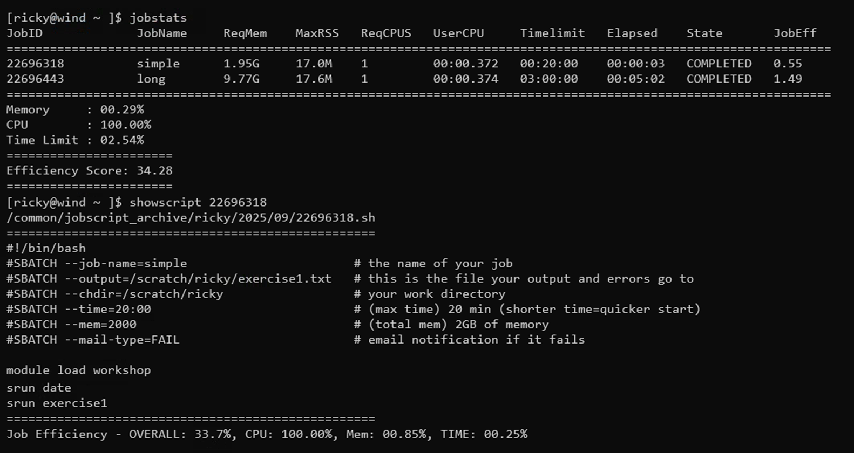
Showscript Demo
Notes:
showscript 10713758
10713758-long.sh
jobstats -S 1/1/24

Slide 70

Checking your disk usage
You can use the “getquotas” command to examine how much space you are using in the various monsoon storage areas

Slide 71
Changing Your Default Account
All researchers have a default slurm account to track usage
See it now by: “sacctmgr show user name=<NAUID>”
Some researchers belong to multiple slurm accounts
Example to override the default:
#SBATCH --account=inf503-fall24
#SBATCH --account=prof_lastname

Slide 72
Confirming Your Account
This is a required step for your account to be fully enabled!
After completing the exercises: one, two, and four, you will have three, 32 character alpha-numeric codes
With the codes in hand, confirm your monsoon account with the commands:
  module load workshop
  confirm_user
More information here:
  https://in.nau.edu/arc/obtaining-an-account/

Slide 73
Optimizing Your Cluster Use
To get the most out of the cluster for yourself and your team, it is important to optimize the settings for your jobs.
Optimization includes memory requested, time for the job to run, number of cpus

Slide 74
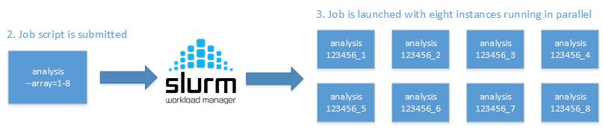
Slurm Arrays!
$SLURM_ARRAY_JOB_ID (%A): the (parent) job-ID
$SLURM_ARRAY_TASK_ID (%a): the ID of (child) job array member n
Notes:
https://rcdata.nau.edu/hpcpub/test/

Slide 75
Slurm Arrays Exercise
From your scratch directory: (“cd /scratch/NAUID”)
tar xvf /common/contrib/examples/bigdata_example.tar
cd bigdata
edit the file “job_array.sh” so that it works with your nau id, replacing all “NAUID” with your own
Submit the script “sbatch job_array.sh”
Run squeue and notice you have 5 jobs running, how did that happen!
Notes:
https://rcdata.nau.edu/hpcpub/test/
WE WILL JUST WALK THROUGH THIS
More time on arrays in advanced topics-pt2

Slide 76
MPI Example
Refer to the MPI example here:
  /common/contrib/examples/job_scripts/mpijob.sh
Edit it, for your work areas, then experiment:
  Change number of tasks, nodes … etc
Also can run the example like this:
  srun --qos=debug –n4 /common/contrib/examples/mpi/hellompi

Slide 77
Keep these tips in mind
Know the software you are running, is it multi-threaded?
Request resources accurately
Supply an accurate time limit for your job
Don’t be lazy, it will affect you and your group negatively

Slide 78
Common Questions
Should I use OnDemand or the command line?
  Power users will tend to use command line
  However, the terminal in ondemand is worth using all the time
Can I use/How should I use AI tools on Monsoon?
  Guidelines: https://in.nau.edu/arc/ai-tool-guidelines
  Data classification: https://in.nau.edu/its/data-classification

Slide 79
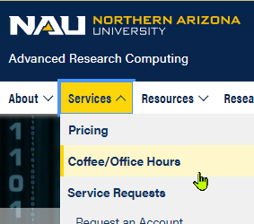
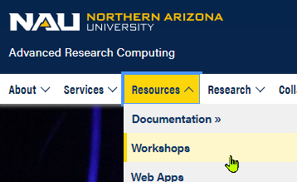
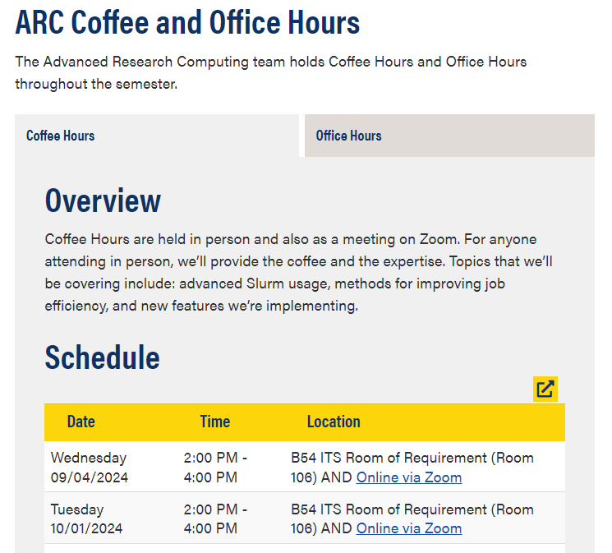
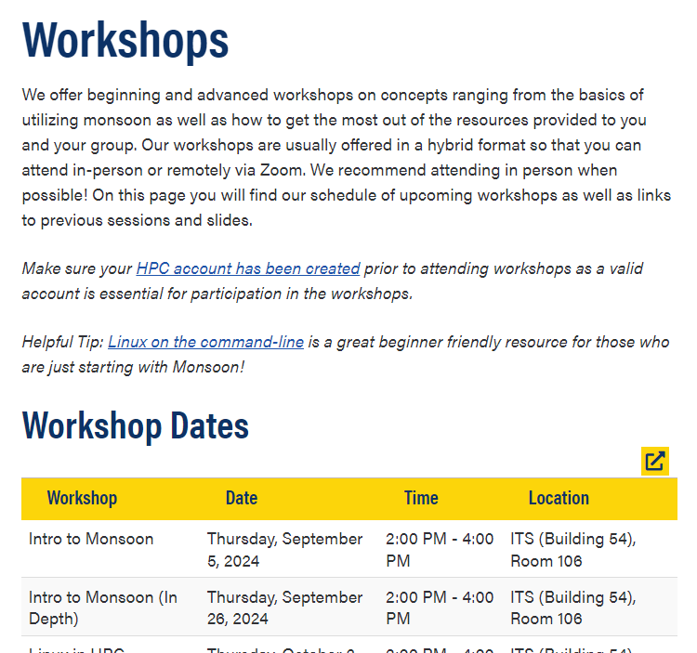
Workshops, Office-, and Coffee-hours!

Slide 80
Question and Answer
More info here:
    http://in.nau.edu/arc
    ask-arc@nau.edu
Job efficiency
  http://metrics.hpc.nau.edu
FREE – Linux command line book:
  http://linuxcommand.org/tlcl.php
  Info here: https://in.nau.edu/arc/external-resources/linux-resources/
And on the nauhpc listserv
  nauhpc@lists.nau.edu

Slide 81
Exercise 1 (CLI)
Create a simple job and run it on the compute nodes
cp /common/contrib/examples/job_scripts/exercise1.sh ~/
nano exercise1.sh (or another editor)
Change all “NAUID” to be your nau user-ID, e.g.: abc123!
Set the name of your job (--job-name) to “simple”
Set your --output path to be /scratch/<NAUID>/exercise1.txt
Make your jobscript load the module named “workshop”
Make your jobscript run the “date” command (i.e. “srun date”)
Finally, have it run the “exercise1” command, as well
Save the file (for nano: ctrl-x, and y(es))
Submit the batch script to slurm: sbatch exercise1.sh
Make a note of the secret code written to exercise1.txt
Next Slide: Exercise 2 (CLI)

Slide 82
Exercise 2 (CLI)
cp /common/contrib/examples/job_scripts/exercise2.sh ~/
nano exercise2.sh (or another editor)
Change all “NAUID” to be your nau user-ID, e.g.: abc123!
Set your --output path to be /scratch/<NAUID>/long.txt
Make your jobscript load the module named “workshop”
Make, have it run the “exercise2” command (i.e. “srun exercise2”)
Finally, make your job sleep for 5 minutes
  i.e. “srun sleep 300” (Sleep is a command that does nothing for N seconds)
Save the file (for nano: ctrl-x, and y(es))
Submit the batch script to slurm: sbatch exercise2.sh
When it has completed, examine the output in long.txt
Make a note of the secret code from long.txt
Next Slide: Command Line Access

