Slide 1
> Linux command-line for HPC
10/3/2024 presented by Jason Buechler
Slides > https://rcdata.nau.edu/hpcpub/workshops/linux.pdf

Slide 2
Outline
What is Linux? (3 slides)
Let’s get started: The command-line (3 slides)
Intro to the shell (4 slides)
Navigating the file-system (10 slides + 1 demo + 1 exercise)
Managing files (3 slides + 1 demo + 1 exercise)
Dealing with text (4 slides + 1 exercise)
Dealing with processes (2 slides + 1 demo + 1 exercise)
Advanced stuff (6 slides)

Slide 3
Introductions
Introduce yourself
Name
Department / Group
Linux or Unix experience

Slide 4
What is Linux?
Linux is a computer operating system like Mac OS or Windows
Keep in mind: an operating system is (much) more than the user-interface
It is an open-source operating system where the defining piece is the Linux kernel which was developed by Linus Torvalds in 1991
Linus + UNIX = Linux
The Linux operating system is:
Linux kernel, and
Open-source, and
More open-source software

Slide 5
Unix architecture layers
Engine/ Drivetrain/ Wheels
Linkages/ Steering/ Electrical
Wheel/ Pedals/
Gearing
Driver
Notes:
Like a car: drivetrain → linkages & wiring → driver controls → driver

Slide 6
Vehicle analogy
Engine/ Drivetrain/ Wheels
Linkages/ Steering/ Electrical
Wheel/ Pedals/
Gearing
.
.
Driver
Notes:
Like a car: drivetrain → linkages & wiring → driver controls → driver

Slide 7
Linux continued
Linux powers businesses, universities, the internet, and HPC clusters.
Linux powers 100% of the top 500 HPC clusters in the world
http://www.top500.org/statistics/details/osfam/1
HPC is the future of computing
A hint of what will be on your desktop, or your hand, in 10 years
HPC is built on linux, so futureproof your skills by learning linux skills early!

Slide 8
Let’s get started: The command-line
Most user applications use a GUI, but this workshop uses a text-based “shell” to interface with the operating system
Shell commands (i.e. what you type) will be colored like this
<pointy brackets> indicate values that will vary by person/choice
Your computer’s front-end interface “app”
Mac OS – Use Terminal (Applications > Utilities > Terminal)
Windows – Use Powershell (or Putty if you prefer)
More info: https://in.nau.edu/arc/overview/connecting-to-monsoon

Slide 9
Logging in
You must first be on the NAU network, or NAU VPN
Open Terminal (on Mac) or Powershell (on Windows)
Use the ssh command to connect to Monsoon
ssh <NAUID>@monsoon.hpc.nau.edu
Classroom students: replace monsoon with rain
You’ll be prompted to accept a SSH key, type Y.
Type your LOUIE password & hit Enter
NOTE: no *’s or characters are printed! (no visual feedback for passwords)
Notes:
Ssh key prompt -> This happens only once per host, per local workstation

Slide 10
I’m logged in, now what?
You should see a “prompt” like this:
[<NAUID>@wind ~ ]$
You are now “on” one of Monsoon’s login nodes, in this case “wind”
or rain, for classroom students
Note that the login nodes are not meant for heavy processing, they are solely for:
Editing / submitting job scripts
Moving data to/from monsoon
Trivial debug work (short tests of <=30 min)

Slide 11
Intro to the shell
The shell is how you interact with Linux
It’s just a program (analogous to Finder/explorer.exe)
A user types commands “into” the shell
The shell sends them to the kernel, where the work is done
Result: text is printed to the screen and/or to a file
The Linux shell used in this course is called “bash”
One can see what shell they’re in/using
echo $SHELL

Slide 12
Interacting with the shell
There is no mouse, so we must use the keyboard keys!
Arrow keys
left/right: moves cursor across text when entering commands
up/down: iterate through previous shell commands
TAB to complete typing (one) matching filename, directory, or cmd
TAB-TAB to show multiple matching expansions
control-c to interrupt any program

Slide 13
Try some commands out
pwd - print working directory (where you currently sit)
id - this is your user id, and the groups you belong to
ls - list files in the current directory, (try “ls -l” too)
w - who’s logged in today, system load, and uptime
getquotas - report your quota
date - get the current date and time
echo - print a message, e.g. echo “hello world”
Try a few (now!), then use the up arrow to check out your history!

Slide 14
About options (flags)
Most linux commands accept extra options or “flags”
ls -a (list all files, including hidden ones)
ls -l (list files, as a table with lots of details)
ls -t (list files, and sort by modification time)
Combine options one after another
Order usually does not matter
ls -a -l == ls -l -a (list all files, with details)
Flags are usually specified after a dash “-”, or double-dash “--”
Single-dash flags can often be combined
ls -alt (list all files, long listing, sort by time)

Slide 15
Navigating the file-system
In Windows and Mac OS, the GUI has informative windows
displays what folder you’re looking in
offers controls to change how the contents are displayed
double-clicking a folder views that different folder
To navigate the system via our shell, we will use:
pwd – print working directory (compare with the prompt!)
ls – list files in current/a directory
cd – change directory

Slide 16
Demonstration: Navigating the filesystem
To navigate the system we will use:
pwd – print working directory (compare with the prompt!)
ls – list files
ls , ls .. , ls ~ , ls <dir> , ls <dir/subdir>
cd – change directory
cd , cd .. , cd ~ , cd <dir> , cd <dir/subdir>

Slide 17
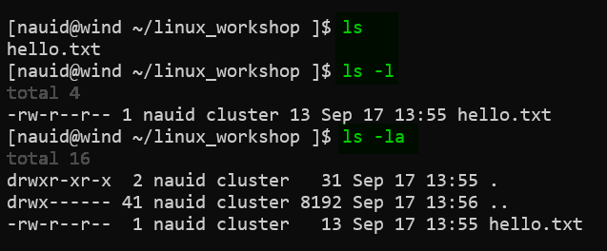
List files using extra options
[NAUID@wind ~/linux_workshop ]$ ls
hello.txt
[NAUID@wind ~/linux_workshop ]$ ls -l
total 4
-rw-r--r-- 1 NAUID cluster 8 Sep 22 13:56 hello.txt
[NAUID@wind ~/linux_workshop ]$ ls -la
total 24
drwxr-xr-x 2 NAUID cluster 4.0K Sep 22 13:56 .
drwx------ 234 NAUID cluster 8.0K Sep 16 13:06 ..
-rw-r--r-- 1 NAUID cluster 8 Sep 22 13:56 hello.txt

Slide 18
Listing files: dot-files
Note the funny looking filenames there:
[NAUID@wind ~ ]$ ls -la
drwx------ 2 NAUID cluster 4096 Sep 22 13:56 .
drwxr-xr-x 234 root root 8192 Sep 16 13:06 ..
-rw-r--r-- 1 NAUID cluster 213 Jul 11 2014 .bashrc
File names that begin with a “.” are (usually) hidden.
“.” is the current directory
“..” is the parent directory
.bashrc is a hidden bash configuration file

Slide 19
Listing files: relative hierarchy
$ tree -F /home/billy/jobs
/home/billy/jobs
├── 2023/
│ ├── q1/
│ ├── q2/
│ │ └── jobs_april.txt
│ ├── q3/
│ └── q4/
├── 2024/
│ ├── q1/
│ ├── q2/
│ └── q3/
│ └── jobs_july.txt
├── file1
└── file2
[billy@rain ~ ]$ cd ~/jobs
[billy@rain ~/jobs ]$ ls
2023 2024 file1 file2
[billy@rain ~/jobs ]$ ls 2023
q1 q2 q3 q4
[billy@rain ~/jobs ]$ ls ./2024
q1 q2 q3
[billy@rain ~/jobs ]$ cd 2024
[billy@rain ~/jobs/2024 ]$ ls ../
2023 2024 file1 file2
[billy@rain ~/jobs/2024 ]$ ls ../2023/q2
jobs_april.txt
cd /home/billy/workshop
ls 2023
q1 q2 q3 q4
ls ./2023/
q1 q2 q3 q4
cd 2024
ls ../
2023 2024 file1 file2
ls ../2023/q2
jobs_april.txt

Slide 20
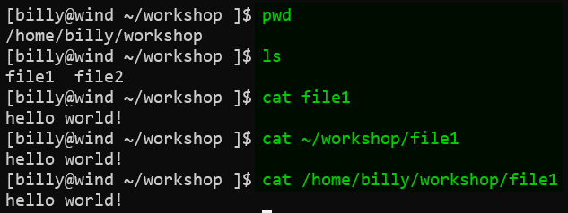
Absolute vs relative paths
File/dir locations can be absolute or relative
Absolute paths start with “/” (“~” = “/home/nauid”)
Relative paths are just filenames, or start with “.” or “..” or a directory
* Note that Linux filesystems are CASE SENSITIVE with regard to almost everything!!
* Also: not recommended to have spaces in filenames and directory names! It can be a pain.
Same result now… …buuuuut after cd’ing elsewhere?

Slide 21
More commands
cat <file> - print contents of a file to the screen
file <file> - print the type of a file: ascii, dir, symlink,…
mkdir <dirname> - create a directory name ”dirname”
rmdir <dirname> - remove a directory named “dirname”
rm <filename> - remove a file
cd <dirname> - “open” directory “dirname”
touch <file> - create an empty file, or update modified timestamp
less <file> - view a file with a useful interactive viewer
man <command> - view the manual for a command (“q” to exit)

Slide 22
Lab 1 – directory structure
Print your working directory, where you are currently (pwd)
List the contents of the directory you are in (ls)
Create a directory in your home directory named “linux” (mkdir)
Change directory to the new directory “linux” (cd)
Create a directory named “is” inside of the linux directory (mkdir)
Change directory to the “is” directory (cd)
Create a file in the ”is” directory named “awesome” (touch)
Change directory back to your home (cd)
Do a recursive listing on the “linux” directory: ls –lR linux
Try this and note changes: ls –lR linux | grep –v total

Slide 23
Lab 1 - Solution
[NAUID@wind ~ ]$ ls -lR linux
linux:
total 0
drwxr-xr-x 2 NAUID cluster 28 Sep 21 14:20 is
linux/is:
total 0
-rw-r--r-- 1 NAUID cluster 0 Sep 21 14:20 awesome

Slide 24
Wildcards
While in the shell, you can select files/directories based on wildcards
? - matches any 1 character
* - matches 0, or 1, or more characters
Note that this may not work within interactive programs
Programs like Matlab or R (etc…) have shells with their own rules

Slide 25
Wildcard Examples
While in the shell, you can specify files/directories based on wildcards
Multiple wildcards can be specified at once
ls *.txt - lists all files/folders that end in “.txt”
ls lin* - lists all files/folders that start with “lin”
ls *2024* - lists all files/folders with “2024” in their name
ls 20?4-fall* - list 2014-fall.pdf, 2014-fall.txt, 2024-sum.txt, etc

Slide 26
Demonstration: Bash basics & wildcards
“cd” to the /common/contrib/tutorials/linux directory
List all the filenames that end with “.pdf”
List all the files that have the exact string “ADIOS” in their name
List all the files in your home (~) directory from here
“cd” to your home directory
Show the sizes of all files in the first directory with ‘Tol’ in their name

Slide 27
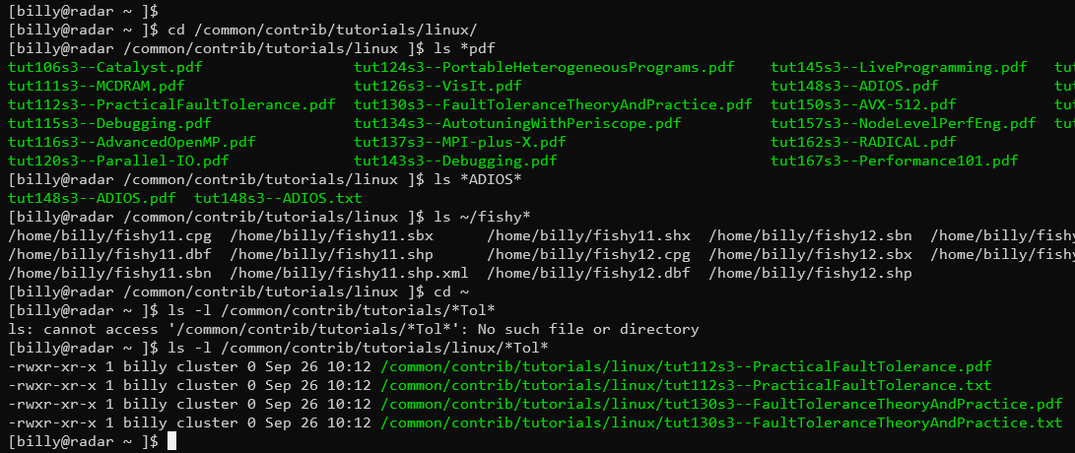

Slide 28
Lab 2 – Wildcards Solutions
[NAUID@wind ~ ]$ cd /common/contrib/tutorials/linux
[NAUID@wind /common/contrib/tutorials/linux ]$ ls *.pdf
tut106s3--Catalyst.pdf tut143s3--Debugging.pdf
tut111s3--MCDRAM.pdf tut145s3--LiveProgramming.pdf
tut112s3--PracticalFaultTolerance.pdf tut148s3--ADIOS.pdf
tut115s3--Debugging.pdf tut150s3--AVX-512.pdf
tut116s3--AdvancedOpenMP.pdf tut157s3--NodeLevelPerfEng.pdf
tut120s3--Parallel-IO.pdf tut162s3--RADICAL.pdf
tut124s3--PortableHeterogeneousPrograms.pdf tut167s3--Performance101.pdf
tut126s3--VisIt.pdf tut168s3--InfiniBand-HighSpeedEthernet.pdf
tut130s3--FaultToleranceTheoryAndPractice.pdf tut170s3--OpenFabrics.pdf
tut134s3--AutotuningWithPeriscope.pdf tut171s3--BigDataOnClusters.pdf
tut137s3--MPI-plus-X.pdf tut173s3--PowerAwareHPC.pdf
[NAUID@wind /common/contrib/tutorials/linux ]$ ls *ADIOS*
tut148s3--ADIOS.pdf tut148s3--ADIOS.txt

Slide 29
Review: Navigating the file-system
To navigate the system we can use use commands like:
cd move into/open a directory
pwd print current directory (that you’re in)
ls print contents of a/current directory
rm remove (delete) a file
To get more/varied output from your commands:
Some commands accept/require “input” args (e.g. cd some_dir)
Most commands offer “options” (e.g. ls -a)
File/dir locations can be absolute or relative
Absolute paths start with “/”
Relative paths are just filenames, or start with “.” or “..” or “~” or a directory
Notes:
Absolute/relative → earlier slide

Slide 30
Managing Files:
Interpreting ls -l details
Permissions and ownership
Moving, copying, deleting files (and directories)

Slide 31
Managing Files: File permissions
drwxr-xr-x 2 NAUID cluster 28 Sep 21 14:20 linux
1 2 3 4 5 6 7
1. The mode and type of the file, in this case a “d” (directory), mode 755
From left to right: Type,User,Group,Other
Type is directory (d) (could also be “-” (file), “l” (link), others)
User has read (r), write (w), and execute (x)
Group has read (r) and execute (x)
Other has read (r) and execute (x)
2. Number of hardlinks (you can kinda forget about this)
3 & 4. The owning-user and owning-group
5. Size of the file in bytes
6. The date, of last modified
7. The name of the file or directory
 | (4=2²) read + | (2=2¹) write + | (1=2⁰) exec = | bits
user | 4 + | 2 + | 1 = | 7
group | 4 + |  | 1 = | 5
other | 4 + |  | 1 = | 5
= “mode” 755

Slide 32
Changing file permissions
Default permissions for files and directories:
File: rw- for owning-user, r-- for group, and r-- for others
Directory: rwx for owning-user, r-x for group, and r-x for others
Change owner/owner-group
chown billy some_file
chown :SICCS-Beekman-lab some_file
Change mode (permissions)
chmod g+rw some_file – add read and write for group
chmod +x some_file – add execute to a file, for user,group,other

Slide 33
Managing files: commands
cp file target - make a copy (“target”) OR copy INTO directory “target”
If “target” is an existing directory, “cp” assumes you want a same-name copy there
mv file target - move “file” to directory “target” OR rename to “target”
If “target” is an existing directory, “mv” assumes you want to move “file” there
touch file - create empty file, or update time stamp
rmdir dir - remove (empty, only!) directory
mkdir dir - make directory
rm file - remove file
rm -f file - force removal of file/directory (no verify prompt)
rm -r dir - recursively remove a directory
rm –rf dir - force remove recursively (CAUTION!!!!)

Slide 34
Demonstration: Operating on multiple files
cp * works like ls *
(Not) Including “hidden” dot-files (!!)
Multiple sources -> single target
Recursive copy for directories
Forcing deletions
Deleting non-empty directories

Slide 35
Lab 2 – Editing/moving files
Change directory to the linux/is directory (cd)
Rename the file “awesome” to be “best” (mv)
Make a directory in the “is” directory named “the” (mkdir)
Move the “best” file to the “the” directory (mv)
Edit the “best” file, with contents “of course!” (nano, emacs, vi)
Copy the “best” file to the “is” directory, naming it “fun” (cp)
Find out what type of file ”fun” is (file)
Print the contents of the “fun” file (cat)
*BONUS* Make the file hidden

Slide 36
Lab 2 – Editing/moving files Solutions
[NAUID@wind ~ ]$ cd linux/is
[NAUID@wind ~/linux/is ]$ mv awesome best
[NAUID@wind ~/linux/is ]$ mkdir the
[NAUID@wind ~/linux/is ]$ mv best the
[NAUID@wind ~/linux/is ]$ cd the
[NAUID@wind ~/linux/is/the ]$ nano best
[NAUID@wind ~/linux/is/the ]$ cd ..
[NAUID@wind ~/linux/is ]$ cp best fun
[NAUID@wind ~/linux/is ]$ file fun
fun: ASCII text
[NAUID@wind ~/linux/is ]$ cat fun
of course

Slide 37
Dealing with text (and text-data)
It’s all text! Everywhere!
Text editors
Pagers for viewing large files (most notably: “man” manuals)
Not all screen text is equal
Intended command output =/= error output
Redirecting command output
…into new files, or appending to existing
…directly into another command (no intermediate file!)
Finding and isolating specific file-contents

Slide 38
Editors (vs text-pagers)
Lots of editors:
nano
Simple to use
Onscreen “menu”
vi, vim, emacs
more featureful
have learning curves
Start out using nano:
ctrl-o: save (“O” as in write-Out)
ctrl-x: exit (AND prompt to save)
Pagers (text-pagers):
Fill a different role than editors
How you read “manual pages”
less
arrow keys navigate (PgUp/PgDn also)
h enter help screen
q exit
/ start a search
n: next result
N: prev result

Slide 39
Redirecting Input and Output
Default system streams
stdin/stdout/stderr = File Descriptors 0/1/2
> Redirects output to another file, overwriting if it exists
>> Appends to a file
2>&1 Redirects error messages to standard output
&> Redirects stdout, and stderr to a file
| (vertical bar) Redirects (“pipes”) output from one program to another’s input (more on this later)

Slide 40
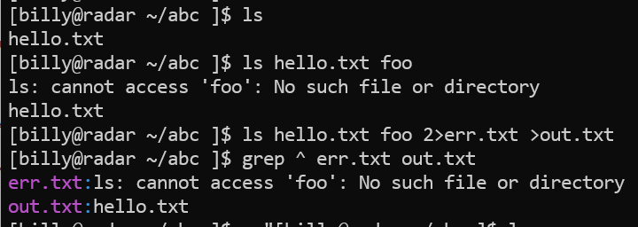
Redirection Examples
ls > out.txt - sends output from ls to “out.txt” file
ls >> out.txt - appends output from ls to “out.txt”
ls foo 2> error.txt - sends only errors to ”error.txt”
ls foo &> out.txt - writes output and errors to out.txt
ls | wc -l - send output from ls to the wc (wordcount) program and counts lines

Slide 41
Lab 3 [guided] – Editing files
cd ~/linux
nano grepfile.txt (enter this text, then ctrl-x)
Hello world!
The world is a big place.
Try: grep place grepfile.txt
Try: grep –v world grepfile.txt (“-v” will invert results)
Use grep recursively to find a term in any files nested within directories
[NAUID@wind ~/linux ]$ grep -r course *
is/the/best:of course!
is/fun:of course!

Slide 42
Lab 3 [guided] – continued
Remember the | symbol (pipe)?
We can redirect the output of one command to the input of another
Let’s add a few lines to our grepfile.txt so it looks like this:
Hello world!
The world is a big place
test 1
test 2
testing 3
We can grep for test, and pipe the output to grep for the character “2”
[NAUID@wind ~/linux ]$ grep test grepfile.txt
test 1
test 2
testing 3
[NAUID@wind ~/linux ]$ grep test grepfile.txt | grep 2
test 2

Slide 43
Lets do some simple data mining
Use grep to search a file and return all instances of a string of text
grep world grepfile.txt
…should return 2 lines, whereas just 1 is returned from…
grep place grepfile.txt
Use grep recursively to look for instances of a word in nested directories and files
From our “linux” directory, we can find all instances of the word “course” we wrote earlier…
[NAUID@wind ~/linux ]$ grep -r course *
is/the/best:of course!
is/fun:of course!

Slide 44
More data mining
With grep you can invert your selection as well
[NAUID@wind ~/linux ]$ grep world grepfile.txt
Hello world!
The world is a big place
Vs
[NAUID@wind ~/linux ]$ grep -v big grepfile.txt
Hello world!

Slide 45
Dealing with processes
It’s all text! Everywhere! …so how do I close/cancel something?
ps and top list running processes
kill ends a running process (of yours)
Ctrl-c to “force quit” an active process (usually)

Slide 46
Processes
top – Real-time view all running processes on this login-node
akin to task manager in windows
Hotkey “u” – show only one user’s processes
Hotkey “k” – kill a process (use ESC key to cancel)
Hotkey “q” immediately exits
ps – Shows current processes
The “ps -u” option has a more useful format, including cpu %
kill <process id> – Terminates a running process (if you are the owner of the process)

Slide 47
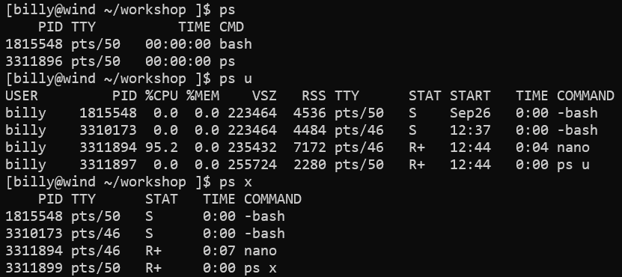

Slide 48
Demonstration: Processes
Run the top program to view all processes currently running. Alternatively, you can run ps for a one-time snapshot, and top –u <userid>
Look for your sleep process in the list. Specifically, look at the first column labelled “PID”. This means “process id”. Take note of your sleep process’s PID
Press q to quit top and get back to the terminal
Type kill <PID> where PID is your sleep process PID. This will end the sleep process

Slide 49
Lab 4 – Pipes and Processes
Start a new process by running sleep for 999 seconds (sleep)
Open another shell and cd to ~/linux again
Find the PID of your sleep process using ps and grep
Kill your sleep process (kill)
Verify your process is gone by running your previous ps and grep command
Do a long recursive listing of your linux directory, filter the results so only filenames with the word “best” are returned, and send the output to a file called results.txt (ls, grep, > )
List the contents of “results.txt” to verify the results (cat)
Remove the file “results.txt” (rm)

Slide 50
Lab 4 – Pipes and Processes Solutions
NAUID@wind:~/linux$ sleep 999
NAUID@wind:~/linux$ ps | grep sleep
46396 pts/0 00:00:00 sleep
NAUID@wind:~/linux$ kill 49396
[1]+ Terminated: 15 sleep 999
NAUID@wind:~/linux$ ps | grep sleep
NAUID@wind:~/linux$ ls -alR | grep best > results.txt
NAUID@wind:~/linux$ cat results.txt
-rw-r--r-- 1 NAUID cluster 11B Oct 22 11:45 best
NAUID@wind:~/linux$ rm results.txt

Slide 51
Some more-advanced stuff!
Variables
Command substitution:
getting output into a variable
nesting one command within another!
Loops
(Soft-) Links

Slide 52
Variables
Set your own variables: MYVAR=1234
Un-set a variable: unset MYVAR
Use existing variables by prepending them with $
echo “$MYVAR” to display variable contents
Best practice is to use double-quotes with echo
But note that single-quotes prevent variable expansion

Slide 53
Variables - Example
$ MYVAR="this is my variable"
$ echo $MYVAR
this is my variable
$ echo '$MYVAR'
$MYVAR
$ unset MYVAR
$ echo $MYVAR
$

Slide 54
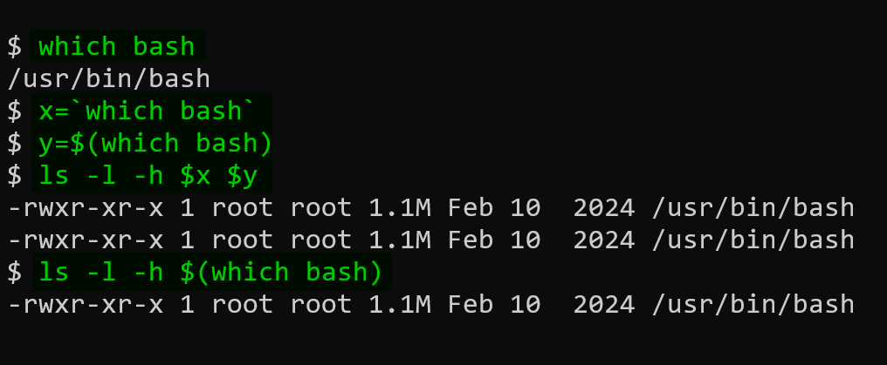
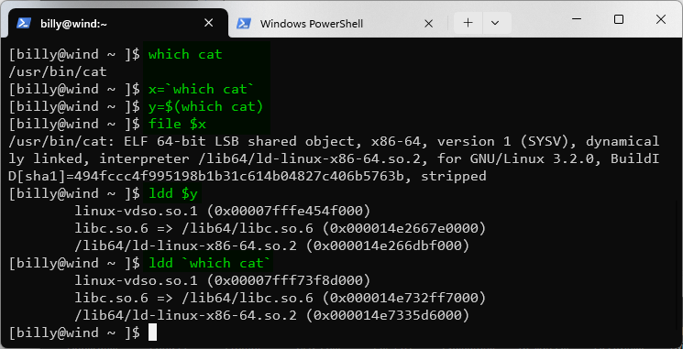
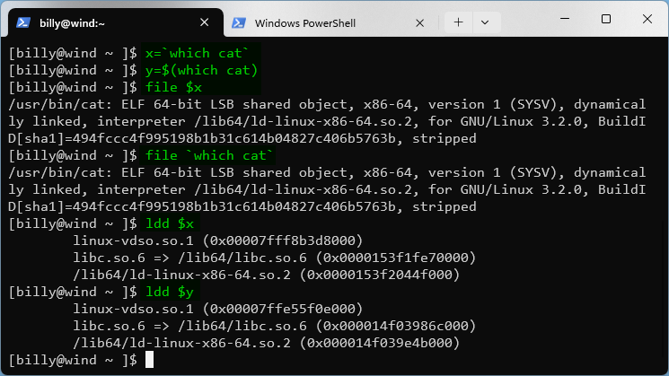
Command substitution
It is possible to imbed command results within a command
file `which cat`
[NAUID@wind ~/linux ]$ file `which cat`
/bin/cat: ELF 64-bit LSB executable, x86-64, version 1 (SYSV) …
ldd $(which cat)
[NAUID@wind ~/linux ]$ ldd $(which cat)
linux-vdso.so.1 => (0x00007fff6d5d4000)
libc.so.6 => /lib64/libc.so.6 (0x0000003c20000000)
/lib64/ld-linux-x86-64.so.2 (0x0000003c1f800000)

Slide 55
Loops: simple one-liners
One-line loop over “words”
$ for i in red blue green; do echo “$i is a color”; done
red is a color
blue is a color
green is a color
One-line loop over consecutive numbers
$ for c in `seq 1 10 21`; do echo “count is $c”; done
count is 1
count is 11
count is 21
Use a custom variable, e.g. i and reference it with the $ sign, just like any other variable

Slide 56
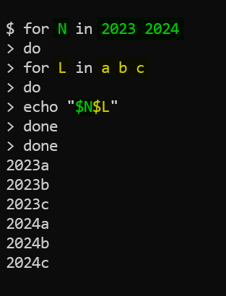
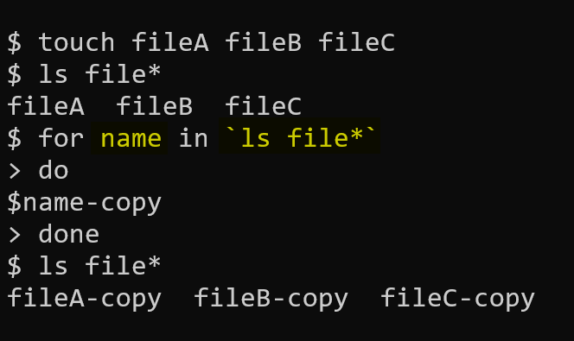
Loops: multiline & nested

Slide 57
Soft links
We will focus on soft links for now; just know there are hard links too
Soft links (AKA: symbolic links) are the most common type of links that you will use/encounter
ln -s <existing_file> <symlink_name>
Basically same as ‘shortcuts’ in Windows, or ‘aliases’ in Mac OS
$ ln -s /scratch/NAUID /home/NAUID/scratch_link
$ cd ~
$ ls –l scr*
lrwxrwxrwx 1 NAUID cluster 4 Sep 22 10:15 scratch_link -> /scratch/NAUID

Slide 58
Questions?
Lots more to Linux
Try this book out for more:
http://linuxcommand.org/tlcl.php
Refer to the advanced workshop!
link / calendar /etc
Notes:
Include ask-arc@nau.edu

Slide 59
Questions?
Lots more to Linux
Try this book out for more:
http://linuxcommand.org/tlcl.php
ARC webpage
Ex 1
Ex 2
Udemy? (need to find if there’s compact / easy ones)
Refer to the advanced workshop! → link / calendar /etc

Slide 60
Controlling Your Environment
~/.bashrc file controls your bash environment settings
Note that due to the dot at the beginning, this is a hidden file
Contents of the file get run each time you start a terminal session
NOTE: This means that edits to the file will not go into effect until you “source” the script or log off and then log back in
Allows you to set persistent variables for every session
export MYVAR=10
Allows you to create short custom names or “aliases” for complex or long commands
alias sq=“squeue”
Now when you type sq, you will get the same results as typing squeue
alias sj=“scontrol show job”

Slide 61
Simple Text manipulation
sed is a command that allows you to perform manipulations to text without the need of a text editor and the patience to tediously do the edits yourself.
To perform a text substitution:
sed ‘s/oranges/apples/’ commafile (changes go to stdout)
sed –i ‘s/oranges/apples/’ commafile (in place)
sed ‘s/oranges/apples/’ commafile > output.txt (redirect to new file)
Notice that it replaced all instances of oranges with apples!
Additionally, sed can take a stream of files as input and perform the same operations over all the files -- yet another advantage over your standard text editor.
sed ‘s/oranges/apples’ commafile1 commafile2 commafile3

Slide 62
Processes
top – Real-time view all running processes, akin to task manager in windows (for color, try htop)
kill <process id> - Terminates a running process (if you are the owner of the process)
ps - Shows current processes
ctrl-z – sends a process to the background
ctrl-c – ends a running process in the foreground
bg – lists processes running in the background
fg – brings background processes to the front

Slide 63
Guided Exercise – Processes Part 1
Lets create a process. Run the command sleep 500. This will cause your cursor to disappear until the process is finished.
Press ctrl-z to put the sleep process in the background, allowing you to regain control of your terminal.
Type jobs. You should see your sleep program listed as a current background process in the stopped state.
Type bg, your process will then begin running in the background
Type jobs. You should see your sleep program listed as a current background process in the running state.
Type fg. Your sleep process will now regain control of your terminal. Press ctrl-c to end the current process.
Press Ctrl-z and bg to return your process to the background.

Slide 64
Guided Exercise – Processes Part 2
Run the top program to view all processes currently running. Alternatively, you can run ps for a one-time snapshot, and top –u <userid>.
Look for your sleep process in the list. Specifically, look at the first column labelled “PID”. This means “process id”. Take note of your sleep process’s PID.
Press q to quit top and get back to the terminal.
Type kill <PID> where PID is your sleep process PID. This will end the sleep process.
Press jobs again to view background processes. There should be none.

