Slide 1
> Linux command-line for HPC
3/31/2025
presented by Jason Buechler
Slides > https://rcdata.nau.edu/hpcpub/workshops/linux.pdf
Notes:
3/31/2025=material as presented
9/15/25=FORMAT EDITS

Slide 2
Outline
What is Linux? (3 slides)
Let’s get started: The command-line (3 slides)
  Intro to the shell (4 slides)
  Navigating the file-system (10 slides + 1 demo + 1 exercise)
  Managing files (3 slides + 1 demo + 1 exercise)
Dealing with text (4 slides + 1 exercise)
Dealing with processes (2 slides + 1 demo + 1 exercise)
Advanced stuff (6 slides)

Slide 3
Introductions
Introduce yourself
  Name
  Department / Group
  Linux or Unix experience

Slide 4
What is Linux?
Linux is a computer operating system like Mac OS or Windows
  Keep in mind: an operating system is (much) more than the user-interface
It is an open-source operating system where the defining piece is the Linux kernel which was developed by Linus Torvalds in 1991
  Linus + UNIX = Linux
The Linux operating system is:
  Linux kernel, and
  Open-source, and
  More open-source software

Slide 5
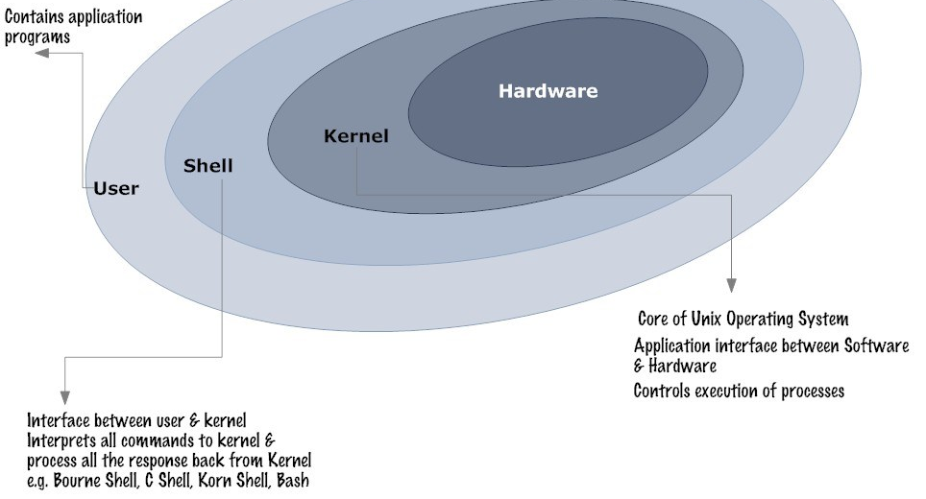
Unix architecture layers
Engine/
Drivetrain/
Wheels
Linkages/
Steering/
Electrical
Wheel/
Pedals/
Gearing
Driver
Notes:
Like a car: drivetrain → linkages & wiring → driver controls → driver

Slide 6

Linux continued
Linux powers businesses, universities, the internet, and HPC clusters.
Linux powers 100% of the top 500 HPC clusters in the world
http://www.top500.org/statistics/details/osfam/1
HPC is the future of computing
  A hint of what will be on your desktop, or your hand, in 10 years
HPC is built on linux, so futureproof your skills by learning linux skills early!

Slide 7
Let’s get started: The command-line
Most user applications use a GUI, but this workshop uses a text-based “shell” to interface with the operating system
  Shell commands (i.e. what you type) will be colored like this
  <pointy brackets> indicate values that will vary by person/choice
Your computer’s front-end interface “app”
  Mac OS – Use Terminal (Applications > Utilities > Terminal)
  Windows – Use Powershell (or Putty if you prefer)
  More info: https://in.nau.edu/arc/overview/connecting-to-monsoon

Slide 8
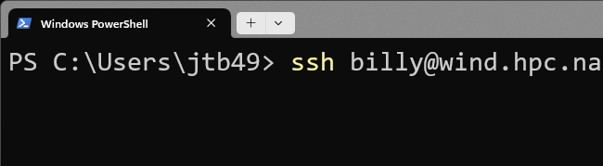
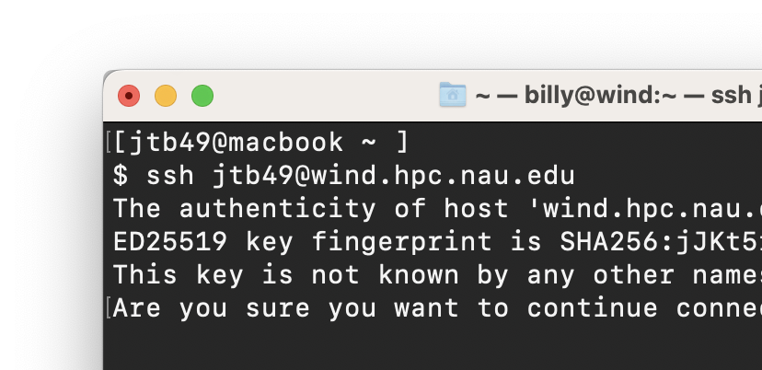
Logging in
You must first be on the NAU network, or NAU VPN
Open Terminal (on Mac) or Powershell (on Windows)
Use the ssh command to connect to Monsoon
    ssh <NAUID>@monsoon.hpc.nau.edu
    Classroom students: replace monsoon with rain
You’ll be prompted to accept a SSH key, type Y.
Type your LOUIE password & hit Enter
NOTE: no *’s or characters are printed!
(no visual feedback for passwords)
Notes:
Ssh key prompt -> This happens only once per host, per local workstation
“you don’t have a record of this host… YET” = security feature = keep you outta danger

Slide 9
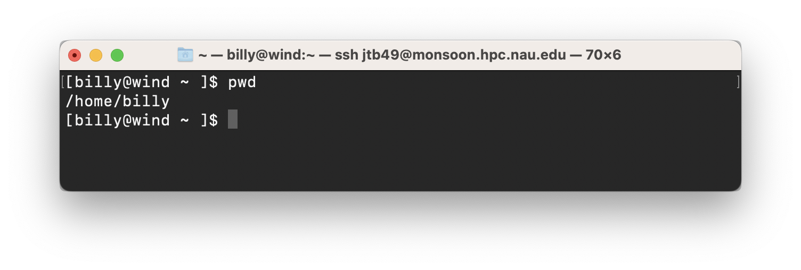
I’m logged in, now what?
You should see a “prompt” like this:
  [<NAUID>@wind ~ ]$
You are now “on” one of Monsoon’s login nodes, in this case “wind”
  or rain, for classroom students
Note that the login nodes are not meant for heavy processing, they are solely for:
  Editing / submitting job scripts
  Moving data to/from monsoon
  Trivial debug work (short tests of <=30 min)
Notes:
Not unlike Windows Explorer file-manager window displaying pwd & etc metadata
Pwd = ~ = /home/billy on monsoon

Slide 10
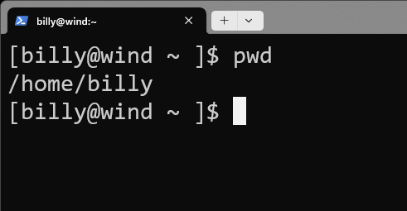
Intro to the shell
The shell is how you interact with Linux
  It’s just a program (analogous to Finder/explorer.exe)
  A user types commands “into” the shell
  The shell sends them to the kernel, where the work is done
  Result: text is printed to the screen and/or to a file
The Linux shell used in this course is called “bash”
One can see what shell they’re in/using
  echo $SHELL

Slide 11
Interacting with the (bash) shell
There is no mouse, so we must use the keyboard keys!
Arrow keys
  left/right: moves cursor across text when entering commands
  up/down: iterate through previous shell commands
TAB to complete typing (one) matching filename, directory, or cmd
TAB-TAB to show multiple matching expansions
control-c to interrupt any program

Slide 12
Try some commands out
ls - list files in the current directory, (try “ls -l” too)
pwd - print working directory (where you currently sit)
id - this is your user id, and the groups you belong to
w - who’s logged in today, system load, and uptime
getquotas - report your quota
date - get the current date and time
echo - print a message, e.g. echo “hello world”
Try a few (now!), then use the up arrow to check out your history!
Notes:
Echo takes an ARGUMENT
LS offers OPTIONS/flags

Slide 13
About options (flags)
Most linux commands accept extra options or “flags”
  ls -a (list all files, including hidden ones)
  ls -l (list files, as a table with lots of details)
  ls -t (list files, and sort by modification time)
Combine options one after another
  Order usually does not matter
  ls -a -l == ls -l -a (list all files, with details)
Flags are usually specified after a dash “-”, or double-dash “--”
  Single-dash flags can often be combined
  ls -alt (list all files, long listing, sort by time)
Notes:
USUALLY → some flags require arguments of their own
e.g. LS –COLOR=NEVER

Slide 14
Navigating the file-system
In Windows and Mac OS, the GUI has informative windows
displays what folder you’re looking in
offers controls to change how the contents are displayed
double-clicking a folder views that different folder
To navigate the system via our shell, we will use:
pwd – print working directory (compare with the prompt!)
ls – list files in current/a directory
cd – change directory
Notes:
GUI vs CLI analogy

Slide 15
Demonstration: Navigating the filesystem
To navigate the system we will use:
pwd – print working directory (compare with the prompt!)
ls – list files
  ls , ls .. , ls ~ , ls <dir> , ls <dir/subdir>
cd – change directory
  cd , cd .. , cd ~ , cd <dir> , cd <dir/subdir>
Notes:
CLEAR command
~ is a shortcut offered by bash for exactly /home/abc
LS TAKES ARGS
Ls in ~ vs ls in ~/notes vs ~/notes/weekly-old => REPRESENTED in prompt
.. Is a shortcut offered by bash for PARENT
TAB key once typing

Slide 16
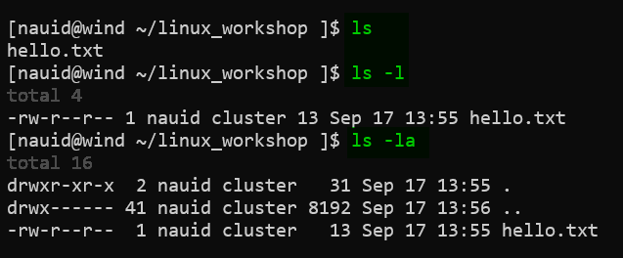
List files using extra options
[NAUID@wind ~/linux_workshop ]$ ls
hello.txt
[NAUID@wind ~/linux_workshop ]$ ls -l
total 4
-rw-r--r-- 1 NAUID cluster 8 Sep 22 13:56 hello.txt
[NAUID@wind ~/linux_workshop ]$ ls -la
total 24
drwxr-xr-x 2 NAUID cluster 4.0K Sep 22 13:56 .
drwx------ 234 NAUID cluster 8.0K Sep 16 13:06 ..
-rw-r--r-- 1 NAUID cluster 8 Sep 22 13:56 hello.txt
Notes:
LS vs LS –L on single file

Slide 17
Listing files: dot-files
Note the funny looking filenames there:
[NAUID@wind ~ ]$ ls -la
drwx------ 2 NAUID cluster 4096 Sep 22 13:56 .
drwxr-xr-x 234 root root 8192 Sep 16 13:06 ..
-rw-r--r-- 1 NAUID cluster 213 Jul 11 2014 .bashrc
File names that begin with a “.” are (usually) hidden.
“.” is the current directory
“..” is the parent directory
.bashrc is a hidden bash configuration file
Notes:
Single dot useful for copy/move commands
(double dot too)

Slide 18
Listing files: relative hierarchy
$ tree -F /home/billy/jobs
/home/billy/jobs
├── 2023/
│ ├── q1/
│ ├── q2/
│ │ └── jobs_april.txt
│ ├── q3/
│ └── q4/
├── 2024/
│ ├── q1/
│ ├── q2/
│ └── q3/
│ └── jobs_july.txt
├── file1
└── file2
[billy@rain ~ ]$ cd ~/jobs
[billy@rain ~/jobs ]$ ls
2023 2024 file1 file2
[billy@rain ~/jobs ]$ ls 2023
q1 q2 q3 q4
[billy@rain ~/jobs ]$ ls ./2024
q1 q2 q3
[billy@rain ~/jobs ]$ cd 2024
[billy@rain ~/jobs/2024 ]$ ls ../
2023 2024 file1 file2
[billy@rain ~/jobs/2024 ]$ ls ../2023/q2
jobs_april.txt
cd /home/billy/workshop
ls 2023
  q1 q2 q3 q4
ls ./2023/
  q1 q2 q3 q4
cd 2024
ls ../
  2023 2024 file1 file2
ls ../2023/q2
  jobs_april.txt
Notes:
Several empty dirs.
Cd jobs = cd ~/jobs but latter more explicit
./2024 explicit notation
A trailing slash *on a dir* almost never has semantic difference (explicit insurance for copy)

Slide 19
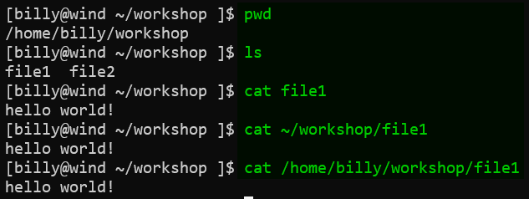
Relative vs absolute (“full”) paths
File/dir locations can be absolute or relative
Absolute paths start with “/” (“~” = “/home/nauid”)
Relative paths are just filenames, or start with “.” or “..” or a directory
* Note that Linux filesystems are CASE SENSITIVE with regard to almost everything!!
* Also: not recommended to have spaces in filenames and directory names! It can be a pain.
Same result now…
…buuuuut after
cd’ing elsewhere?
Notes:
“or a dir IN CURRENT PWD”
Same contents for all 3, but first version only works in “right” dir
FILE DOESN’T EXIST ➔ maybe you cd’d or just must specify full path
Quotes help spaces but caaaan be complicated

Slide 20
More commands
cat <file> - print contents of a file to the screen
file <file> - print the type of a file: ascii, dir, symlink,…
mkdir <dirname> - create a directory name ”dirname”
rmdir <dirname> - remove a directory named “dirname”
rm <filename> - remove a file
cd <dirname> - “open” directory “dirname”
touch <file> - create an empty file, or update modified timestamp
less <file> - view a file with a useful interactive viewer
man <command> - view the manual for a command/prog (“q” to exit)
Notes:
Rmdir only works on empty dirs.
RM only works on files (option to override)

Slide 21
Lab 1 – directory structure
Print your working directory, where you are currently (pwd)
List the contents of the directory you are in (ls)
Create a directory in your home directory named “linux” (mkdir)
Change directory to the new directory “linux” (cd)
Create a directory named “is” inside of the linux directory (mkdir)
Change directory to the “is” directory (cd)
Create a file in the ”is” directory named “awesome” (touch)
Change directory back to your home (cd)
Do a recursive listing on the “linux” directory: ls –R linux
Try this and note changes: ls –lR linux | grep –v total
Notes:
Grep = hint toward more advanced stuff
Cleans up list showing *details* on recursive listing
NEXT SLIDE shows non-cleaned up

Slide 22
Lab 1 - Solution
[NAUID@wind ~ ]$ ls -lR linux
linux:
total 0
drwxr-xr-x 2 NAUID cluster 28 Sep 21 14:20 is
linux/is:
total 0
-rw-r--r-- 1 NAUID cluster 0 Sep 21 14:20 awesome
Notes:
That grep removed the totals

Slide 23
Wildcards
While in the shell, you can select files/directories based on wildcards
  ? - matches any 1 character
  * - matches 0, or 1, or more characters
Note that this may not work within interactive programs
  Programs like Matlab or R (etc…) have shells with their own rules

Slide 24
Wildcard Examples
While in the shell, you can specify files/directories based on wildcards
  Multiple wildcards can be specified at once
ls *.txt - lists all files/folders that end in “.txt”
ls lin* - lists all files/folders that start with “lin”
ls *2024* - lists all files/folders with “2024” in their name
ls 20?4-fall* - list 2014-fall.pdf, 2014-fall.txt, 2024-fall.txt, etc

Slide 25
Demonstration: Bash basics & wildcards
“cd” to the /common/contrib/tutorials/linux directory
List all the filenames that end with “.pdf”
List all the files that have the exact string “ADIOS” in their name
List all the files in your home (~) directory from here
“cd” to your home directory
Show the sizes of all files in the first directory with ‘Tol’ in their name
Notes:
Combining filename-wildcards AND (partial) paths

Slide 26
Review: Navigating the file-system
To navigate the system we can use use commands like:
  cd move into/open a directory
  pwd print current directory (that you’re in)
  ls print contents of a/current directory
  rm remove (delete) a file
To get more/varied output from your commands:
  Some commands accept/require “input” args (e.g. cd some_dir)
  Most commands offer “options” (e.g. ls -a)
File/dir locations can be absolute or relative
  Absolute paths start with “/”
  Relative paths are just filenames, or start with “.” or “..” or “~” or a directory
Notes:
Absolute/relative → earlier slide

Slide 27
Managing Files:
Interpreting ls -l details
Permissions and ownership
Moving, copying, deleting files (and directories)

Slide 28
Managing Files: File permissions
drwxr-xr-x 2 NAUID cluster 28 Sep 21 14:20 linux
1 2 3 4 5 6 7
1. The mode and type of the file, in this case a “d” (directory), mode 755
  From left to right: Type,User,Group,Other
  Type is directory (d) (could also be “-” (file), “l” (link), others)
  User has read (r), write (w), and execute (x)
  Group has read (r) and execute (x)
  Other has read (r) and execute (x)
2. Number of hardlinks (you can kinda forget about this)
3 & 4. The owning-user and owning-group
5. Size of the file in bytes
6. The date, of last modified
7. The name of the file or directory
 | (4=2²) read + | (2=2¹) write + | (1=2⁰) exec = | bits
user | 4 + | 2 + | 1 = | 7
group | 4 + |  | 1 = | 5
other | 4 + |  | 1 = | 5
= “mode” 755
Notes:
Group permissions facilitate(d) collaboration … don’t worry about it
Large “bytes” can be changed with –h flag
Chart is JUST to note numerical representation exist (e.g. following instructions)

Slide 29
Changing file permissions
Default permissions for files and directories:
  File: rw- for owning-user, r-- for group, and r-- for others
  Directory: rwx for owning-user, r-x for group, and r-x for others
Change owner/owner-group
  chown billy some_file
  chown :SICCS-Beekman-lab some_file
Change mode (permissions)
  chmod g+rw some_file – add read and write for group
  chmod +x some_file – add execute to a file, for user,group,other

Slide 30
Managing files: commands
cp src target - make a copy (“target”) OR copy INTO directory “target”
  If “target” is an existing directory, “cp” assumes you want a same-name copy there
mv src target - move “file” to directory “target” OR rename to “target”
  If “target” is an existing directory, “mv” assumes you want to move “file” there
touch file - create empty file, or update time stamp
rmdir dir - remove (empty, only!) directory
mkdir dir - make directory
rm file - remove file
rm -f file - force removal of file/directory (no verify prompt)
rm -r dir - recursively remove a directory
rm –rf dir - force remove recursively (CAUTION!!!!)

Slide 31
Demonstration: Operating on multiple files
cp * works like ls *
  (Not) Including “hidden” dot-files (!!)
  Multiple sources -> single target
Recursive copy for directories
Forcing deletions
Deleting non-empty directories
Edit a text file
Notes:
Cd ~/linux ; Mkdir dir2 ; Touch fileA fileB fileC
Ls –l ; Ls file* ; Ls fileA fileB fileC
SHELL is doing translation from *
Cp fileA fileB fileC dir2 ; Ls dir2
Mv dir2/file* . ; ls ; ls dir2 ← empty
Chmod u-rwx fileA fileC ; rm file* ; ls –l ← deletions gone
Touch dir2/newfile ; rm dir2

Slide 32
Lab 2 – Editing/moving files
Change directory to the ~/linux/is directory (cd)
Rename the file “awesome” to be “best” (mv)
Make a directory in the “is” directory named “the” (mkdir)
Move the “best” file to the “the” directory (mv)
Edit the “best” file, with contents “of course!” (nano, emacs, vi)
Copy the “best” file to the “is” directory, naming it “fun” (cp)
Find out what type of file ”fun” is (file)
Print the contents of the “fun” file (cat)
*BONUS* Make the file hidden (hint: dot!)

Slide 33
Lab 2 – Editing/moving files Solutions
[NAUID@wind ~ ]$ cd linux/is
[NAUID@wind ~/linux/is ]$ mv awesome best
[NAUID@wind ~/linux/is ]$ mkdir the
[NAUID@wind ~/linux/is ]$ mv best the
[NAUID@wind ~/linux/is ]$ cd the
[NAUID@wind ~/linux/is/the ]$ nano best
[NAUID@wind ~/linux/is/the ]$ cd ..
[NAUID@wind ~/linux/is ]$ cp best fun
[NAUID@wind ~/linux/is ]$ file fun
fun: ASCII text
[NAUID@wind ~/linux/is ]$ cat fun
of course

Slide 34
Dealing with text (and text-data)
It’s all text! Everywhere!
Text editors
Pagers for viewing large files (most notably: “man” manuals)
Not all screen text is equal
  Intended command output =/= error output
Redirecting command output
  …into new files, or appending to existing
  …directly into another command (no intermediate file!)
Finding and isolating specific file-contents
Notes:
Redirect intended output – errors still print to screen!

Slide 35
Editors (vs text-pagers)
Lots of editors:
nano
  Simple to use
  Onscreen “menu”
vi, vim, emacs
  more featureful
  have learning curves
Start out using nano:
ctrl-o: save (“O” as in write-Out)
ctrl-x: exit (AND prompt to save)
Pagers (text-pagers):
  Fill a different role than editors
  How you read “manual pages”
  less
    arrow keys navigate (PgUp/PgDn also)
    h enter help screen
    q exit
    / start a search
      n: next result
      N: prev result

Slide 36
Redirecting Input and Output
Default system streams
  stdin/stdout/stderr = File Descriptors 0/1/2
> Redirects output to another file, overwriting if it exists
>> Appends to a file
2>&1 Redirects error messages to standard output (use w/ >,>>,|)
&> Redirects stdout, and stderr to a file
| (vertical bar) Redirects (“pipes”) output from
one program to another’s input (more on this later)

Slide 37
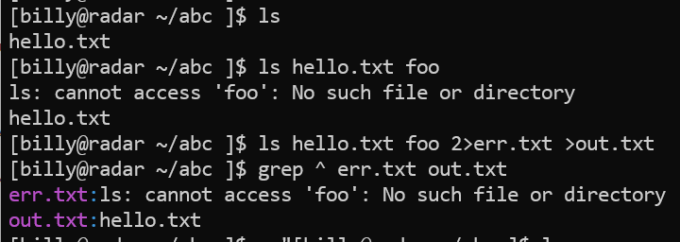
Redirection Examples
ls > out.txt - sends output from ls to “out.txt” file
ls >> out.txt - appends output from ls to “out.txt”
ls foo 2> error.txt - sends only errors to ”error.txt”
ls foo &> out.txt - writes output and errors to out.txt
ls | wc -l - send output from ls to the wc (wordcount) program and counts lines

Slide 38
Lab 3 [guided] – Editing files
cd ~/linux
nano grepfile.txt (enter this text, then ctrl-x)
  Hello world!
  The world is a big place.
Try: grep place grepfile.txt
Try: grep –v place grepfile.txt (“-v” will invert results)
Use grep recursively to find a term in any files nested within directories
  [NAUID@wind ~/linux ]$ grep -r course *
  is/the/best:of course!
  is/fun:of course!
Notes:
GREP –R Useful for MANY files

Slide 39
Lab 3 [guided] – continued
Remember the | symbol (pipe)?
  We can redirect the output of one command to the input of another
Let’s add a few lines to our grepfile.txt so it looks like this:
  Hello world!
  The world is a big place
  test 1
  test 2
  testing 3
We can grep for test, and pipe the output to grep for the character “2”
  [NAUID@wind ~/linux ]$ grep test grepfile.txt
  test 1
  test 2
  testing 3
  [NAUID@wind ~/linux ]$ grep test grepfile.txt | grep ing
  Testing 3

Slide 40
Dealing with processes
It’s all text! Everywhere! …so how do I close/cancel something?
ps and top list running processes
kill ends a running process (of yours)
Ctrl-c to “force quit” an active process (usually)
Notes:
On mac windows, close a window with X or red bubble
Or kill programs with task manager/activity monitor

Slide 41
Processes
top – Real-time view all running processes on this login-node
  akin to task manager in windows
  Hotkey “u” – show only one user’s processes
  Hotkey “k” – kill a process (use ESC key to cancel)
  Hotkey “q” immediately exits
ps – Shows current processes
  The “ps -u” option has a more useful format, including cpu %
kill <process id> – Terminates a running process (if you are the owner of the process)

Slide 42
Demonstration: Processes
Run the top program to view all processes currently running. Alternatively, you can run ps for a one-time snapshot, and top –u <userid>
Look for your sleep process in the list. Specifically, look at the first column labelled “PID”. This means “process id”. Take note of your sleep process’s PID
Press q to quit top and get back to the terminal
Type kill <PID> where PID is your sleep process PID. This will end the sleep process
Notes:
Top is INTERACTIVE → “u” to isolate
Sleep ← ps –u ← kill
Dmesg –T | less …vs… dmesg –T | nano ← ctrl-c doesn’t work!
Kill is last line of defense

Slide 43
Lab 4 – Pipes and Processes
Start a new process by running sleep for 999 seconds (sleep)
Open another shell and cd to ~/linux again
Find the PID of your sleep process using ps -u and grep
Kill your sleep process (kill)
Verify your process is gone by running your previous ps and grep command
Do a long recursive listing of your linux directory, filter the results so only filenames with the word “best” are returned, and send the output to a file called results.txt (ls, grep, > )
List the contents of “results.txt” to verify the results (cat)
Remove the file “results.txt” (rm)

Slide 44
Lab 4 – Pipes and Processes Solutions
NAUID@wind:~/linux$ sleep 999
NAUID@wind:~/linux$ ps -u | grep sleep
jtb49 1153597 0.0 0.0 217168 844 pts/33 S+ 13:24 0:00 sleep 9999
jtb49 1153821 0.0 0.0 222016 1108 pts/57 S+ 13:25 0:00 grep sleep
NAUID@wind:~/linux$ kill 1153597
[1]+ Terminated: 15 sleep 9999
NAUID@wind:~/linux$ ps | grep sleep
NAUID@wind:~/linux$ ls -alR | grep best > results.txt
NAUID@wind:~/linux$ cat results.txt
-rw-r--r-- 1 NAUID cluster 11B Oct 22 11:45 best
NAUID@wind:~/linux$ rm results.txt

Slide 45
Some more-advanced stuff!
Variables
Command substitution:
  getting output into a variable
  nesting one command within another!
Loops
(Soft-) Links

Slide 46
Variables
Set your own variables: MYVAR=1234
Un-set a variable: unset MYVAR
Refer to existing variables by prepending them with $
echo “$MYVAR” to display variable contents
  Best practice is to use double-quotes with echo
  But note that single-quotes prevent variable expansion
Notes:
Note no space after initialization

Slide 47
Variables - Example
$ MYVAR="this is my variable"
$ echo $MYVAR
this is my variable
$ echo '$MYVAR'
$MYVAR
$ unset MYVAR
$ echo $MYVAR
$

Slide 48
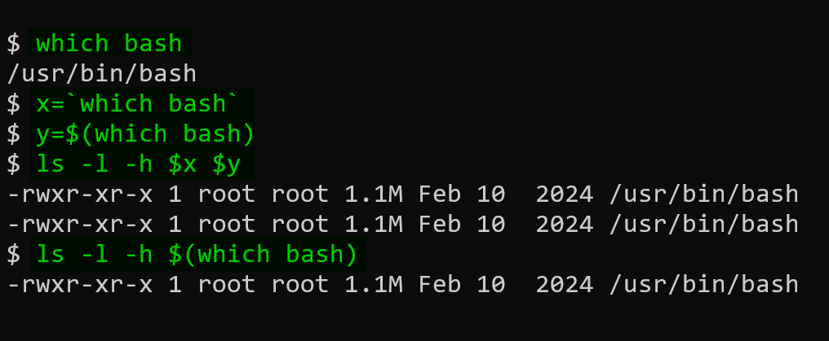
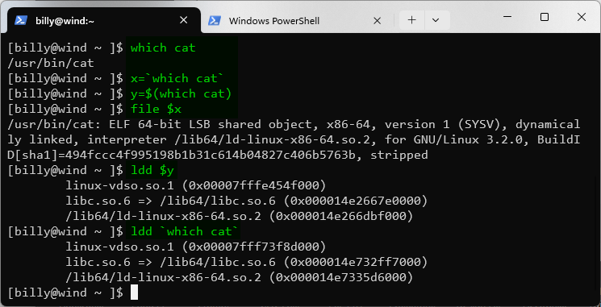
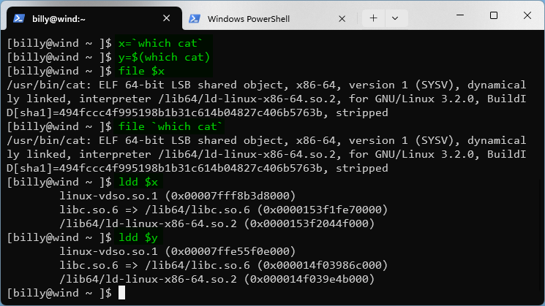
Command substitution
It is possible to imbed command results within a command
file `which cat`
  [NAUID@wind ~/linux ]$ file `which cat`
  /bin/cat: ELF 64-bit LSB executable, x86-64, version 1 (SYSV) …
ldd $(which cat)
  [NAUID@wind ~/linux ]$ ldd $(which cat)
  linux-vdso.so.1 => (0x00007fff6d5d4000)
  libc.so.6 => /lib64/libc.so.6 (0x0000003c20000000)
  /lib64/ld-linux-x86-64.so.2 (0x0000003c1f800000)
Notes:
Bash is a program – program stored in filesystem – WHICH shows where stored
Command substitution allows to avoid using variables (or copy/pasting)

Slide 49
Loops: simple one-liners
One-line for-loop over “words”
  $ for i in red blue green; do echo “$i is a color”; done
  red is a color
  blue is a color
  green is a color
One-line loop over consecutive numbers
  $ for c in `seq 1 10 21`; do echo “count is $c”; done
  count is 1
  count is 11
  count is 21
Use a custom variable, e.g. i and reference it with the $ sign, just like any other variable

Slide 50
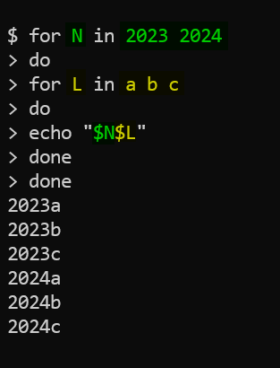
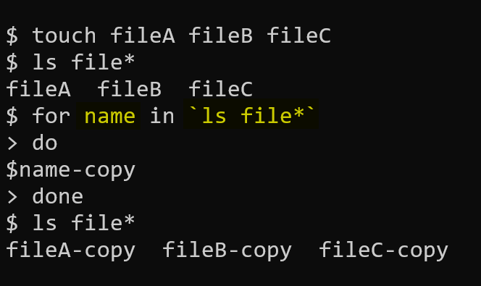
Loops: multiline & nested
cp $name copy-$name
$ ls copy*
copy-fileA copy-fileB copy-fileC

Slide 51
Soft links
We will focus on soft links for now; just know there are hard links too
Soft links (AKA: symbolic links) are the most common type of links that you will use/encounter
  ln -s <existing_file> <symlink_name>
Basically same as ‘shortcuts’ in Windows, or ‘aliases’ in Mac OS
$ ln -s /scratch/NAUID /home/NAUID/scratch_link
$ cd ~
$ ls –l scr*
lrwxrwxrwx 1 NAUID cluster 4 Sep 22 10:15 scratch_link -> /scratch/NAUID

Slide 52
Questions?
Lots more to Linux
Try this book out for more:
  http://linuxcommand.org/tlcl.php
Check out our workshops!
  https://in.nau.edu/arc/workshops/
We also hold (weekly) Office Hours & (monthly) Coffee Hours
  https://in.nau.edu/arc/hours/
Create a help-ticket via ask-arc@nau.edu
Notes:
Include ask-arc@nau.edu

